Slide 1

Laura Brady, PhD
IRB Administrator
Office of Sponsored Programs
Spring 2025
Introduction to Cayuse

Slide 2
The CMU IRB Review Process:
Researchers
IRB Administrator
IRB Reviewer (member)
IRB Administrator
Researchers

Slide 3
CAYUSE TUTORIAL

Slide 4

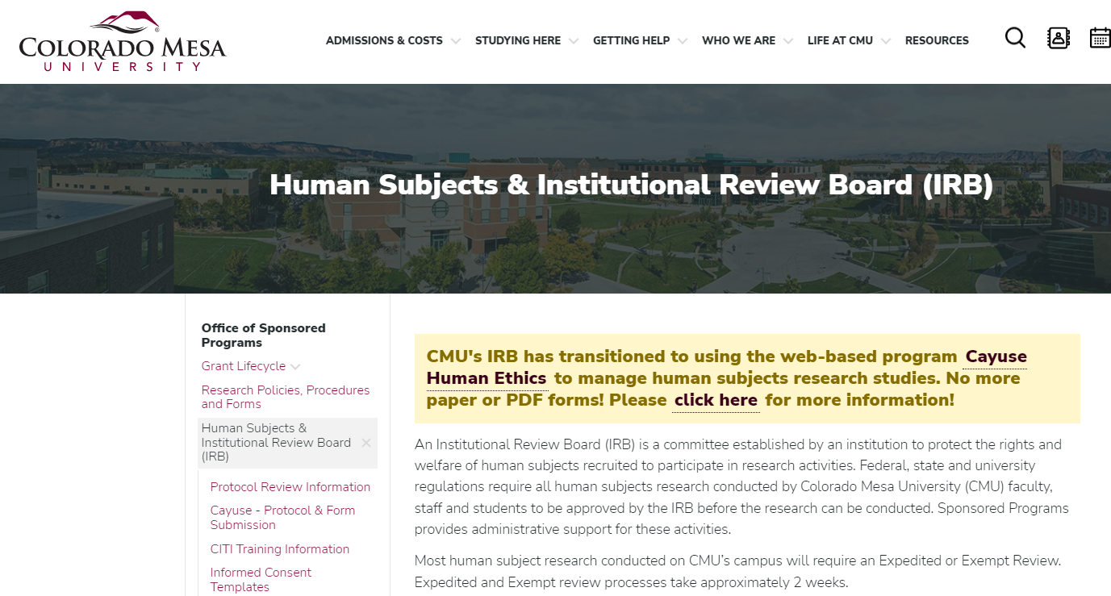
Finding the Site
https://coloradomesa.app.cayuse.com/
Bookmark the site for easy future access
You can also reach it through the OSP website, www.coloradomesa.edu/sponsored-programs/irb

Slide 5
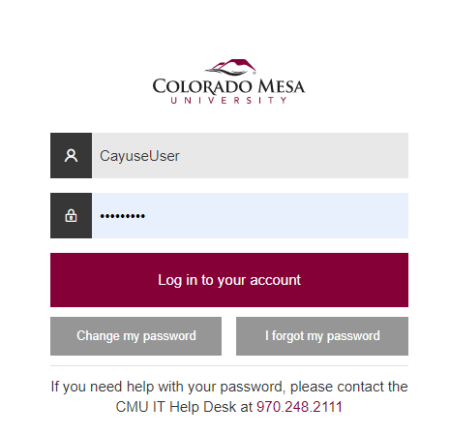
Creating a Cayuse Account
You will likely need to contact the IRB Administrator to request a new account
Many faculty members will already have accounts, so try logging in first
Students will likely need to request an account
To request a new account:
Complete the Account Request Form on the CMU IRB website: www.coloradomesa.edu/sponsored-programs/irb
Once you have an account, you will use your MavZone credentials to login
Please ensure all research team members have accounts before starting!

Slide 6
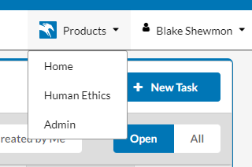

Creating a New Protocol
1. Once logged in, click Products → Human Ethics
2. Ensure that the Researcher role is selected

Slide 7

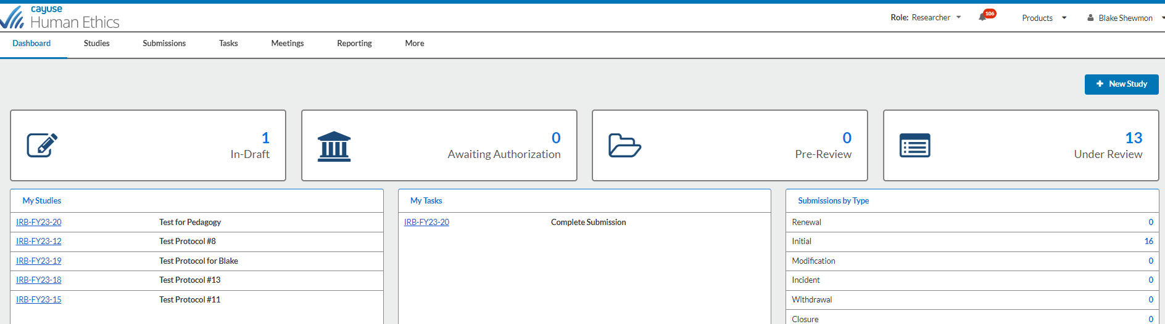
Creating a New Protocol
1. Once logged in, click Products → Human Ethics
2. Ensure that the Researcher role is selected
3. Click New Study

Slide 8
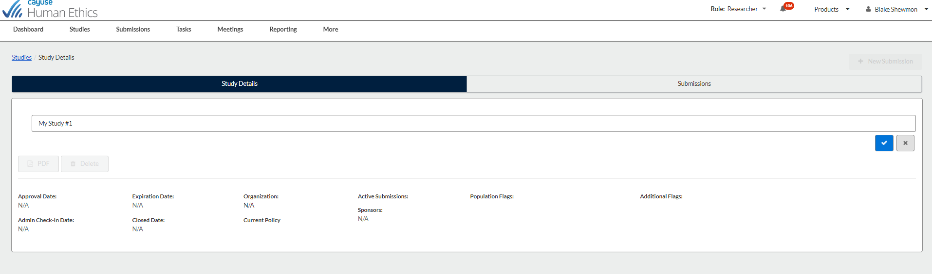
Creating a New Protocol
Enter a name for your study, then click the blue check mark

Slide 9
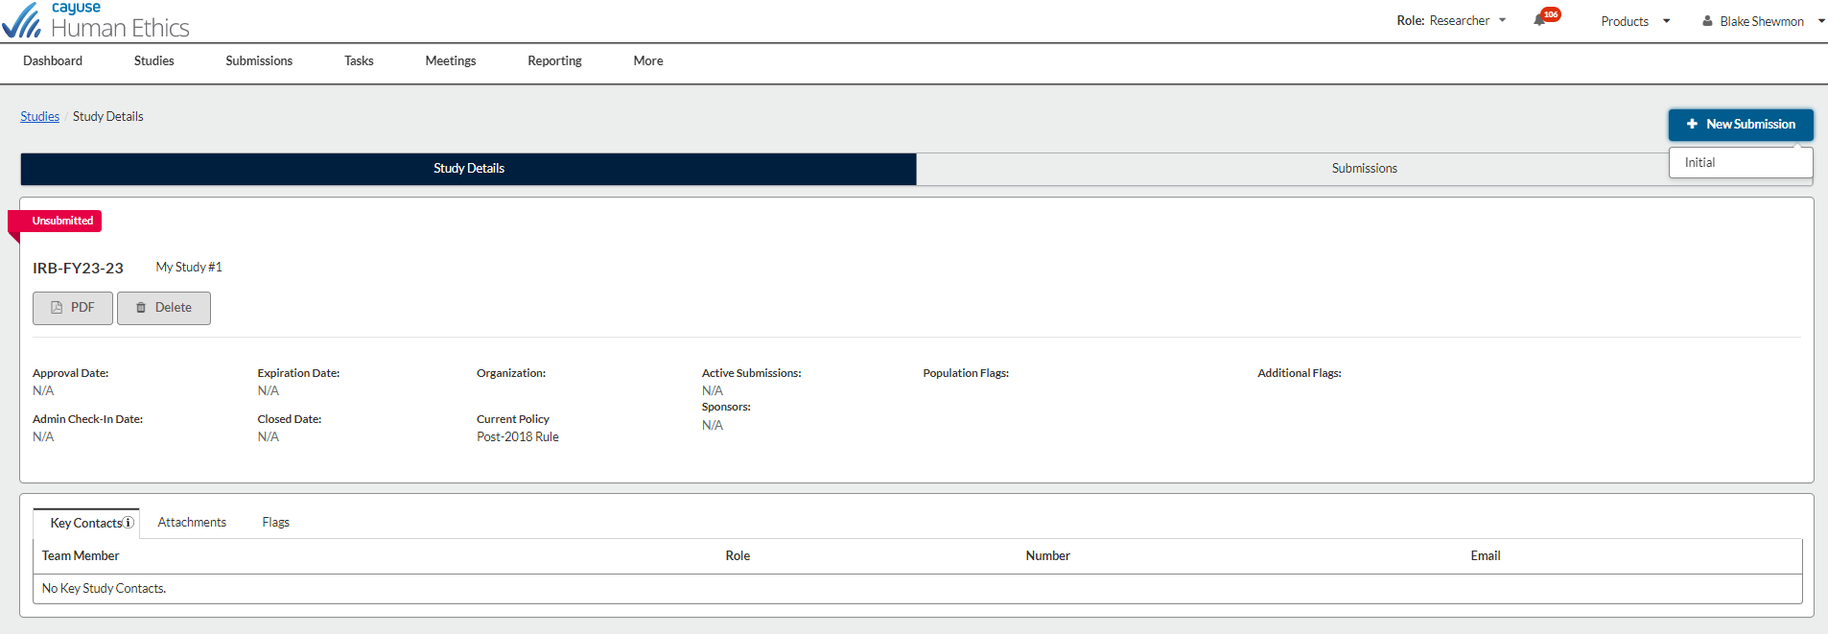
Creating a New Protocol
Click New Submission → Initial

Slide 10
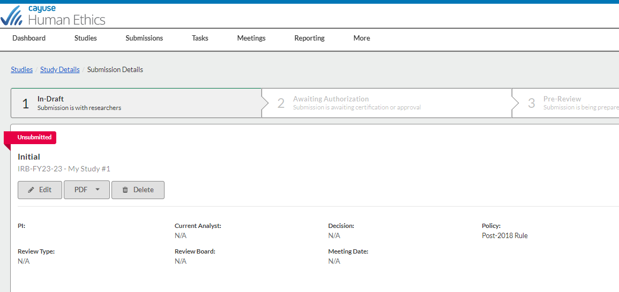
Creating a New Protocol
Click Edit → This will allow you to start filling out your application

Slide 11
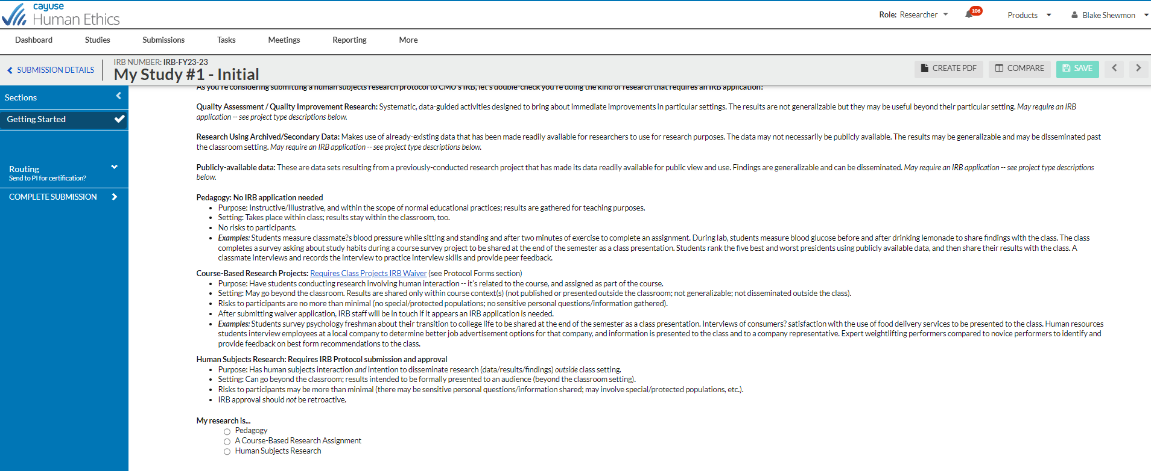
Screening Question
Please read all provided information and answer the question at the bottom.
If you believe—based on the info provided—that your study is Pedagogy or a Course Based Research Assignment, use the hyperlink for Course Based Research and complete the Request for Waiver Form instead
If your project is Human Subjects Research, please proceed

Slide 12
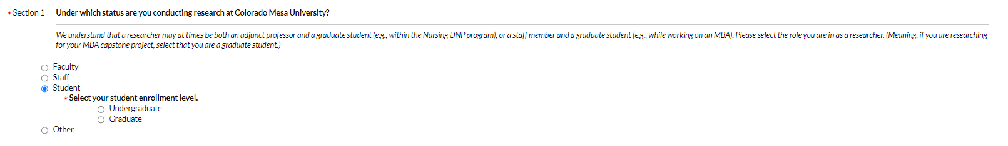
Building a Protocol
You are now in the Human Subjects Research protocol application
Work your way through and answer questions
Red asterisks indicate required questions
Carefully read the instructions/descriptions for each question
Depending on your responses, new questions may generate
Notice that new questions may appear, depending on response

Slide 13
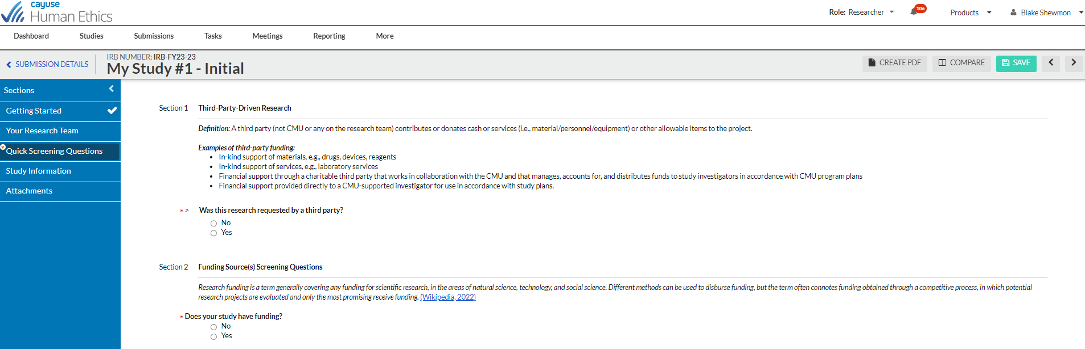
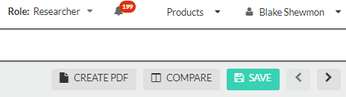
Building a Protocol
It may be easier to utilize the Word version IRB application and copy-and-paste responses into Cayuse as you work through the questions
The Word form is found on the CMU IRB website
This may also allow you to work offline on your protocol
MAKE SURE TO SAVE OFTEN!
Cayuse does not auto-save any work for you

Slide 14
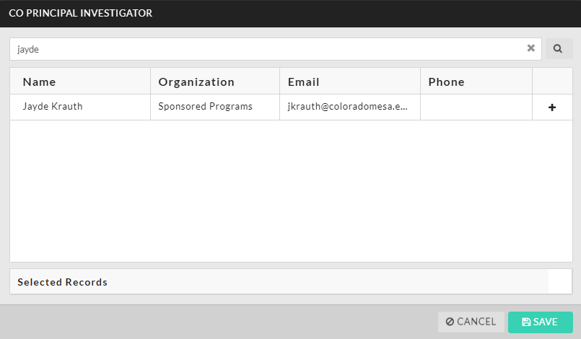
Adding Investigators
Please ensure that all members of your research team have active Cayuse accounts before you begin work on your protocol application
When adding co-investigators and faculty advisors, Cayuse will draw users from the system for you to add
You cannot manually enter the name, email, etc. for any study personnel

Slide 15
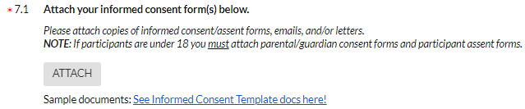
Adding Attachments
Some questions in the protocol request attachments; some are required
Red asterisks indicate a requirement
To add an attachment to these types of questions, click Attach
You will also get to review your attachments at the end, prior to submission

Slide 16
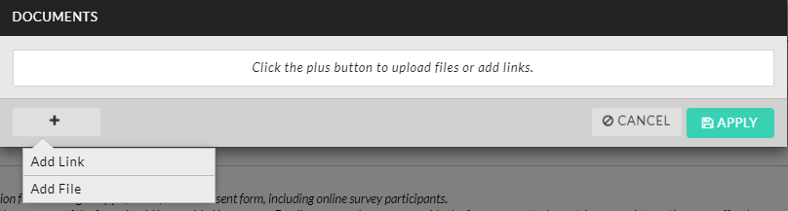
Adding Attachments
After clicking Attach, you will need to add either a link or file
We ask that you submit files whenever possible, preferably PDFs
Links may not always have sufficient sharing permissions (i.e., a link to a document in OneDrive might not be accessible by the IRB reviewer)
Click the + symbol, then select Add Link or Add File
You can add multiple links/files

Slide 17

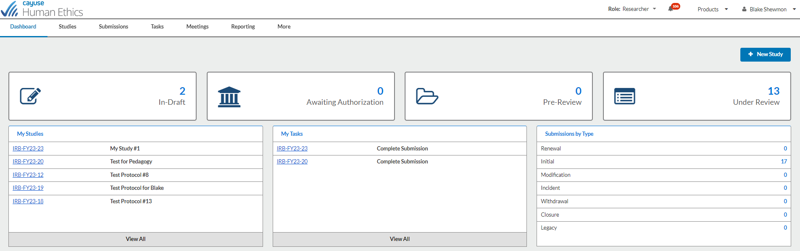
Resuming Editing
If you need to pause your editing and resume at a later date:
Make sure to save your work first!
Once the work is saved, you can exit out of Cayuse
When you log in again, click In-Draft to view your protocol draft(s)

Slide 18
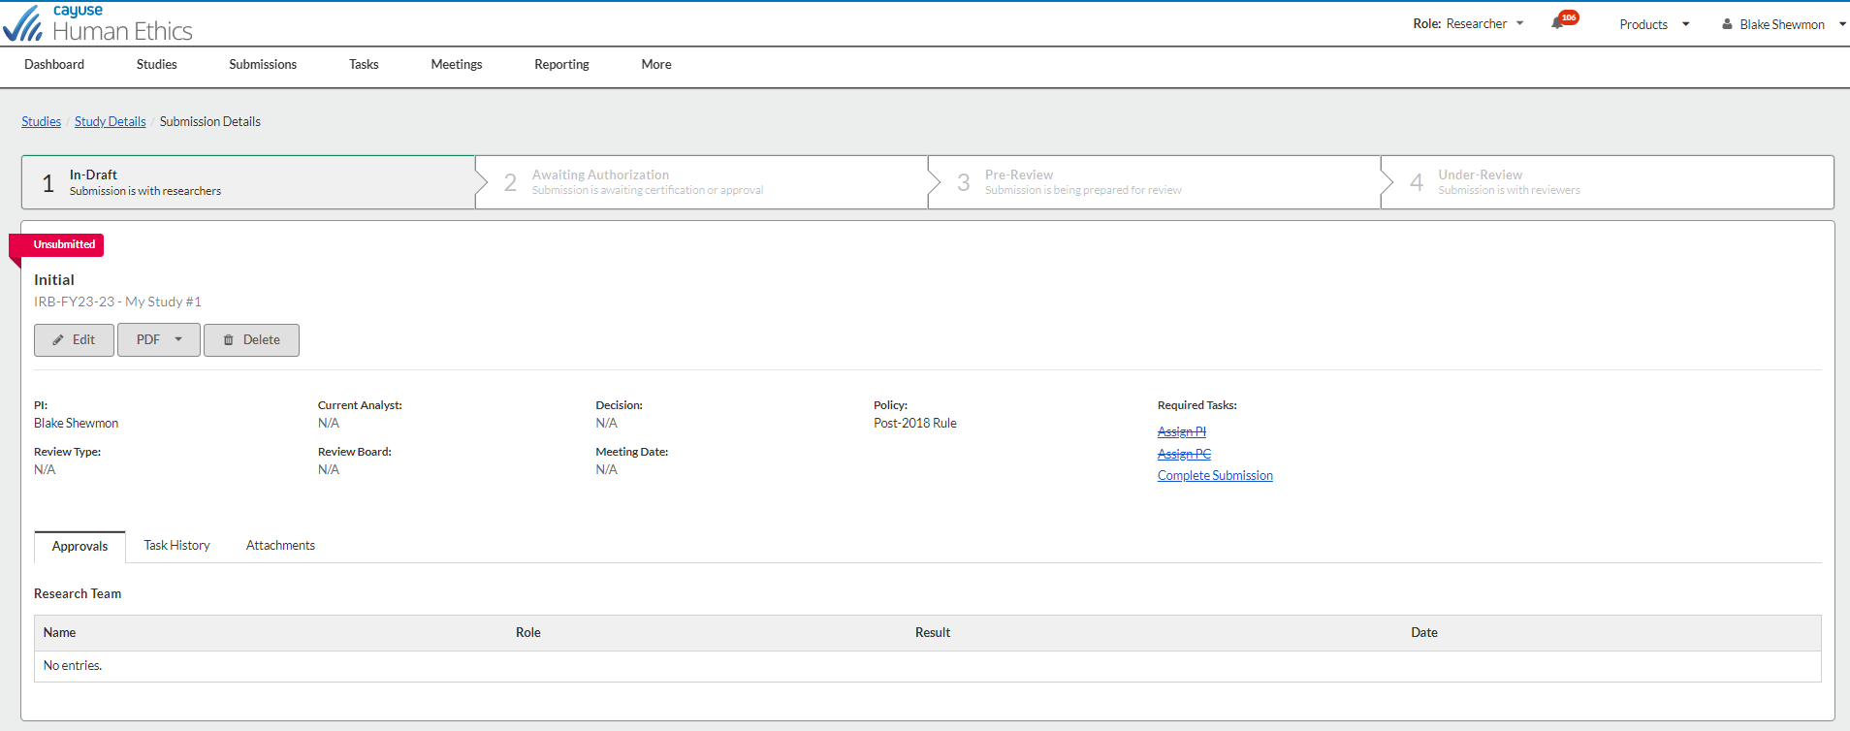
Resuming Editing
After selecting the protocol you want to work on, click Edit and make your changes
Again, make sure to save throughout!

Slide 19
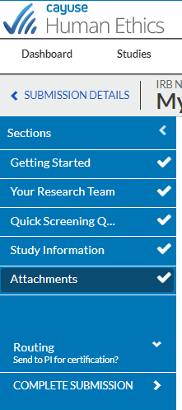
Ready to Submit
The left-hand sidebar will show checkmarks next to each section once all required questions have been answered
A checkmark will not appear if any required questions remain unanswered in a section
Once you have completed all sections, the option to Complete Submission will appear

Slide 20
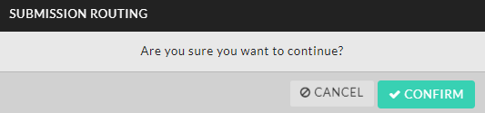
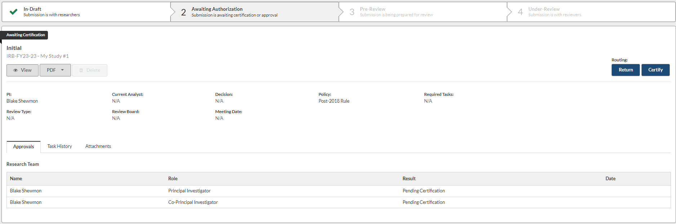
Ready to Submit
Once you have reviewed your protocol and are ready to submit, click Complete Submission
Then click Confirm
After clicking Confirm, you are taken to the screen below

Slide 21
Ready to Submit
Once Certify is clicked, the study is sent to the IRB Office (Sponsored Programs) for review by the IRB Administrator
Only the PI can certify the study, but all members of the research team will receive a confirmation email upon submission

Slide 22
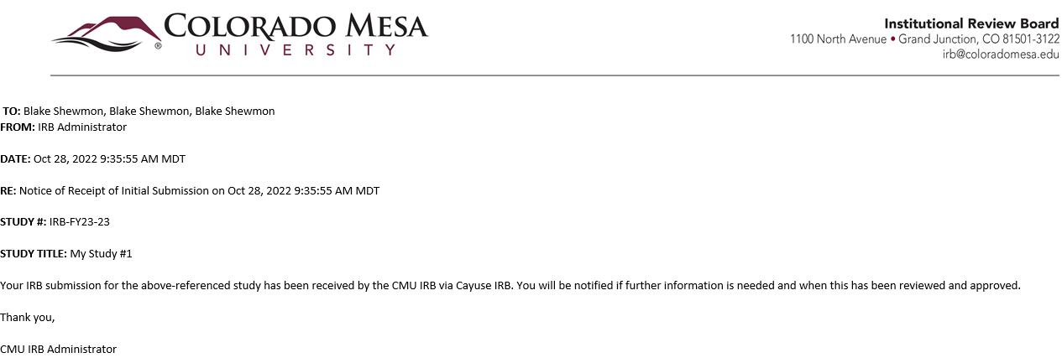
Submission Confirmation
After the PI certifies and submits the protocol to the IRB Office for review, all research team members will receive the following email:

Slide 23
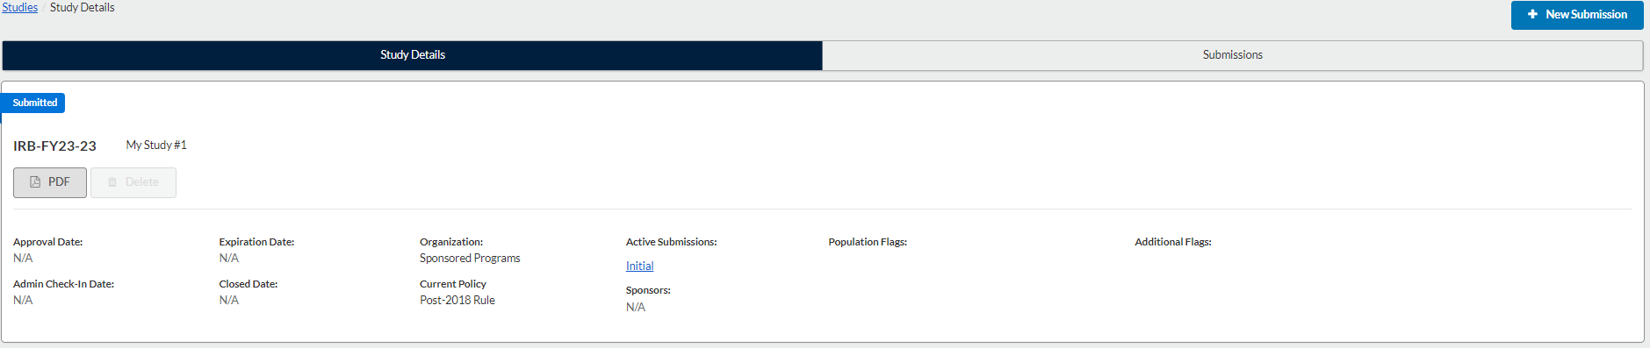
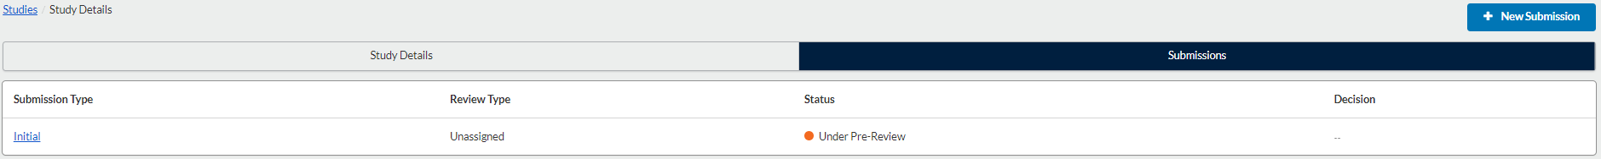
Protocol Status
While the study is under pre-review by the IRB Administrator, members of the research team will see the following on the Studies page in Cayuse

Slide 24
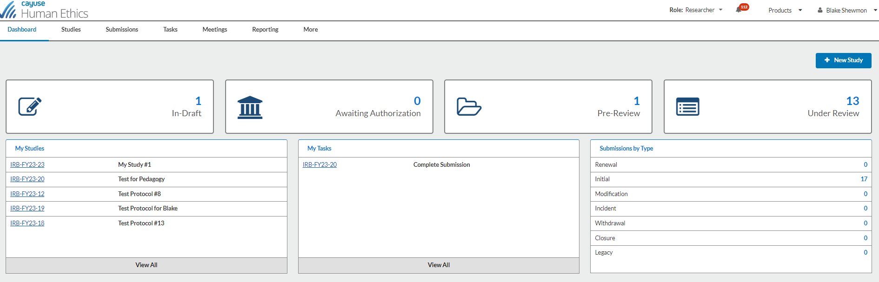
UPDATES
After submitting the study for review, you will be notified of updates in the review process (approval, requested modifications, etc.) via email
Please ensure that emails from do-not-reply@cayuse.com are not directed to your spam folder
Please also use the My Tasks tab in Cayuse to see the status of your protocol and if anything is needed from you

Slide 25

Who to Contact With IRB Questions:
Visit the IRB website
https://www.coloradomesa.edu/sponsored-programs/irb/index.html
OR search “IRB” on the CMU website
Any questions should be directed to the IRB Administrator
irb@coloradomesa.edu
970-248-2350
Stop by the Office of Sponsored Programs (LHH 214)

Slide 26

Thank
you

