Slide 1

Elementary Education
Anne Gillies
Kilee Sofich
Sensory Tools in The Classroom

Slide 2

Sensory Tools
in The Classroom
By: Kilee Sofich

Slide 3
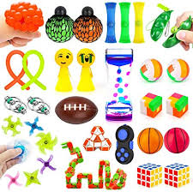
What are sensory tools?
Sensory tools are self-regulation tools to help with focus, attention, calming, and active listening. They come in all different shapes, sizes, and textures and are often referred to by various different names.
The key to a sensory-informed classroom is that it supports the various sensory needs of the students in the classroom in a way that is as natural as possible. Not all students learn the same, nor do they have the same sensory needs. When you include sensory supports or tools in a classroom, they will be used differently by kids depending on what their bodies need, when they need input, and how they choose to use the tools.

Slide 4
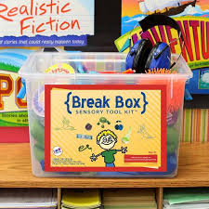
Why should I use them?
Most negative behaviors are primarily due to sensory issues, therefore, simple sensory interventions can greatly alleviate these behavioral issues.
Providing students with the sensory stimulation they need results in increased work production, on task behavior, improved focus and attention, and a happier more content student.
These interventions are fairly simple and can yield significant results for the effort and time put in.

Slide 5
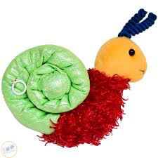
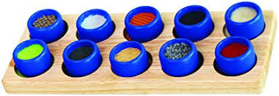
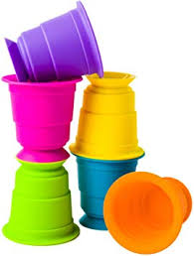
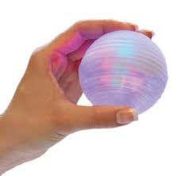
What are the
different types?
Suction Kupz are colorful silicone cups that feature suction cups on the bottom to encourage fine motor skills, spatial reasoning, creativity, exploration, and experimentation. In addition to a suction cup on the bottom, they feature a suctioning brim at the top.
The Color Changing Light Ball is a tactile silent fidget toy, sensory ball, and light show combined in one, designed for individuals ages 5 and up. This ball lights up and changes color with a touch of a button. This silent fidget ball can be used as a stress relief or helpful for those with cognitive impairments.
Sensory Snail
Texture Memory Game
The Vibrating Sensory Snail is an imaginative fidget toy that provides various types of sensory input for children with ADHD, sensory processing disorder, and autism. The perfect pet companion, the Vibrating Sensory Snail is soft, multi textured and moves as the user wishes
The Texture Memory Game is a sensory memory game to help expose children to the different textures they will encounter during their sensory development. By identifying, remembering, and pairing the textures of the 10 game pieces, children will strengthen their memory and sensory skills as they play.
Suction Kupz
Light Ball

Slide 6
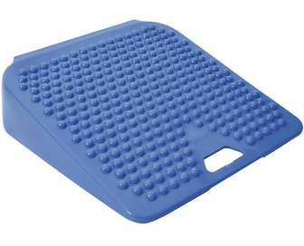
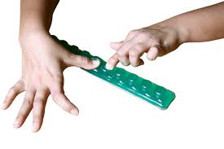
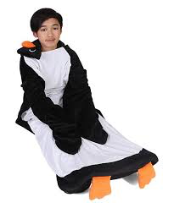
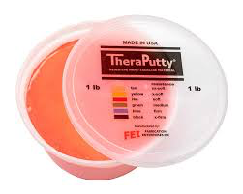
What are the
different types?
The Penguin Weighted Blanket is sensory integration equipment for children ages 3 and up with attention deficit-hyperactivity disorder, sensory processing disorder, and autism to help calm or soothe them. The user can crawl inside the Penguin Weighted Blanket and wrap themselves in comfort with one or both of the weighted arms.
Theraputty Sparkle Exercise Putty is a non-toxic putty with bits of sparkling glitter designed for children with limited hand function, sensory processing disorders, and carpal tunnel syndrome, to stimulate the senses and improve hand function.
Balance Wedge
Balance Wedges are inflatable wedge- shaped cushions made for people with physical and mobility disabilities to use in a classroom or other setting that requires prolonged sitting.
Caterpinch
Caterpinch is a fine motor fidget for those with ADD, ADHD, or concentration disabilities. Each segment of the "caterpillar" is a securely sealed liquid that is "mushable".
Weighted Blanket
TheraPutty

Slide 7
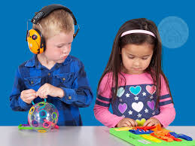
When should I use them?
When students show sensory sensitivity to stimuli like loud sounds, specific tones or noise, textures of objects, foods, and other things in the environment, light, temperature, pressure on body, clothes, too many objects in room, too much activity, etc.
With students who have ADD and/or ADHD
With students on the autism spectrum

Slide 8

What I found
5th grade student with ADHD
Used it through writing and reading
He used a couple different small and handheld ones that he was able to switch out at any time
He was able to stay in the moment and on task for much longer
When he struggled, he was able to take his own sort of brain break then refocus to the assignment

