Slide 1


Slide 2
Crested Butte’s strong contempt for a mine in their backyard has turned a once promising prospect into an almost impossible challenge.

Slide 3
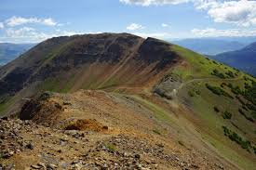
History of the red lady mine
A Molybdenum deposit was discovered on Mt Emmons(Red Lady) in 1976 by a lead and zinc mining operation called the Keystone Mine
The estimated amount of Molybdenum within the Red Lady is 151,186,000 mt ore at a .228 grade making it one of the largest reserves in the world(United States Geologic Survey)
The Company Amex made plans to start mining in the 1980’s using a block caving method (USGS) method but they were faced with several obstacles: Crested Butte opposition, Chinese steel, Environmental activists, Govt nonprofits
Ownership of the mine transferred then to-Freeport-to US energy Corp- back to Freeport

Slide 4
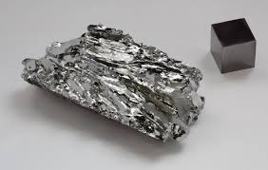
History of Molybdenum
:essential element
First used in the late 19th century when technology for extraction of commercial quantities became practical
Experiments with Molybdenum demonstrated that it could effectively replace Tungsten in many steel alloys. This change brought weight benefits since the atomic weight of Tungsten(183.84 u) is nearly twice that of Molybdenum(95.95 u).
Demand for alloy steels during WW1 greatly increased molybdenum demand
After the war Molybdenum steel became widely used in civilian life, its uses include automotive steel, and structural steel. Molybdenum is used in structural steels because of its corrosion resistance, strength and durability. Such steels are very useful in protecting metals against chloride corrosion, thus they are used in a wide range of marine environment applications (e.g. offshore oil rigs), as well as oil and gas pipelines.

Slide 5
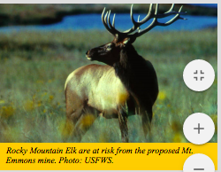
Trouble permitting the Mine
The town of Crested Butte opposed the mine because they believed it would directly impact Coal Creek, the towns main water source
The High County Conservation Commission was formed in 1977 to fight the Molybdenum project and successfully thwarted 3 different mining proposals
The HCCC celebrated their 43rd red lady salvation ball this year in celebration of their victories protecting the Red Lady
The Chinese were also able to prevent the mine from opening by over producing steel and selling it at low costs which lowered the price of molybdenum
The National Wildlife Federation was also a major contributor against the project stalling any NEPA progress claiming it was in violation of the Clean Water Act

Slide 6
Recent abandonment plan
The most recent owner Freemont has announced in 2016 that they plan to abandon the project
They told the Forest Service to dispose of any plans of operation for the Red Lady Mine
They also made plans of reclamation for the existing water Treatment plant near Coal Creek that has existed since the Keystone lead and zinc mine
Crested Butte’s strong contempt for a mine in their backyard has turned a once promising prospect into an almost impossible challenge.

Slide 7
US Energy Portfolio Standard
10 state have 100% renewable energy mandates by 2050
https://www.ncsl.org/research/energy/renewable-portfolio-standards.aspx
Cal-100% clean (wind,solar,hydro) energy by 2045.
Col-100% clean energy by 2050 for utilities serving 500,000 or more customers.
Haw- 100% by 2045.
Maine-100% renewables by 2050
Nev-100% carbon-free by 2050.
NM-100% of electricity supplied by zero-carbon resources by 2045.

Slide 8
Molybdenum Uses in Renewable energy and batteries
Molybdenum plays an important role in the rapidly growing renewable industry, its applications include thin film technologies in solar panels, battery improvement, and steel in wind turbines
• (Solar) Molybdenum withstands process temperatures up to 650 °C - Molybdenum resists high-temperature corrosion by selenium-enhances solar cell efficiency because of its suitable electrical and optical properties.
(Battery) Since mid-2016, numerous academic studies have been published, worldwide, demonstrating that the use of molybdenum in various states and compounds improves battery performance by several times. Research indicates that the improvements are evident in all types of batteries not only lithium-ion batteries. Currently, scientists are refining the various materials to optimize the technology.
Wind turbines are composed of 71-79% steel in mass

Slide 9
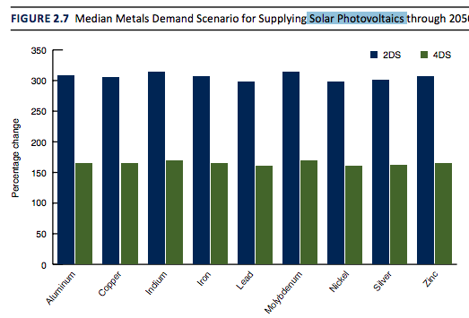

Slide 10
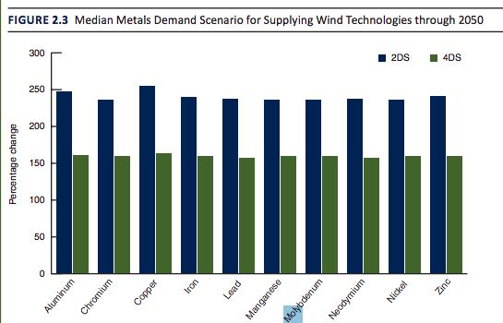

Slide 11
Political Analysis:
The Renewable Paradox
A study done by the World Bank Group and the Extractives Global Program Report showed that “(wind, solar, hydrogen and electricity systems) are in fact significantly MORE material intensive in their composition than current traditional fossil-fuel-based energy supply systems”
“Relevant metals demand roughly doubles for wind and solar technologies, but the most significant upsurge occurs with energy battery storage technologies—more than a 1000 percent rise for metals required for that particular clean energy option” http://documents.worldbank.org/curated/en/207371500386458722/pdf/117581-WP-P159838-PUBLIC-ClimateSmartMiningJuly.pdf
How can these US mandates be achieved if cities like Crested Butte and it’s High City Council Commission refuse to allow mining in a mineral rich area.
The HCCC and Crested Butte fight Coal and natural gas projects and advocate for renewable Energy, but don’t realize that an essential part of reducing carbon emissions is through mining for metals and other rare earths.

Slide 12
100% Renewables mean becoming dependent on China
If a push for permitting and opening new mines in the US isn’t made a top priority, the United states will rely on the Communist Party of China for natural resources, finished goods, and worst of all energy.

Slide 13
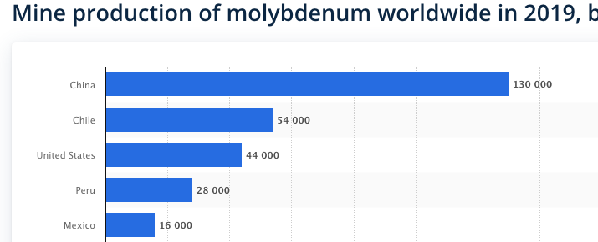
Molybdenum production by country
China by far is the world’s largest producer of MO, they nearly triple US production
They are able to control the price of Molybdenum, making it difficult for new mines in other countries to open

Slide 14
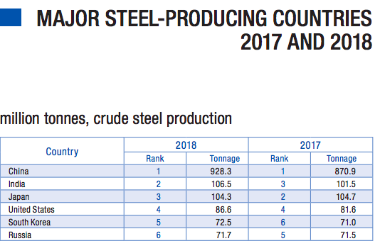
Steel production by country
China became the world leader in steel production in the year 2000, and has steadily increased the gap between them and the rest of the world

Slide 15
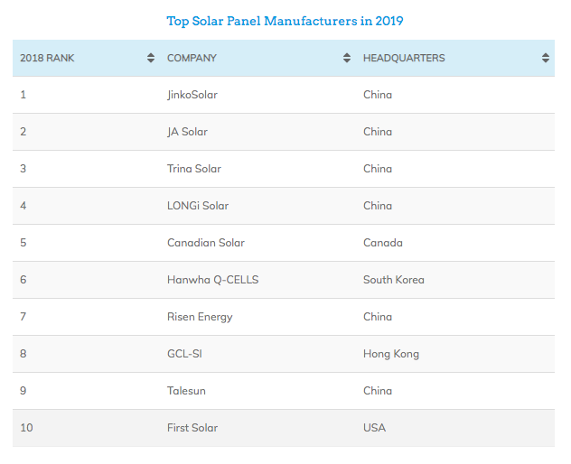
Solar Panel manufacturers
6 of the worlds top producers are from China 7 if you include Hong Kong

Slide 16
Windmill Manufacturers
3 of the top 10 wind manufactories are in china
Ming Yang-china
United Power-china
Goldwind-china

Slide 17
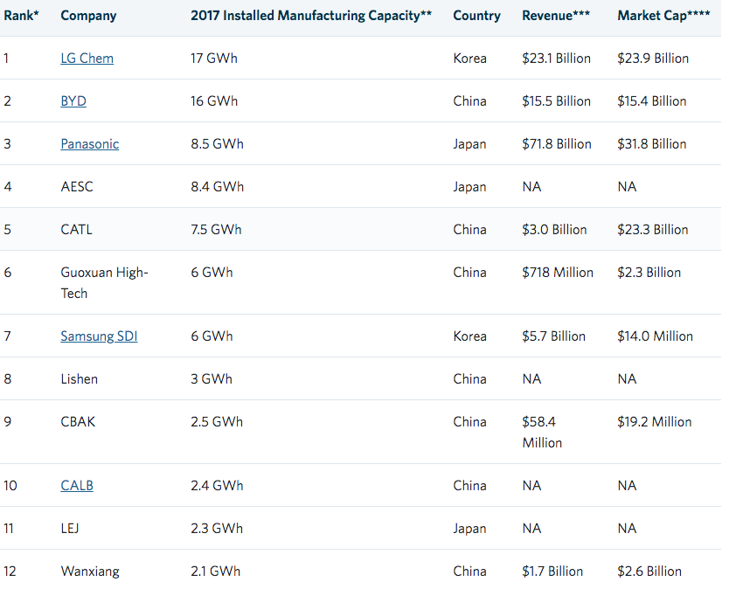
Top Lithium Ion battery manufacturers
7 out of 12 are in China
China is on the way towards a Monopoly on Renewable Energy.

Slide 18
What it means.
China controls the flow of Molybdenum (and many other metals and rare earth minerals), Steel, Solar Panels, Batteries, and have a large market share in Windmill production
With control at every step they will be able to control pricing just as John D Rockefeller did with Standard Oil

Slide 19
The United States must severe it’s Ties to Chinese renewable Energy, and the First step is Opening new Mines like the Red Lady in Crested Butte

Slide 20
References
https://www.thomasnet.com/articles/top-suppliers/battery-manufacturers-suppliers/
https://www.usgs.gov/faqs/what-materials-are-used-make-wind-turbines?qt-news_science_products=0#qt-news_science_products
http://documents.worldbank.org/curated/en/207371500386458722/pdf/117581-WP-P159838-PUBLIC-ClimateSmartMiningJuly.pdf
https://www.imoa.info/download_files/sustainability/IMOA_solar_15.pdf
https://www.imoa.info/molybdenum/molybdenum-history.php
https://www.nwf.org/~/media/PDFs/Wildlife/Mining-Loopholes/CO_MtEmmonsMine_v2.ashx
https://vault.si.com/vault/1979/02/19/life-or-death-for-a-red-lady-crested-butte-is-a-beaut-of-a-spot-whose-mountain-glows-in-the-sunset-but-a-mine-could-make-it-a-molehill
https://www.hccacb.org/2016/05/freeportmemc-terminates-all-proposed-mine-plans-on-mt-emmons/
https://mountaintownnews.net/2016/03/17/retiring-the-molybdenum-damocles-sword-of-mt-emmons-hanging-over-crested-butte/
https://www.statista.com/statistics/910853/global-mine-production-of-molybdenum-by-country/
https://cumoco.com/wp-content/uploads/2018/04/CuMo-Moly-Battery-2018.pdf
https://www.ncsl.org/research/energy/renewable-portfolio-standards.aspx
https://www.worldsteel.org/en/dam/jcr:96d7a585-e6b2-4d63-b943-4cd9ab621a91/World%2520Steel%2520in%2520Figures%25202019.pdf
https://news.energysage.com/best-solar-panel-manufacturers-usa/
https://www.energydigital.com/top-10/top-10-wind-turbine-suppliers

