Slide 1
Approving Official OneCard Training

Slide 2
Allocating Expenses in Access
Cardholder has 5 days following the close of the billing cycle to make sure all transactions for that billing cycle are allocated.
  Allocation locks after the 5th day
Cardholder has 30 days to upload receipts
Approving Official has 60 days to review and approve expenses through US Bank platform

Slide 3
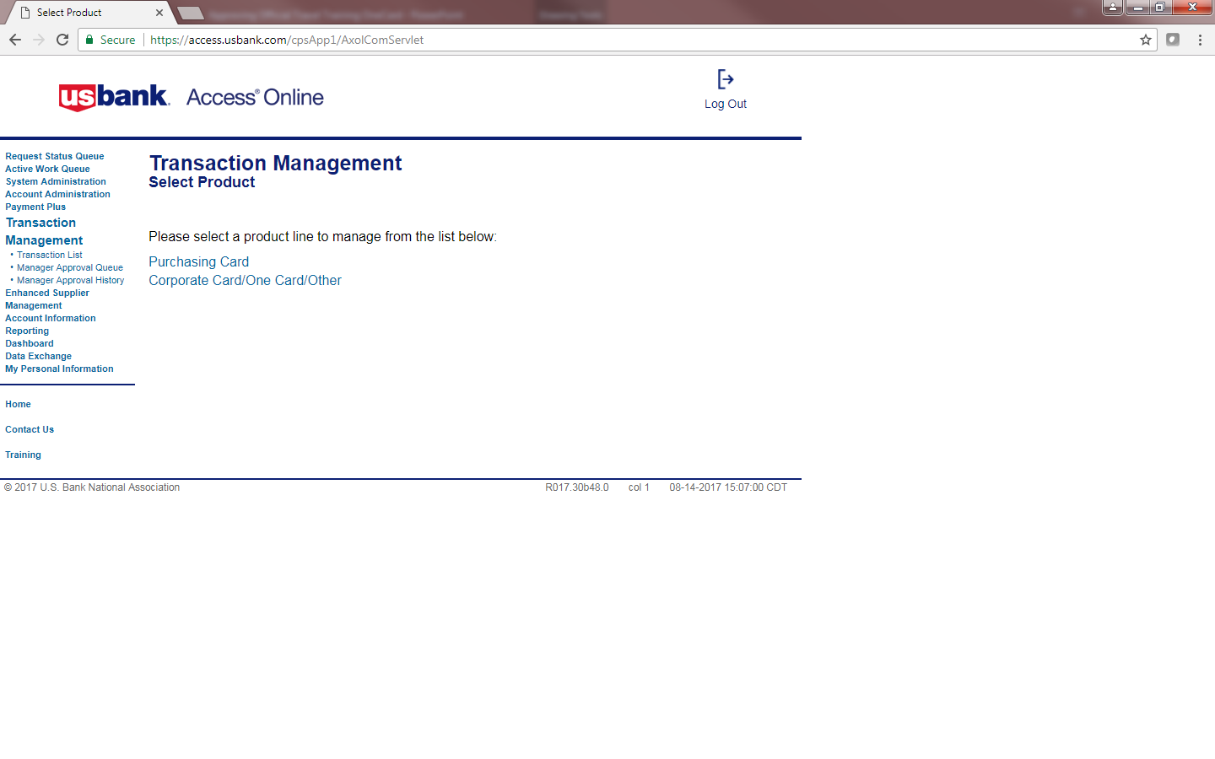
Review Transaction

Slide 4
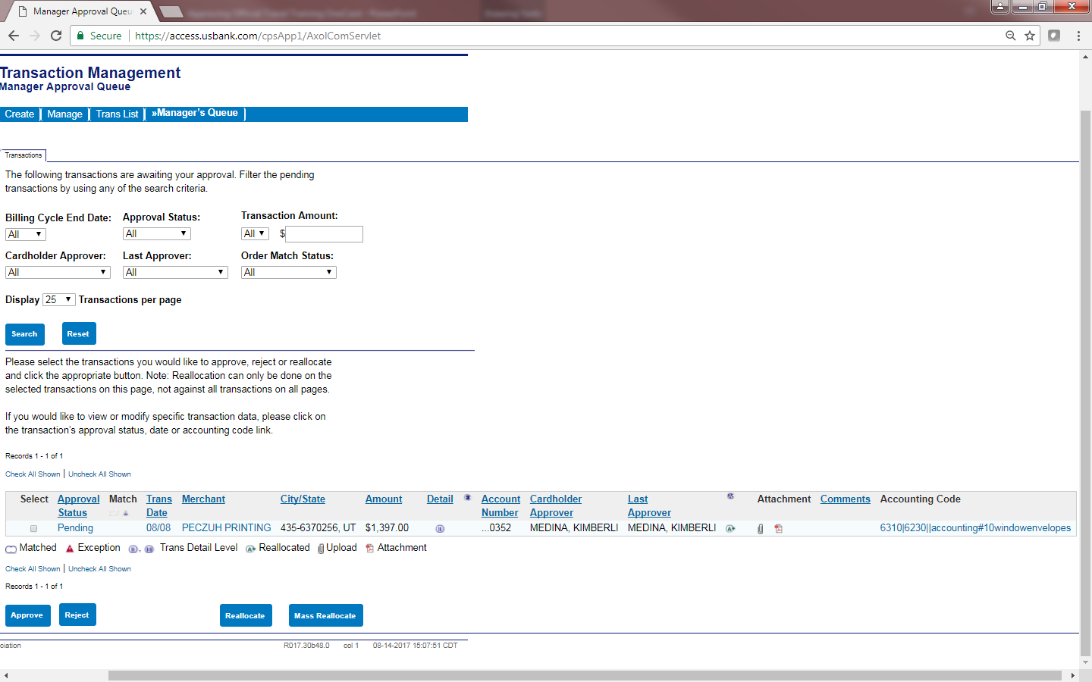
Review Transaction Elements

Slide 5
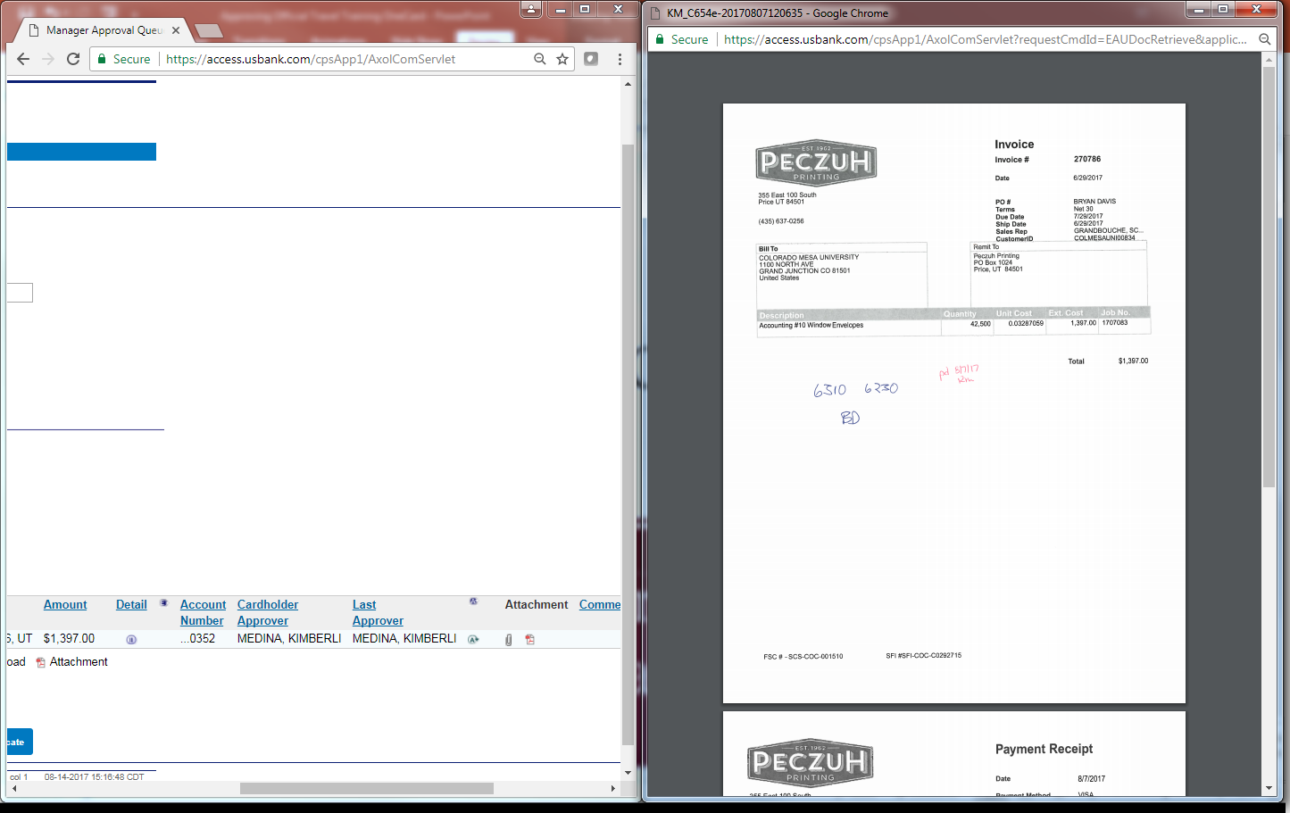
Review Transaction Receipt(s)

Slide 6
Review Transaction and Reject

Slide 7
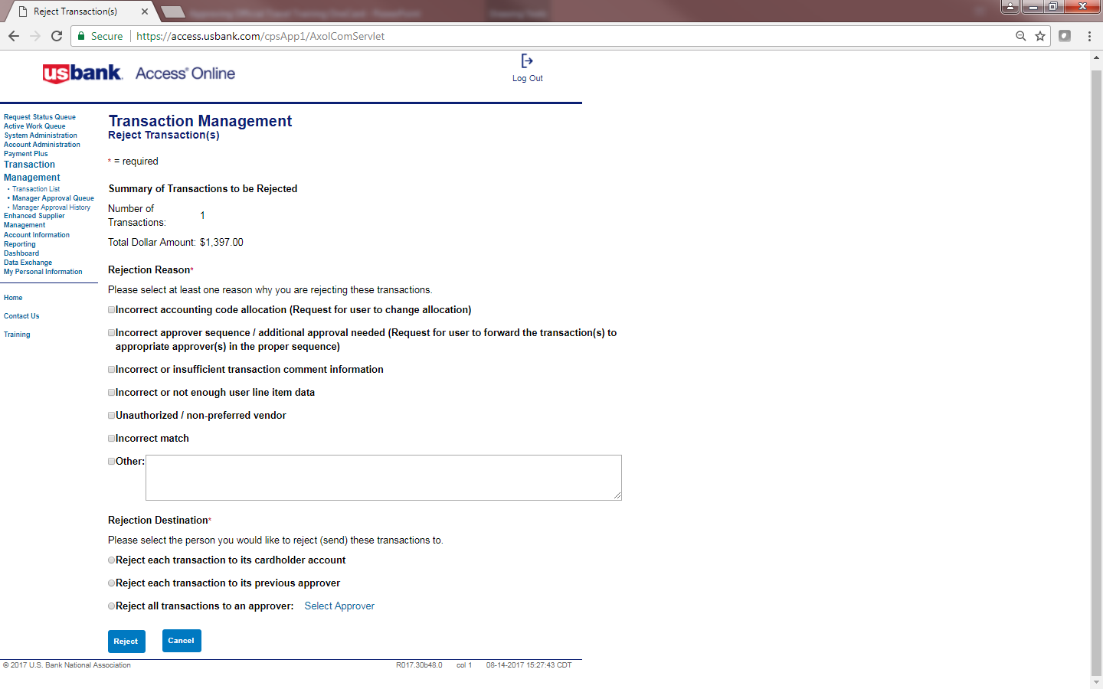
Review Transaction and Reject

Slide 8
Review Transaction and Approve

Slide 9
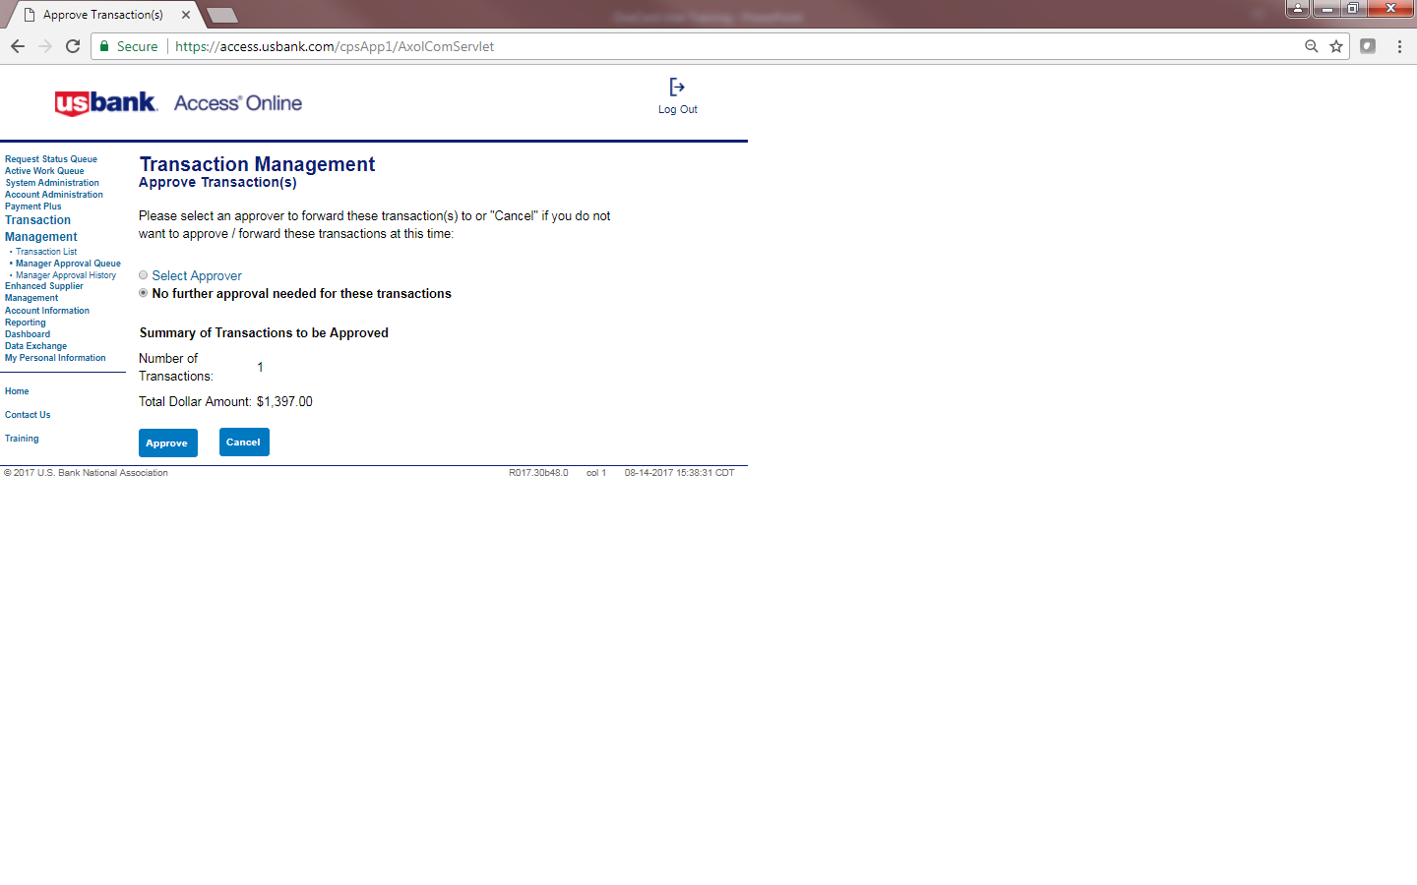
Review Transaction and Approve

Slide 10
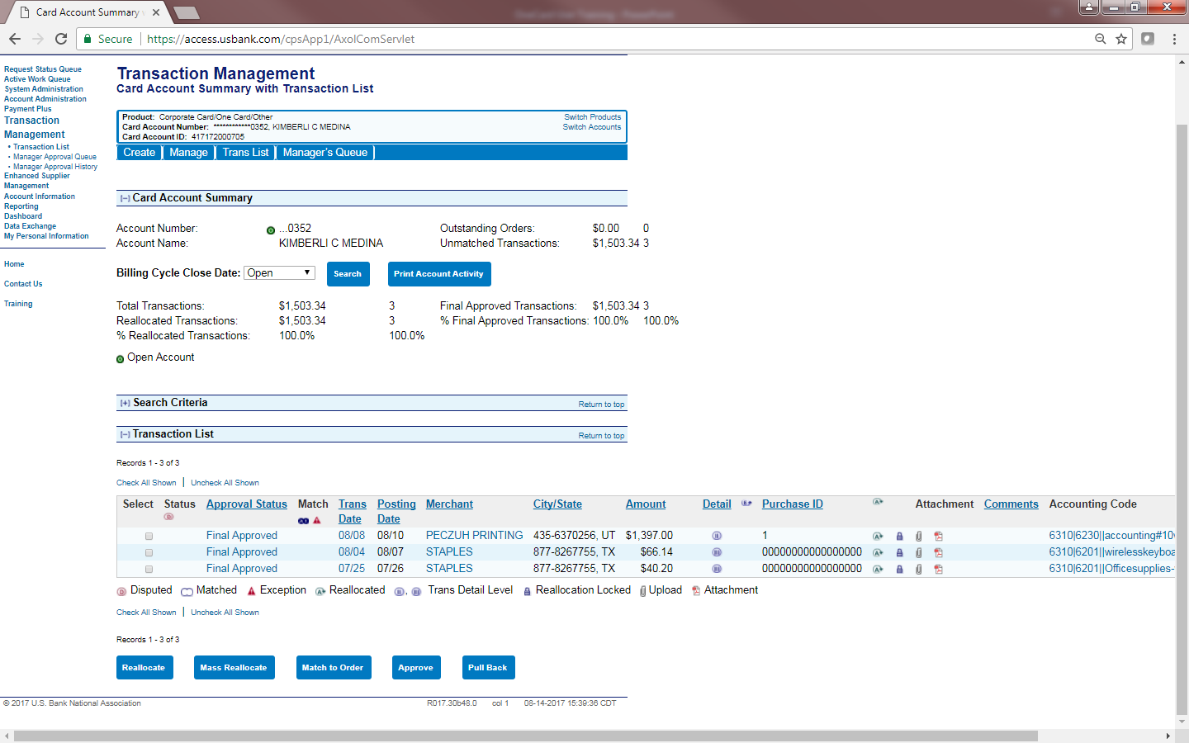
Review Transaction and Approve

