Slide 1

2024 Annual Review Form
Overview
Lorraine Call
Consultant & Coach,
Leadership Training & Development
Notes:
Hello & Welcome:
Thank you for being here today. The purpose of today’s virtual session is to share:
• Why changes have been made to the annual review form
• How you’re measured – Both what you do (performance) and how you do it (behavior)
• What to expect from your managing leader

Slide 2
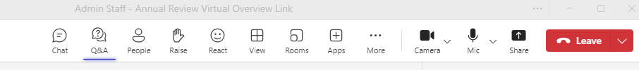
Ask your questions by clicking here.
Grab links by clicking here.
Notes:
If you’re newer to Teams calls, the Q&A button is up on the top bar of your screen next to your People icon. The CHAT button is just to the left of that.

Slide 3
Agenda
What’s New & Why
The Annual Review – What It’s Not, What It Is
The Performance Cycle
The Annual Review Form Components
What’s Next

Slide 4



WHEN YOU THINK ABOUT THE ANNUAL REVIEWS…
What picture best depicts your perspective?
Notes:
Some leaders identify with this first photo. The second is what we think it “should be like”. Some people feel… “I’ll just take my chances.”.
Our desire at CMU is to build a process of ongoing conversations around job performance where both the leader and the employee gain, grow and leave feeling like it was worthwhile.
At the core of our business - We’re all here to serve our customer – the student and parents who send their kids here. So, the purpose of discussing performance is so that we all can do the best work for customer.
One thing that is new this past year is EOS, Entrepreneurial Operating System. Our executive leadership team chose EOS to help us continually improve.

Slide 5
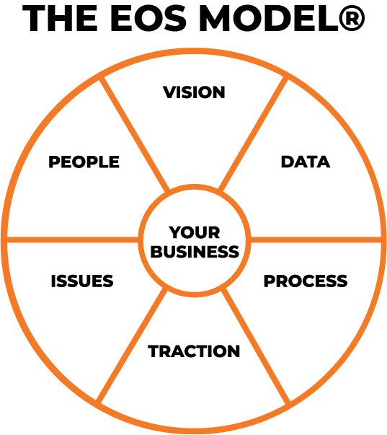
WHAT’S NEW AND DIFFERENT THIS YEAR?
CMU is in the process of fully adopting the EOS continuous improvement framework for thinking about and doing our business.
Notes:
We are fully adopting this continuous improvement framework.
It’s made up of these 6 components and under each component are tools for us to integrate. The benefit is that it gives us a structure or model for how we thinking about and do our business.

Slide 6
WHY EOS?
EOS helps build structure, accountability and excellence around
who we are and how we function.
A system of proven best practices – process and people
A means of harnessing and directing the energy of our people toward our vision

Slide 7
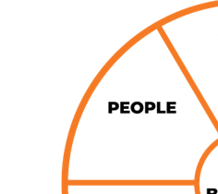
AND…SO WHAT?
Integration will slowly and methodically work across our business.
Adjustments to our processes and new leadership tools are designed to help our leadership be more:
  Intentional,
  Clear,
  Simplified
The Annual Review Form is our first people process
to integrate EOS tools and language.

Slide 8
THE ANNUAL REVIEW
It’s NOT…
A form the leader completes and the employee reads to learn how they’re doing.
Suppose to be a surprise for the employee.
A form that is completed and filed away in HR.
A form that tells the employee what they’ll receive as a pay increase.
Suppose to be awkward and stressful for leaders and employees.
Is…
Part of a broader performance process.
The culmination of an ongoing cycle of dialogue around role, capacity, gaps and how to close those gaps.
A qualitative assessment about what the employee has done (performance) and how they did it (behavioral).
An opportunity for employees to own their performance and behaviors and discuss their contributions to the CMU culture and strategic initiatives.

Slide 9





THE CYCLE OF ONGOING DISCUSSIONS
Leadership Training
Annual Review Form & Process
June ‘24
Performance Management is not a once-a-year event.
Performance Management Cycle
Quarterly Conversation
July ‘24
Annual Review
Jan – Feb ‘25
Quarterly Conversation
October ‘24
Notes:
The cycle shifts I how we approach the review.
In the past we’ve asked employees to complete a “self-evaluation” and the leader completed their evaluation.
In this process, you won’t complete a self-evaluation but you’ll have regular discussions about your role, performance and behaviors through out the year. Then when you leader delivers your review in Feb ‘25, you’ll be given an opportunity to respond and add your thoughts to that form.

Slide 10

Quarterly Conversations Feed the Review
Quarterly Conversations should cover:
CMU CORE VALUES
in Action
ROCKS
The 90 Day World / Priorities
GWC
Get it, Want it, Capacity to Do it
Notes:
We are introducing “quarterly conversations” – regular conversations between a leader and employee where these 3 things are addressed.
-> I know you may be forming some questions here but I’m going to go into these in more depth and then I’ll ask to review the questions.

Slide 11




Our Annual Review Addresses Four
Job Performance Areas
Core Values
GWC
Expectations
Rocks

Slide 12
VALUES IN ACTION, BUILD CULTURE
CORE VALUE | DEFINITION
Love | Extending oneself for nurturing the growth of self and others.
Dignity | Respecting the intrinsic value of each person and believing that others act from a foundation of goodwill.
Courage | Taking risks in the pursuit of new possibilities.
Humility | Suspending one's ego and pride to recognize that no idea is perfect and being open to the input of others.
Resiliency | Investing in the future by adapting to changes, overcoming challenges, and pursuing opportunity.
Curiosity | Cultivating awe and exploring the unknown.
Power | The strength to act collaboratively with individual agency to achieve our goals.
Notes:
Our values are at the heart of who we are, how people experience us and what they’ll eventually know about CMU and the Human Scale University. Our core values drive our culture. Culture is made up of:
What we believe
our traditions,
how we behave,
what’s important,
it’s also what others experience when they’re with us, in our environment.
Dr Marcus Collins (Author and Professor at University Michigan) says
“there is no external force more influential on people than culture”
This is why we are promoting the embodiment of our values and they’re put into the annual review.
It’s important to know our definitions of each of the value.
Put your response in the CHAT - The question for you as a staff member is:
What value(s) resonates the most with you?
How are you demonstrating the core values in the workplace?
How consistent?
When we demonstrate the values, live them out, and others experience them, we build and reinforce our culture.

Slide 13
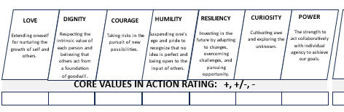
# 1 - CMU’s CORE VALUES
What core value(s) resonates most with you? Why?
How are you demonstrating the core values in the workplace?
How consistent are you?
Notes:
On the annual review form the values section will look like this.

Slide 14
CORE VALUE RATING SCALE
Rating Scale
Means
+, +/-, -
+ (plus) = The employee lives the Core Value most of the time. Focus on
intentionality and growth and don’t get hung up on it being 100% of
the time or perfection.
+/- (plus / minus) = The employee lives this Core Value sometimes with
other times the value not being observed in their work life.
- (minus) = The employee does not live the core value most of the time and it
isn’t observed in their work life.
The Bar: For all employees, the expectation is that their annual review reflects
5 + (plus) ratings and 2 +/- (plus / minus) ratings across the 7 core
values.
Less than 5 + (plus) ratings and any – (minus) ratings across the core values will prompt the need to outline a plan for improvement (PIP).
Notes:
The goal is GROWTH, not perfection!

Slide 15
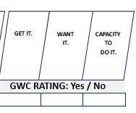
# 2 - GWC
Get It
  Do you understand your role, our culture, systems, and pace the role requires?
Want It
  What you like about your role and scope of responsibility?
Capacity to Do It
  Do you have the skills, knowledge, emotional intelligence and the ability to commit to the scope of this job?
Notes:
GWC is an EOS tool and regular conversation topic for you to have with your leader. The goal and cadence of the conversations is to build rapport, establish a relationship and have an open discuss your contributions to CMUs initiatives and vision.
These are the questions to ask yourself when reflecting on GWC.
- > We hope the answers to these questions is yes, and if through out the year, if the answer is no, we ask that you have more conversations about the role and what it will take to get the “yes” answer.
- > We recognize that transparency requires trust. Trust that you can be open with your leader about how they’re doing and how you see yourself in your role.
The hope and expectation is to have three (3) yeses across GWC. If an employee is rated “no” in any factor of GWC, further conversations will be needed to understand the employee’s perspective, discuss how to resolve concerns and put the appropriate resolutions in place.
It’s also an opportunity for you to reflect on why you like your role and…
Is it still the right fit for you?
Again, this is a conversation topic that should be done consistently to build rapport and transparency around you in the role.

Slide 16
GWC RATING SCALE
Rating Scale
Means
Yes / No
Yes – You are confident in saying “yes” to the questions above.
No – You are not confident in saying “yes” to the questions provided
above.
The Bar: The expectation is to have three (3) yeses across GWC. If
an employee is rated “no” in any factor if GWC, further
conversations will be needed to understand the
employee’s perspective, discuss how to resolve concerns
and put the appropriate resolutions in place.

Slide 17

# 3 - EXPECTATIONS
What does winning look like for your team?
What does winning look like for this individual employee?
  Behavioral
  Observable
  Repeatable
  Trackable
Notes:
Expectations are established by your leader and can be at the team level or the individual level. They answer these questions.
Brene Brown says – “clarity is kindness, and being unclear is being unkind”.
I’ve trained your leaders to establish clear expectations with their teams so that everyone is winning and feels like they are winning.

Slide 18
EXPECTATIONS RATING SCALE
Rating Scale
Means
+, +/-, -
+ (plus) = The employee does what is expected most of the time. Focus on
intentionality and growth and don’t get caught up on it being
100% of the time or perfection.
+/- (plus / minus) = The employee does what is expected sometimes.
- (minus) = The employee does not do what is expected most of the time.
The Bar: For all employees, the expectation is that their annual review reflects
80% + ratings, 20% +/- , - ratings are not acceptable.

Slide 19
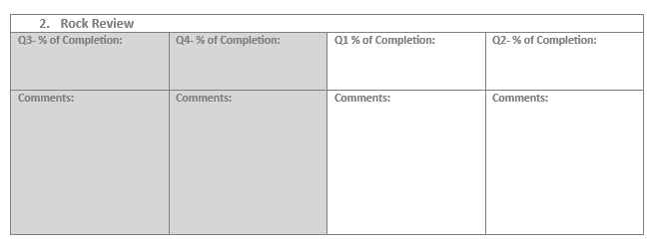
#4 - ROCKS
Rocks create a 90-day world in which to operate.
Rocks are simply goals or priorities to be completed.
Written well, they’ll be:
specific,
measurable
attainable,
relevant
and within a 90-day timeframe.
Notes:
ROCKS are defined as an employee with their leader, not the leader “for” the employee.
Your leaders will work with you to establish these if you haven’t already done so.
For some, a Rock may be a special project, for others it might be focusing on your daily work from a qualitative or quantitative perspective.
On this form, Q3 & Q4 are darkened to represent that there are only 2 quarters for rocks in this year. If you have had rocks during these quarters, then your leader can fill these in. Next year, there will be 4 quarters of rocks.

Slide 20
ROCKS RATING SCALE
The Bar:
The expectation is that an employee would complete their rocks to a minimum of 80% average completion across the quarters.
We recognize that in some quarters, the completion % may differ from other quarters.
Overall, the employee should have on average completed 80% of the Rocks defined.

Slide 21
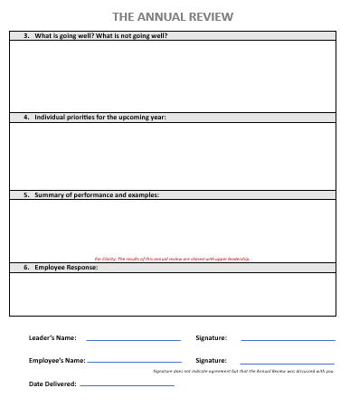
Summary Sections:
  Feedback on what your leader sees as going well or needing improvement.
  Priorities can be considered for next year’s rocks.
  Summarize of overall performance with specific examples.
Area for employees to respond after the review has been delivered.
Both signatures acknowledge that the review was delivered.
  Signatures do not indicate agreement.
Notes:
The 2nd page of the review is an area for your leader to fill in
What’s going well / not going well?
What are the priorities for the upcoming year?
A summary of your performance.
Allow you a section to respond.
In the past, the process may have been different. Maybe you completed a review on yourself, and the leader a review on you and you discussed the results together. This process has shifted the discussions into the quarterly conversations and new you have a section where you can respond to the final review.
Our hope is that it’s more simplified and clear for everyone involved.

Slide 22
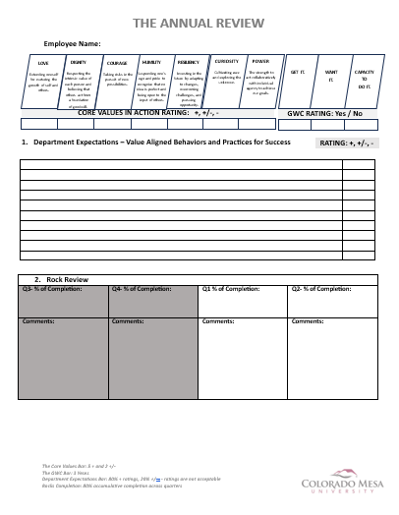
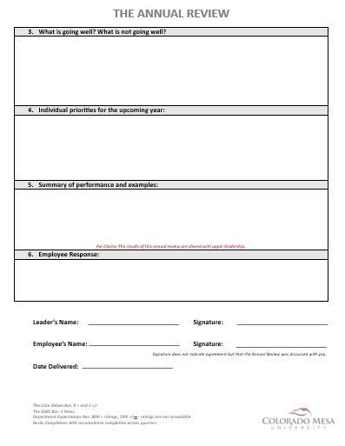
Notes:
Here’s a look at the form, front and back. Your leader will have fillable PDF copies.

Slide 23
What’s Next?
Leaders will begin Quarterly Conversations in July
Expectations clarification and Rock creation may occur, if they have not already been created.
In Jan - Feb 2025, your leader will complete this form, review it with you and provide you the opportunity to add your response.

