Slide 1
Travel Training

Slide 2
Overview of Blanket Travel
Blanket Travel is reoccurring travel throughout the fiscal year.
Examples include athletic coaches, admission recruitment, etc.
Process
Traveler’s supervisor will initiate the request and a Travel Authorization number (TA#) will be given.
Once the TA# is generated, the traveler is approved to travel.
When traveler returns, they will upload/allocate charges in US Bank Access Online. They will also complete the Post Travel (green) portion of the Travel Expense Report (TER) and send it to their approving official.
The approving official will review the TER and submits it to the TCO (Travel Compliance Office) for audit and finalizes the travel paying any reimbursement owed to traveler.

Slide 3
Overview of Non-Blanket Travel
Non-Blanket Travel is non-reoccurring travel throughout the year.
Examples include recruiting, training events, conferences, and seminars.
Process
Traveler complete the Travel Authorization Info (blue) sections of the TER and emails it to their Approving Official.
The Approving Official reviews the TER. Once approved, the Approving Official will email the TER to The Travel Compliance Office (TCO) and to the traveler. The traveler is authorized to travel.
Upon return, the traveler allocates expenses in US Bank Access Online, completes the Post Travel Info (green) on the TER, and submits the TER via email to the TCO at travel@coloradomesa.edu.
The TCO audits the TER, US Bank expenses and reimburses the traveler for out of pocket expenses.

Slide 4
Travel Expense Report (TER)

Slide 5
CMU OneCard
No personal purchases allowed
Must use for all travel related expenses except meals
Student recruit refreshments or similar expenses are allowed on OneCard
Team travel meals are allowed on OneCard
Tax Exempt # is on the card

Slide 6
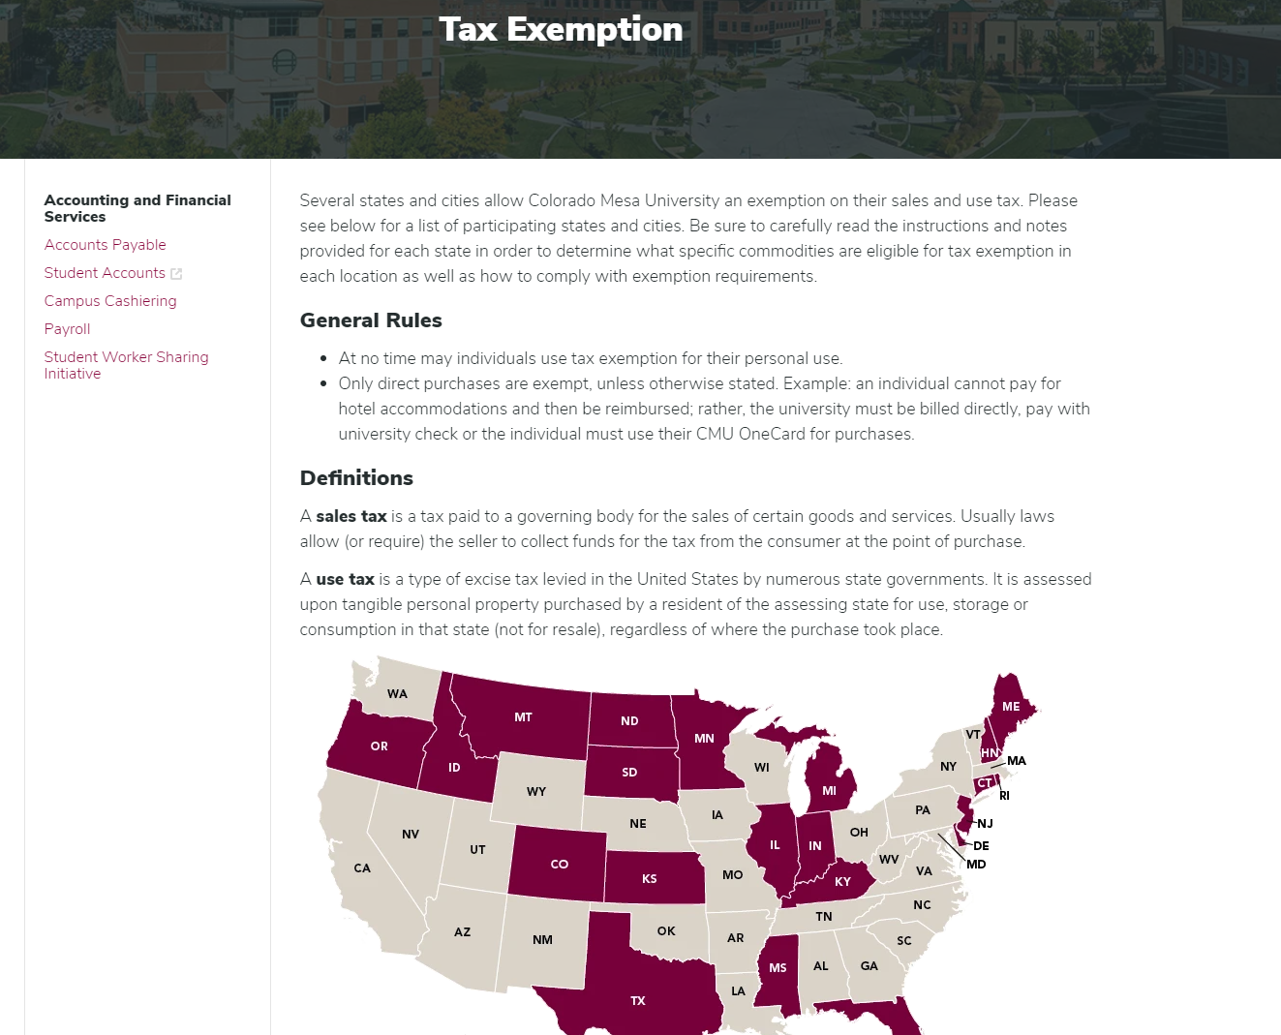
Tax Exemption
https://www.coloradomesa.edu/accounting-financial-services/tax-exemption.html

Slide 7
On The Road…
Meals
Do not put meal expense on your OneCard
Per Diem is used for meal reimbursement
Student centric events are an exception
Refreshments and recruit expenses listed on you TA are allowed to be charged to your OneCard
Team travel meals are allowed on OneCard
Add tip to the meal receipt you keep
Meals Provided by Event In Lieu of Per Diem
Per Diem Will Not Be Reimbursed
Shuttle/Taxi/Subway/Other Transportation
All OneCard expenses require a receipt
Out of pocket expenses $25 and over require a receipt
Out of pocket expenses under $25 do not require a receipt

Slide 8
On the Road…
Rental Vehicles
Receipt Required/Rental Agreement is Insufficient
Your OneCard provides the insurance if the rented vehicle(s) are below 8 seats. Please waive the Collision Damage Waivers (CDW) insurance from the rental agency.
Vehicles with 8 seats or more please accept the rental insurance.
Lodging
Receipt Required/No Balance Due on Receipt
Baggage Fees
Receipt Required

Slide 9
On the Road…
Fuel
Receipt Required
Pre-authorization Not Accepted for Reimbursement
Personal Vehicle
Mileage Reimbursement
2WD Rate $0.53 per Mile
4WD Rate $0.56 per Mile (Nov. 1 through Apr. 1 only)
If adverse weather conditions occur during travel outside 4WD date window, explain in comments section of TER

Slide 10
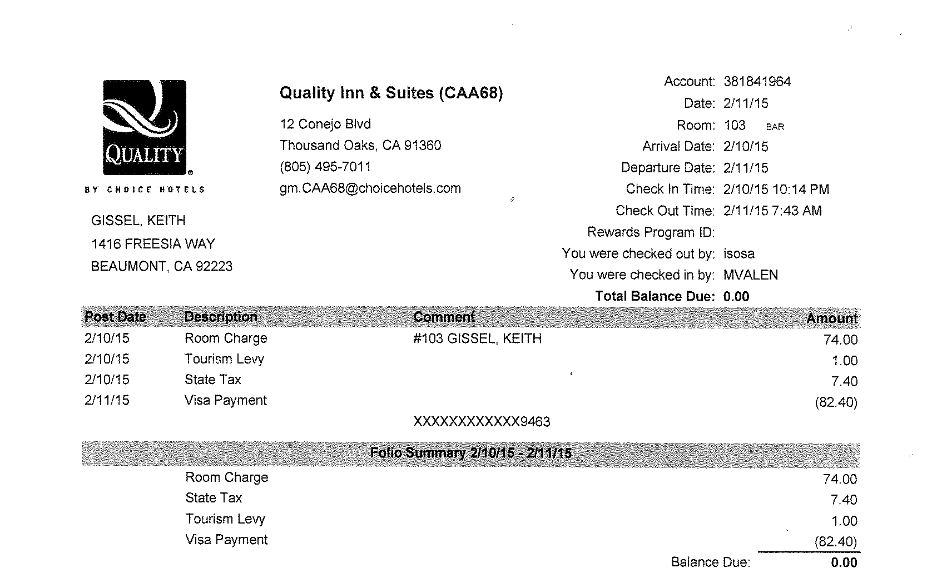
Valid Lodging Receipt
Arrival/Departure dates
Traveler’s name listed
Itemization
Balance due equals $0.00/Payments Equal Charges

Slide 11
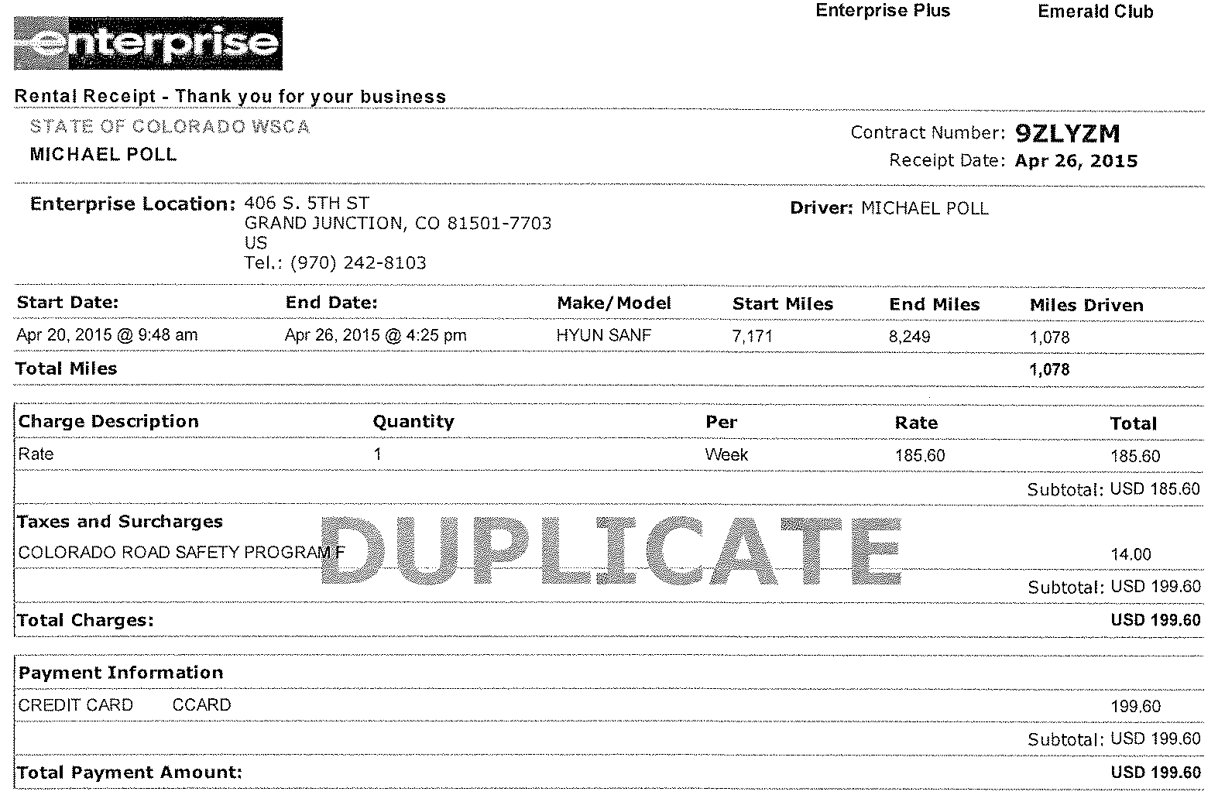
Valid Rental Car Receipt
Renter’s name listed
Start and end dates
Itemization
Itemization
Balance Due Equals $0.00/Payments Equal Charges

Slide 12
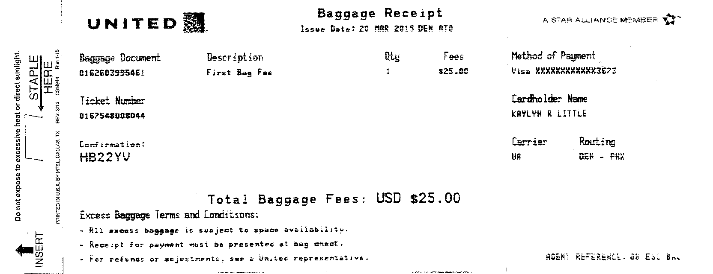
Valid Baggage Fee Receipt
Date of Fee
Credit Card Authorization
Traveler’s Name
Balance Due Equals $0.00/Payments Equal Charges

Slide 13
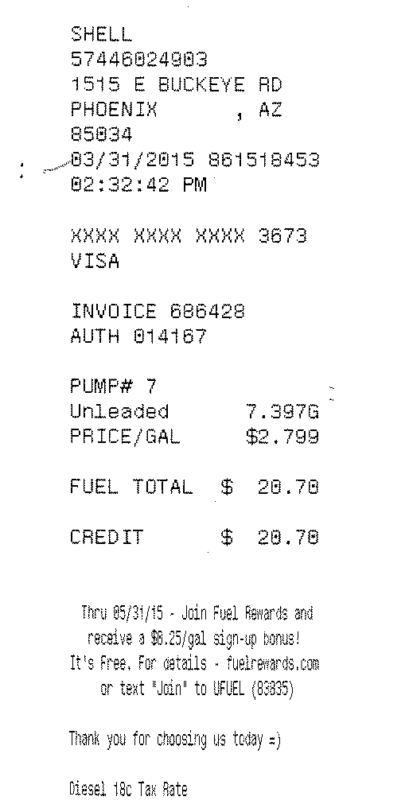
Valid Fuel Receipts
Pre-Authorized Receipts Will Not be Accepted for Reimbursement
Date
Credit card authorization
Itemization
Amount Paid = Total Charges

Slide 14
How to Complete Blanket Travel
Allocate expenses in US Bank
Complete Travel Expense Report (TER) and submit electronically to Approving Official
Accounts Payable audits and processes the Travel Expense Report to ensure compliance with University policies
Generally, no reimbursement to the traveler will occur until traveler has returned from trip

Slide 15
How to Complete Non-Blanket Travel
Allocate expenses in US Bank
Complete Travel Expense Report (TER) and submit electronically to travel@coloradomesa.edu
Accounts Payable audits and processes the Travel Expense Report to ensure compliance with University policies
Generally, no reimbursement to the traveler will occur until traveler has returned from trip

Slide 16
Travel Expense Report
Separate expenses out as they would appear on your US Bank OneCard
i.e. do not group all trip meals together as one expense
Use the comment section to explain anything that might be out of the ordinary
i.e. unable to use CMU OneCard for purchase because of the circumstance

Slide 17
How to Complete Non-Blanket Travel

Slide 18
Blanket Travel Review
Blanket Travel is reoccurring travel throughout the fiscal year.
Examples include athletic coaches, admission recruitment, etc.
Process
Traveler’s supervisor will initiate the request and a Travel Authorization number (TA#) will be given.
Once the TA# is generated, the traveler is approved to travel.
When traveler returns, they will upload/allocate charges in US Bank Access Online. They will also complete the Post Travel (green) portion of the Travel Expense Report (TER) and send it to their approving official.
The approving official will review the TER and submits it to the TCO (Travel Compliance Office) for audit and finalizes the travel paying any reimbursement owed to traveler.

Slide 19
Non-Blanket Travel Review
Non-Blanket Travel is non-reoccurring travel throughout the year.
Examples include recruiting, training events, conferences, and seminars.
Process
Traveler complete the Travel Authorization Info (blue) sections of the TER and emails it to their Approving Official.
The Approving Official reviews the TER. Once approved, the Approving Official will email the TER to The Travel Compliance Office (TCO) and to the traveler. The traveler is authorized to travel.
Upon return, the traveler allocates expenses in US Bank Access Online, completes the Post Travel Info (green) on the TER, and submits the TER via email to the TCO at travel@coloradomesa.edu.
The TCO audits the TER, US Bank expenses and reimburses the traveler for out of pocket expenses.

Slide 20
Reallocating Expenses in Access
Transaction reallocation is how OneCard transactions are “mapped” into Banner and your budget
It is the cardholder’s responsibility to reallocate in a timely manner
Transactions can be reallocated as soon as they are posted in Access® Online

Slide 21
Reallocating Expenses in Access
You have 5 days following the close of the billing cycle to make sure all transactions for that billing cycle are reallocated.
Once the 5 days have passed the transactions become locked and you will not be able to reallocate

Slide 22
Reallocating Expenses in Access

Slide 23
Reallocating Expenses in Access

Slide 24
Reallocating Expenses in Access

Slide 25
Uploading Receipts

Slide 26
Uploading Receipts

Slide 27
Uploading Receipts

Slide 28
Submitting for Approval

Slide 29
Submitting for Approval

Slide 30
Submitting for Approval

Slide 31
Submitting for Approval

Slide 32
Submitting for Approval

Slide 33
Reimbursement for Travel Expenses
Completed Travel Expense Report (TER) should be submitted within 10 days of completion of travel
Reimbursement generally occurs within 10 days of submission to Accounts Payable as long as documentation, authorization and receipts are in order

Slide 34
Reimbursement Issues
Things that delay the Travel Authorization and Reimbursement process…
NSF – Non-Sufficient Funds
Missing required approvals
Missing receipts/documentation
Incomplete forms

Slide 35
End
Questions??…
Questions??…
Contact Donovan Harwell @ 248-1433
dlharwell@coloradomesa.edu
Contact Bryan Davis @ 248-1218
brydavis@coloradomesa.edu
Contact Richard DeGeus @ 248-1974
rdegeus@coloradomesa.edu

