Slide 1
The Mathematics of General Relativity, Black holes, and Cosmology
Chad A. Middleton
Brown Bag Seminar
Mesa State College
February 12, 2010

Slide 2
The Mathematics of General Relativity, Black holes, and Cosmology (in a Nutshell)
Chad A. Middleton
Brown Bag Seminar
Mesa State College
February 12, 2010

Slide 3
Galileo Galilei
ALL objects fall at the same rate!
Notes:
Successes

Slide 4
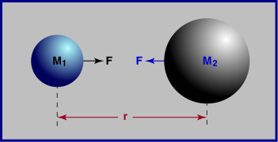
Newton’s Universal Law of Gravitation
Successes
Described the motion of massive bodies…
…on earth
…in the heavens
Notes:
Successes

Slide 5
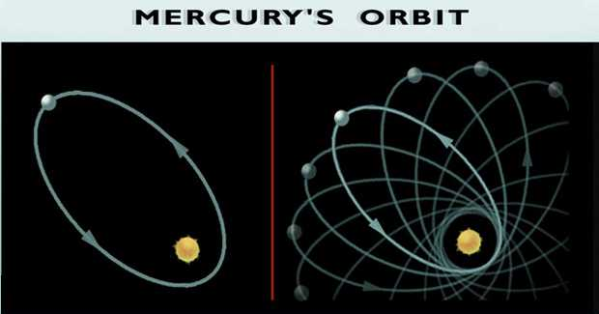
Shortcomings…
“Action at a distance”?
Infinite
propagation speed?
Mercury’s perihelion precession?

Slide 6
3D Euclidean Space Interval
Line element in Euclidean space
is the line element measuring length
is invariant under rotations

Slide 7
In 1905, Einstein’s Theory of Special Relativity..
Lorentz Transformations
Length depends on reference frame

Slide 8
4D Spacetime Interval
Line element in Minkowski (flat) spacetime
is the line element measuring ‘length’
is invariant under ‘rotations’

Slide 9
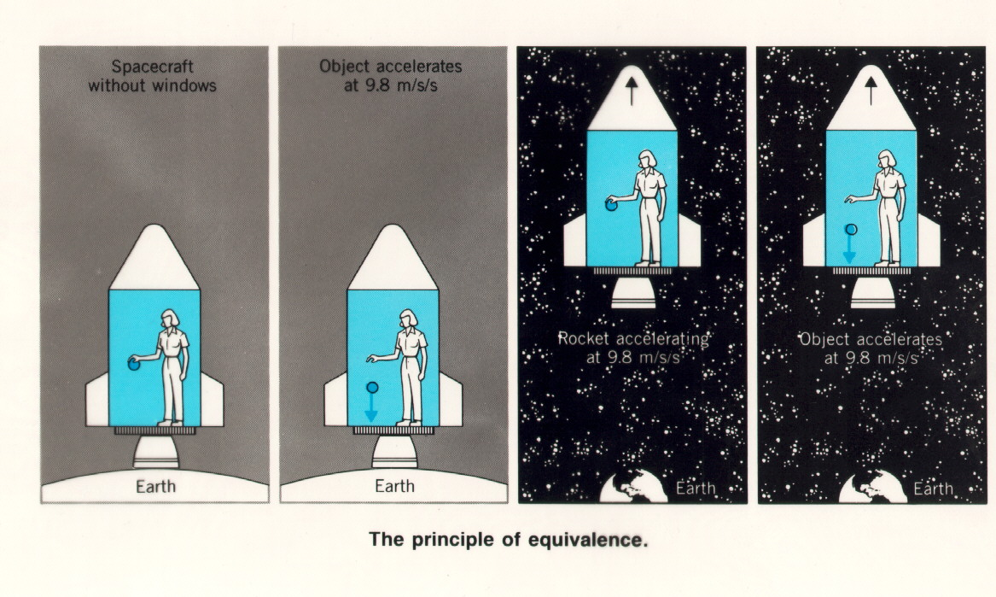
Principle of Equivalence
The motion of freely falling particles is the same in a
gravitational field and a uniformly accelerated frame, in small enough regions of spacetime

Slide 10
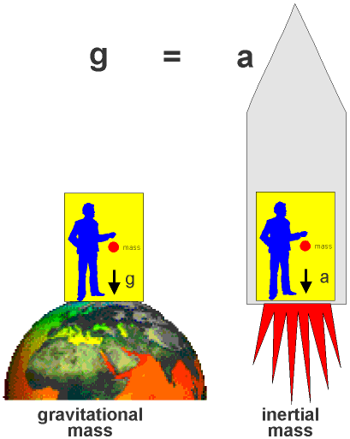
Principle of Equivalence
What about massless particles?
Elevator observer sees light moving in a curved path!
Spacetime is curved!

Slide 11
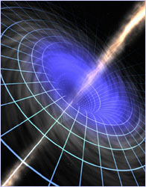
Line element in 4D curved space
is the metric tensor
encodes the geometry
of spacetime
Know , know geometry

Slide 12
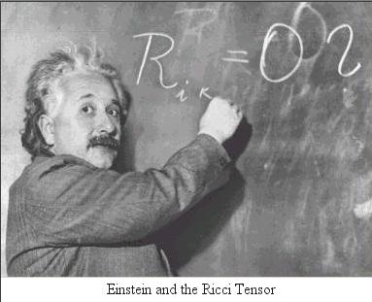
In 1915, Einstein’s gives the world his Theory of General Relativity
describes the curvature of spacetime
describes the matter & energy

Slide 13
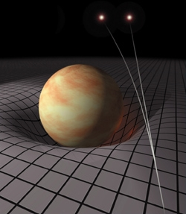
When forced to summarize the general theory of relativity in one sentence; time and space and gravity have no separate existence from matter - Albert Einstein
Matter tells space how to curve
Space tells matter how to move

Slide 14
Einstein field equations
Subscripts label elements of each tensor
metric ( ) encodes the geometry of spacetime
A system of coupled, second-order, non-linear, differential equations

Slide 15
In 1916, Karl Schwarzschild presented an EXACT solution!
The line element for a static, spherically-symmetric massive object
Plug metric ansatz into the Einstein field equations in vacuum

Slide 16
The Einstein field equations become..
These coupled, non-linear, ODEs determine the line element exterior to a spherically-symmetric source

Slide 17
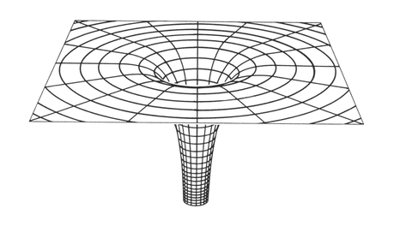
The empty space, spherically-symmetric, solution (i.e. spherical star) is described by
Let:
Notice:
: Coordinate singularity
: Spacetime singularity

Slide 18
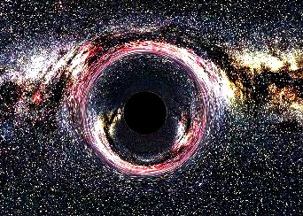
Black Holes
For fixed radius R …
For M_{star} > 3-4 M_{sun}, star must collapse to a Black Hole
Notice:
Black Holes don’t suck!
(External geometry of a Black Hole
is the same as that of a star or planet)

Slide 19
Cosmology
is the scientific study of the large scale properties of the Universe as a whole.
addresses questions like:
Is the Universe (in)finite in spatial extent?
Is the Universe (in)finite in temporal extent?
What are the possible geometries of the Universe?
What is the fate of the Universe?

Slide 20
Friedmann-Robertson-Walker (FRW) Cosmology
The line element for a spatially homogeneous, isotropic Universe evolving in time.
Plug metric ansatz into the Einstein field equations
for matter/energy modeled by a perfect fluid

Slide 21
The Einstein field equations become..
The density (ρ), pressure (p), and curvature (κ ) of the Universe determine the evolution of the scale factor (a)

Slide 22
Setting the spatial curvature to zero..
The density (ρ) and pressure (p) of the Universe determine the evolution of the scale factor (a)
These non-linear, ODEs determine the line element of a flat, homogeneous, isotropic spacetime

Slide 23
Choose an “equation of state”
For radiation:
For pressure-less matter:
For a vacuum energy:

Slide 24
Density as a function of the scale factor
Radiation dominated:
Matter dominated:
Vacuum energy dominated:

Slide 25
Conclusion
General Relativity predicts…
the ultimate collapse of sufficiently massive stars to Black Holes
GR & observational evidence indicate that:
the Universe is infinite in spatial extent
the Universe began w/ a “Big Bang” ~ 13.7 billion years ago
the Universe is flat
the Universe will continue to expand indefinitely

Slide 26
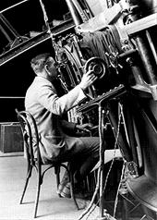
In 1929, Edwin Hubble discovered that the universe is expanding…
What is the fate of the
“decelerating” Universe?
“Big Crunch”
“Big Freeze”
Neither?

Slide 27
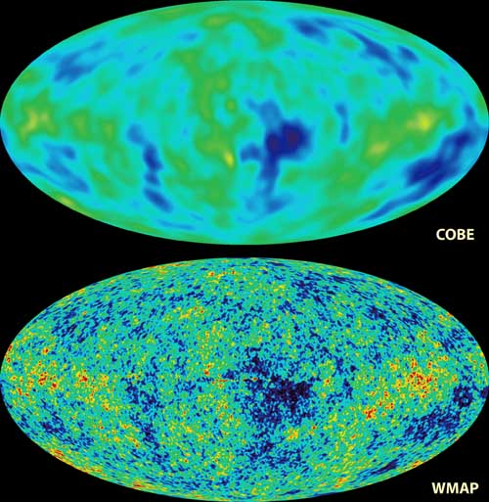
Recent Data from Type Ia Supernovae, WMAP and SDSS implies…
The expansion of the Universe is ACCELERATING!!
The Universe is flat
Seems to imply a new form of Energy

Slide 28
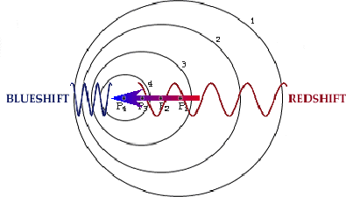
Doppler Shift allows for determining the velocity of approaching/receding galaxies!

Slide 29
Cosmological Principle
On sufficiently large distance scales, the Universe is
1. Isotropic
2. Homogeneous
⇒ Maximally Symmetric Space

Slide 30
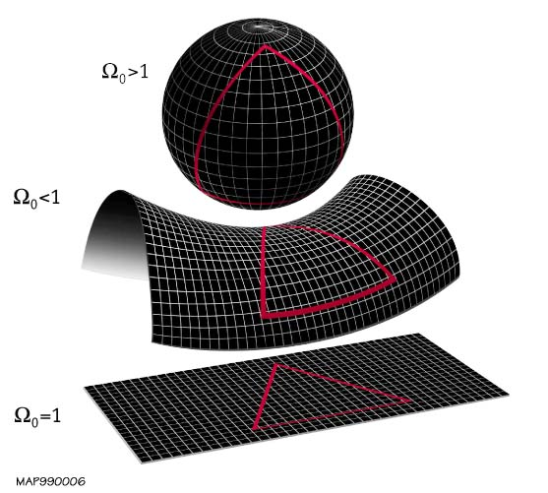
For a Homogeneous & Isotropic Universe… … 3 possible Geometries
Recent data indicates that the Universe is flat

Slide 31
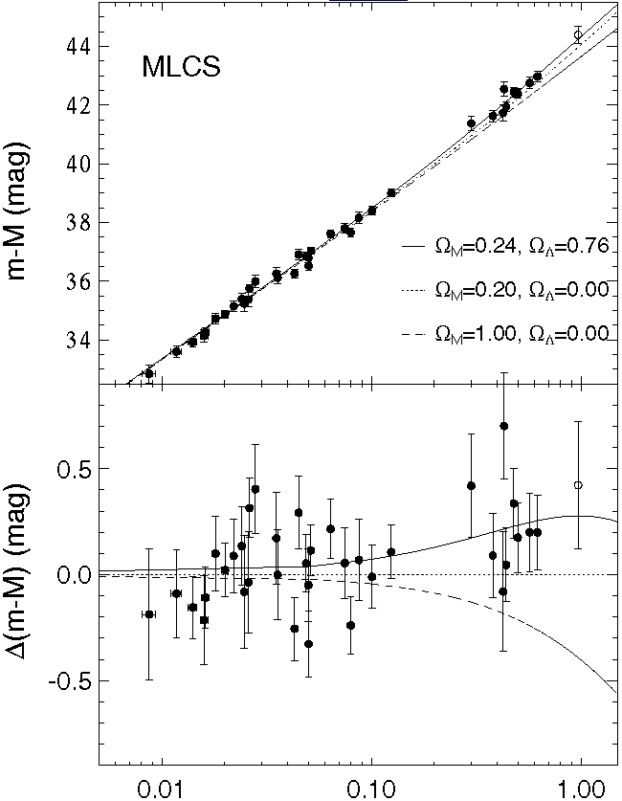
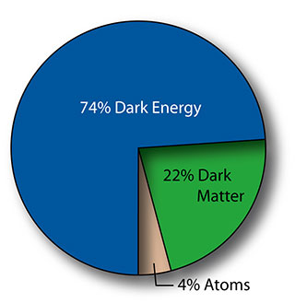
Data from Type Ia Supernovae, WMAP and SDSS implies…
The expansion of the
Universe is ACCELERATING!
The Universe is flat
Seems to indicate a Vacuum Energy
http://nedwww.ipac.caltech.edu/level5/Carroll2/Figures/figure3.jpeg
http://map.gsfc.nasa.gov/media/060916/060916/320.jpg

Slide 32
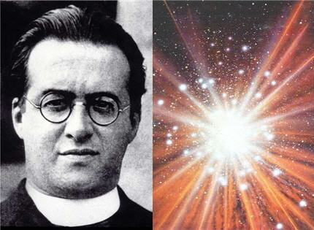
Georges Lemaître suggests the Universe had a temporal beginning..
Belgian Astrophysicist/ Catholic Priest
1927 paper in Annals of the Brussels Scientific Society
Lemaître…
showed that the universe had to be either contracting or expanding.
suggested that the Universe had a definite beginning in which all its matter and energy were concentrated at one point.

Slide 33
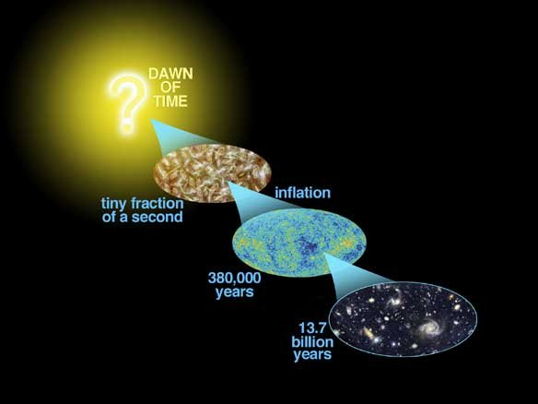
Did the Universe begin with a “Big Bang”??
The “Big Bang” ...
is not an explosion that happened at one point in space
occurred at every place in space @ one moment in time
Big Bang - a time of infinite density, infinite temperature, and infinite spacetime curvature

Slide 34
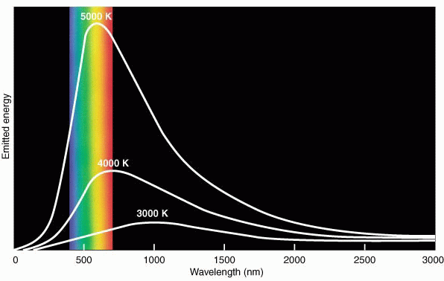
In the early 1960’s, the Princeton group in gravitational physics…
finds that the Universe should be uniformly bathed in a background microwave radiation
predicts a blackbody spectrum of the background radiation w/ T ~ 10K

Slide 35
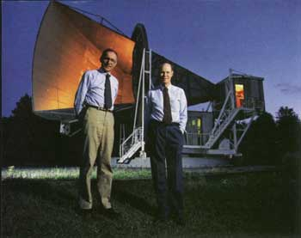
In 1965, observational evidence for the Big Bang!!
Arno Penzias & Robert Wilson
Bell Lab Physicists calibrating the Bell Labs microwave antenna designed for satellite communications
Awarded the 1978 Nobel Prize in physics for discovery of the Cosmic Microwave Background Radiation

Slide 36
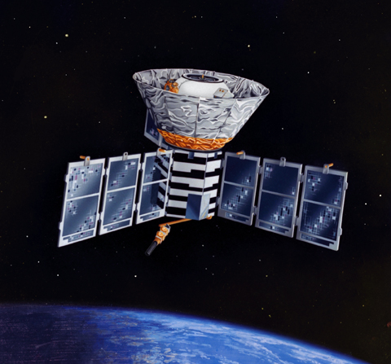
Yeah, but does this microwave background radiation have a Blackbody Spectrum?
In Nov ‘89, NASA launches the Cosmic Background Explorer (COBE) to measure…
the spectrum
the anisotropies
of the cosmic background radiation.

Slide 37
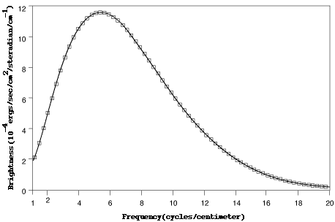
Spectrum of the Cosmic Microwave Background Radiation
John Mather & George Smoot
Awarded the 2006 Nobel Prize in physics “for their discovery of the blackbody form and anisotropy discovery of the CMB”
The excellent agreement with Planck’s law is the best fit ever measured!

Slide 38
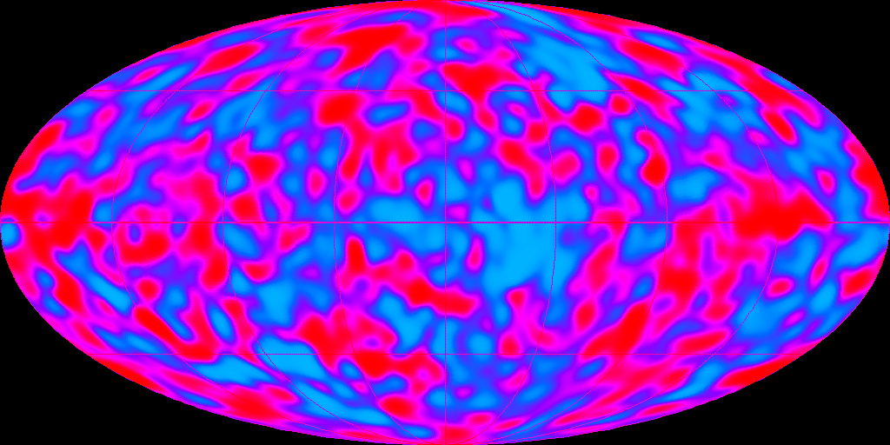
COBE image of the Cosmic Microwave Background Radiation
Light from when the Universe was 380,000 years old…
Map of μK anisotropies

