Slide 1
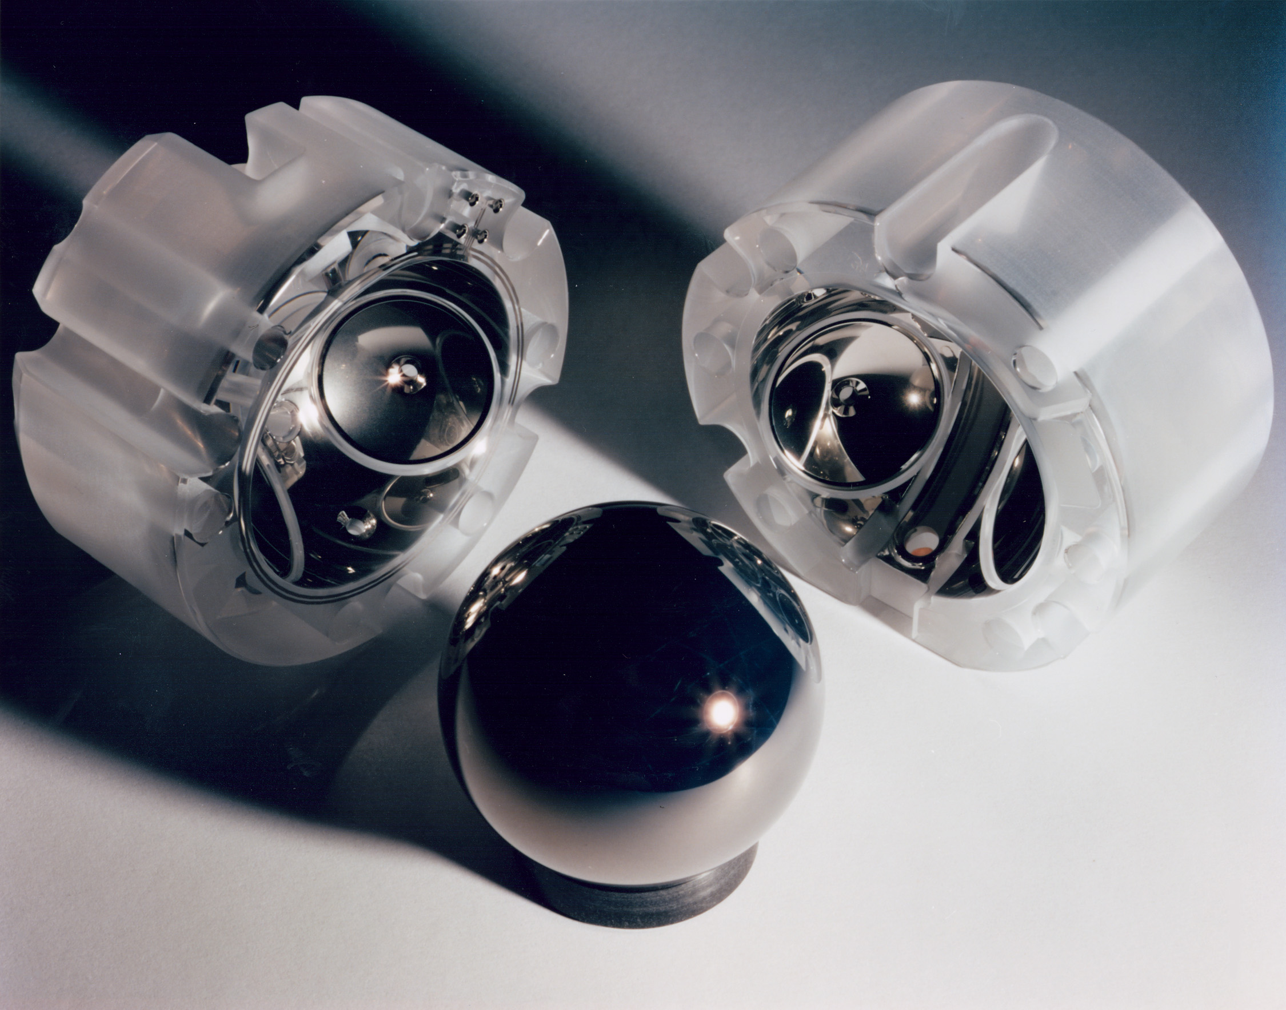
Using Gyroscopes to Probe Einstein’s Spacetime: the Theory Behind Gravity Probe B
Chad A. Middleton, Ph.D.
CMU Physics Seminar
February 23, 2012
“No mission could be simpler than Gravity Probe B.
It’s just a star, a telescope, and a spinning sphere.”
William Fairbank
L.I. Schiff, Phys. Rev. Lett. 4, 215 (1960)
C.W.F. Everitt et al., Phys. Rev Lett. 106, 221101 (2011).

Slide 2
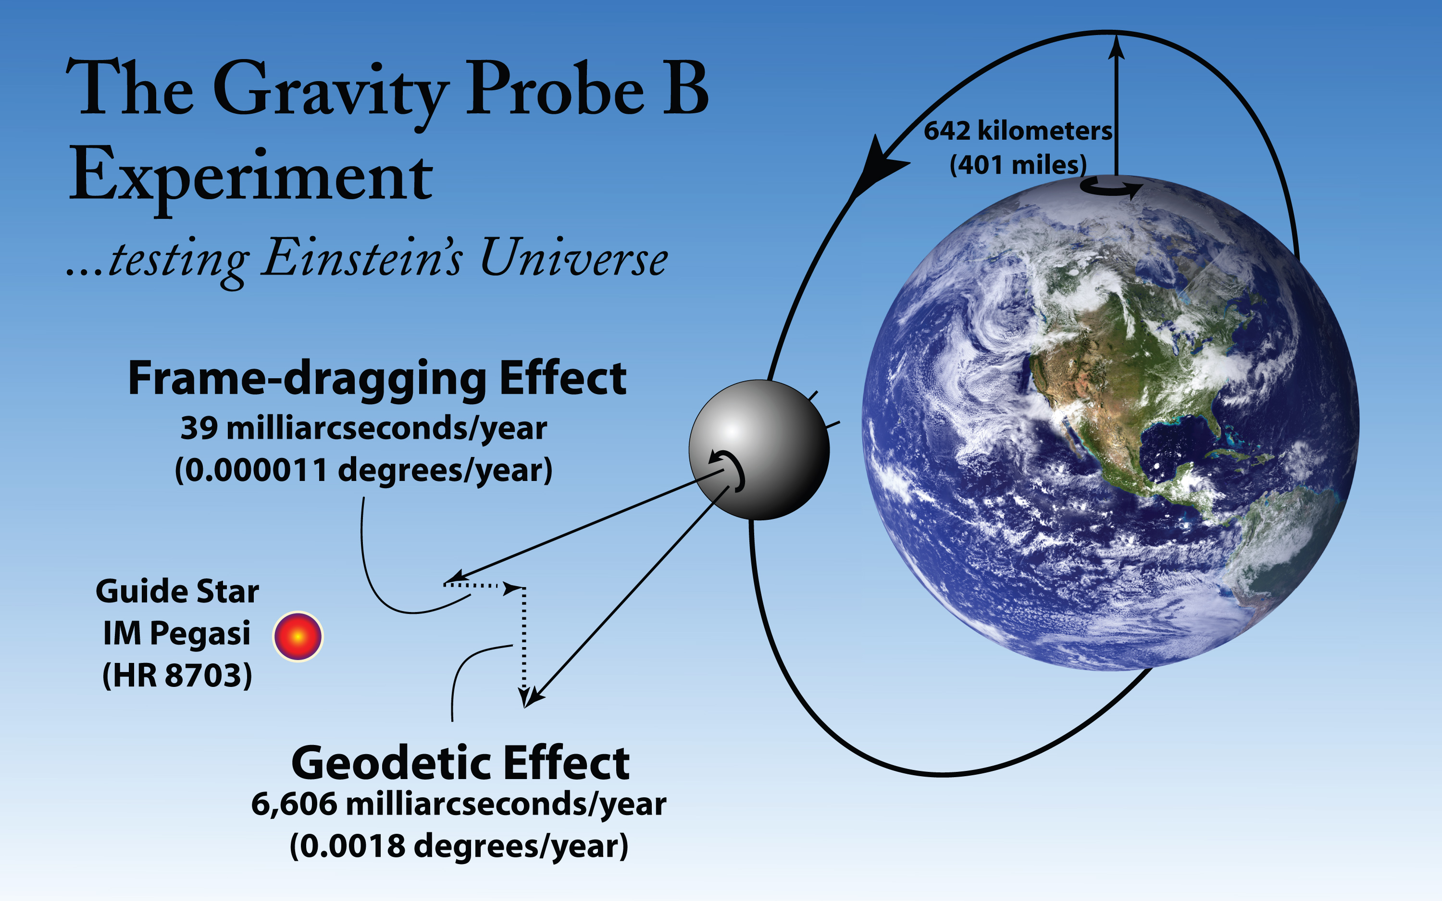
http://einstein.stanford.edu/MISSION/mission1.html
http://einstein.stanford.edu/gallery/

Slide 3
Outline…
Newtonian Gravitation
Gyroscopes in Newtonian Space
Shortcomings of Newtonian Gravity
Einstein’s General Relativity (GR)
Inertial vs gravitational mass
Principal of equivalence
Tests of GR
Gyroscopes in Einstein’s Spacetime
Geodetic effect
Frame-dragging (Lense-Thirring) effect

Slide 4
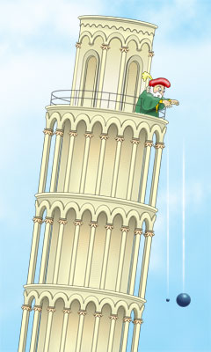
Galileo Galilei
ALL objects fall at the same rate!
Test:
Book and paper
2 spherical balls of different masses
Notes:
Successes

Slide 5
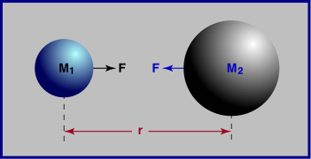
Newton’s Universal Law of Gravitation
Successes:
Described the motion of massive bodies…
…on earth
…in the heavens
Notes:
Successes

Slide 6
Gyroscopes in Newtonian space
According to Newton…
Single absolute time for all inertial observers.
Gravity is a force.
Gyroscope spin axis remains fixed.
http://einstein.stanford.edu/Media/
Notes:
Successes

Slide 7
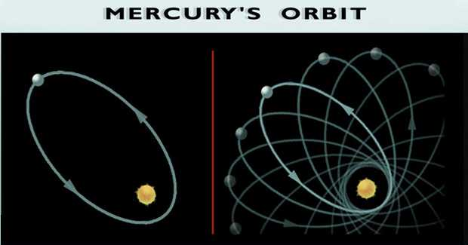
Shortcomings of Newton’s Universal Law of Gravitation…
“Action at a distance”?
Infinite propagation speed?
Mercury’s perihelion precession?

Slide 8
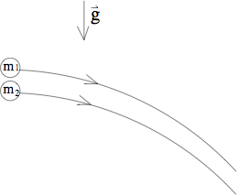
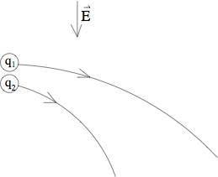
Inertial vs. Gravitational Mass
Newton’s 2ndLaw
Newton’s Law of Gravitation
Force due to Electric field

Slide 9
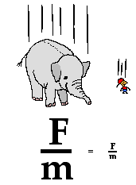
Inertial vs. Gravitational Mass
Eötvös experiment verified
that m_{i} = m_{g} to 1 part in 10¹² !
The Principle of Equivalenceis
All massive objects ‘fall’ at the same rate.

Slide 10
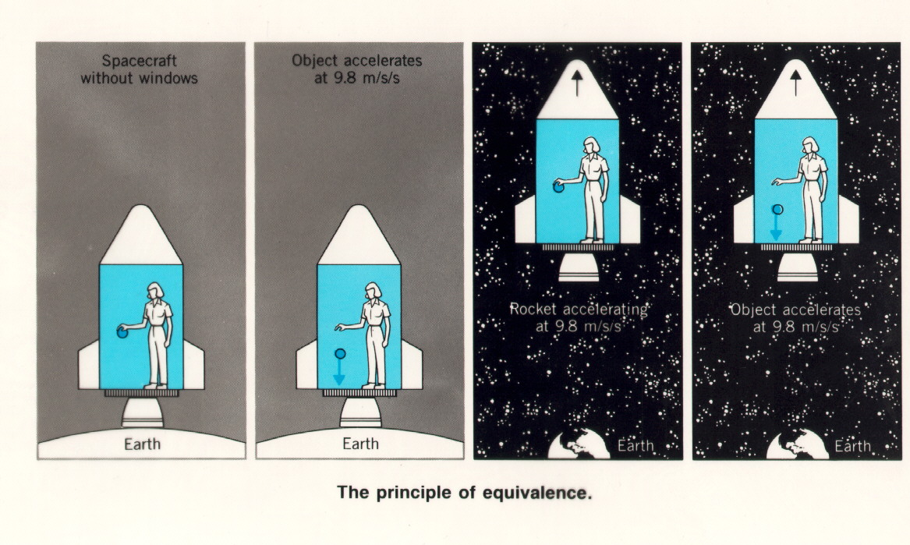
Principle of Equivalence
The motion of freely falling particles is the same in a
gravitational field and a uniformly accelerated frame, in small enough regions of space & time

Slide 11
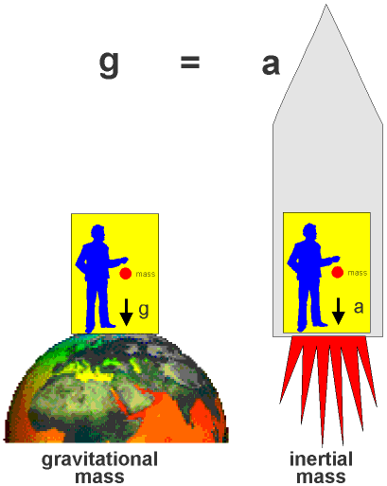
Principle of Equivalence
What about massless particles?
Elevator observer sees light moving in a curved path!
Spacetime is curved!

Slide 12
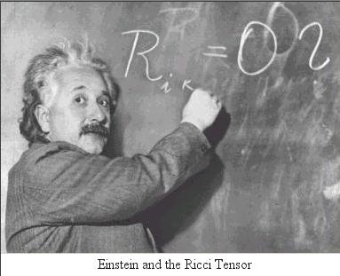
In 1916, Einstein publishes his general theory of relativity
describes the curvature of spacetime
describes the matter&energy in spacetime

Slide 13
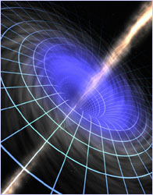
Line element in 4D curved space
is the metric tensor
defines the geometry of spacetime
know , know geometry

Slide 14
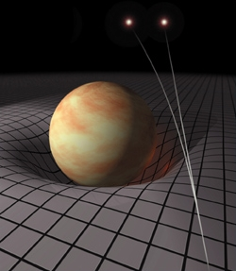
When forced to summarize the general theory of relativity in one sentence; time and space and gravity have no separate existence from matter. - A. Einstein
Matter tells space how to curve,
Space tells matter how to move.
“Spacetime and Geometry” by Sean Carroll, 1st edition,
Pearson publishing

Slide 15
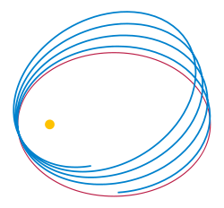
Tests of GR: ‘Extra’ precession of Mercury’s perihelion
Observed precession from Earth-based laboratory is…
Subtract offNewtonian effects:
precession of Earth’s rotation axis
gravitational attraction of other planets
mass quadrupole moment of Sun
Precession unexplained by Newtonian Mechanics:
Predicted precession due to GR:

Slide 16
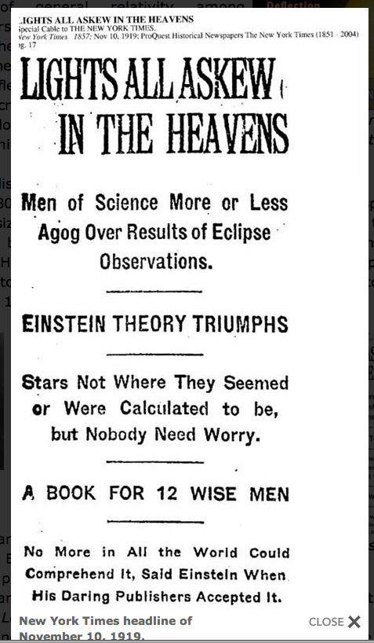
Tests of GR: Deflection of starlight by the Sun
Measurement made by Arthur Eddington in 1919 during a total solar eclipse
1st experimental confirmation of GR!
“

Slide 17
Additional Tests of GR:
Time delay of light
Viking mission to Mars in 1976 (Shapiro et al., 1977)
Experiment was to measure the delay in round trip travel time for a radar signal from Earth to Mars.
Before GP-B, one of the most accurate quantitative tests of GR.
Gravitational radiation effect in binary pulsar
Agreement of observed decrease in orbital period w/ Einstein’s GR for the decrease due to gravitational radiation (better than 1/3% accuracy).
Gravitational Redshift
1st accurate tests by Pound & Rebka (1960) and Pound & Snider (1964)
Used Jefferson Physical Laboratory at Harvard
Confirmed prediction to accuracy of ~ 1%

Slide 18
Geodetic effect…
Consider a gyroscope in orbit around a non-rotating spherical body of mass M (Schwarzschild geometry).
Circular geodesic of radius R.
James B. Hartle, Gravity: An Introduction to Einstein’s GR,
1st ed., pps. 296-308

Slide 19
Geodetic effect…
Gyroscope is described by a spin four-vector
Spin four-vector obeys the gyroscope equation.
One obtains a set of differential equations of the form..
where

Slide 20
Geodetic effect…
After time , gyro completes one orbit.
The angle between and , after one orbit is:
The geodetic precession rate (per year) is…
(per orbit)
(per year)

Slide 21
Geodetic effect…
After time , gyro completes one orbit.
The angle between and , after one orbit is:
The geodetic precession rate (per year) is…
Equivalent to measuring the width of a human hair from 10ft!
(per orbit)
(per year)

Slide 22
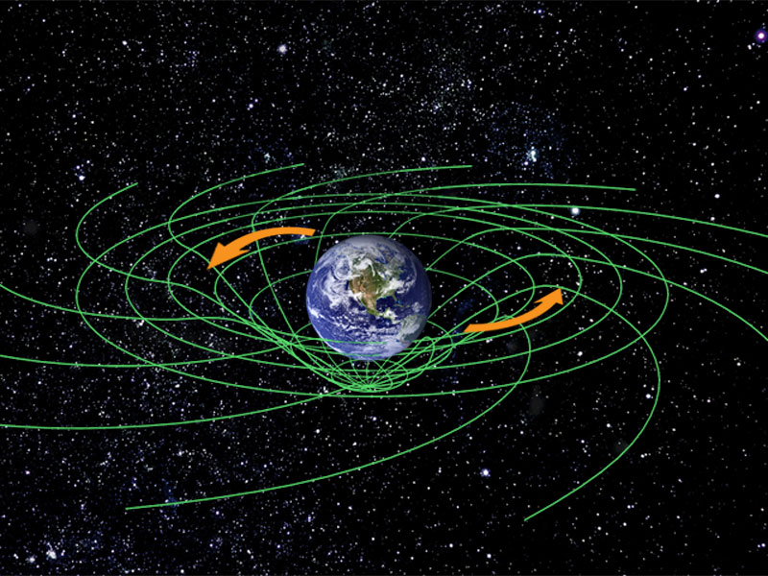
Frame-dragging effect…
Consider a gyroscope in orbit around a rotating spherical body of mass M (weak-field Kerr geometry).
Gyroscope is described by a spin four-vector.
Spin four-vector obeys the gyroscope equation.
The frame-dragging precession rate is…
http://einstein.stanford.edu/MISSION/mission1.html
(per year)

Slide 23
Frame-dragging effect…
Consider a gyroscope in orbit around a rotating spherical body of mass M (weak-field Kerr geometry).
Gyroscope is described by a spin four-vector.
Spin four-vector obeys the gyroscope equation.
The frame-dragging precession rate is…
~ 170 times smaller than the geodetic effect!
http://einstein.stanford.edu/MISSION/mission1.html
(per year)

Slide 24
Gyroscopes in Einstein’s spacetime
http://einstein.stanford.edu/Media/
According to Einstein’s GR…
4D unification of space and time called spacetime.
Gravity is NOT a force, but rather due to curved spacetime.
Gyroscope spin axis precesses.
Notes:
Successes

Slide 25
Gravity Probe B results…
On May 4, 2011, NASA publicly announces the results of Gravity Probe-B…
So, did the results of GP-B verify or refute Einstein’s theory of general relativity?
Notes:
Successes

Slide 26
Gravity Probe B results…
On May 4, 2011, NASA publicly announces the results of Gravity Probe-B…
So, did the results of GP-B verify or refute Einstein’s theory of general relativity?
Professor Bill Tiernan will tell us next week!
Notes:
Successes

Slide 27
Einstein field equations
Subscripts label elements of each tensor
encodes the geometry of spacetime
10 second-order, non-linear differential equations

