Slide 1
Solutions of FRW Cosmology and Inflationary Theory
Chad A. Middleton
Mesa State College
Physics Seminar
February 18, 2010

Slide 2
Cosmology
is the scientific study of the large scale properties of the Universe as a whole.
addresses questions like:
Is the Universe (in)finite in spatial extent?
Is the Universe (in)finite in temporal extent?
What are the possible geometries of the Universe?
What is the fate of the Universe?

Slide 3
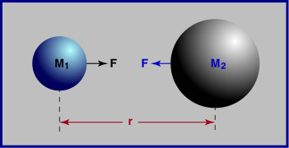
Newton’s Universal Law of Gravitation
Successes
Described the motion of massive bodies…
…on earth
…in the heavens
Notes:
Successes

Slide 4
So what keeps the stars fixed?
Newton’s view of the cosmos: a perfect balance?
Newton envisioned
an infinitely large universe
stars were placed at just the right distances so their attractions cancelled.
Notes:
Successes

Slide 5
Olbers’ Paradox
If the Universe in infinite, unchanging, and everywhere the same, shouldn’t the entire night sky be bright?

Slide 6
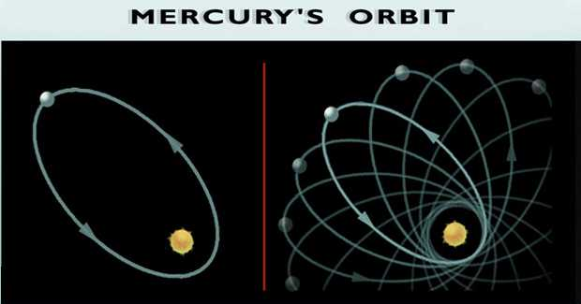
Shortcomings of Newton’s Universal Law of Gravitation…
“Action at a distance”?
Infinite
propagation speed?
Mercury’s perihelion precession?

Slide 7
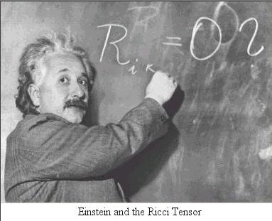
In 1915, Einstein gives the world his General Theory of Relativity
describes the curvature of spacetime
describes the matter & energy

Slide 8
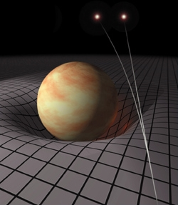
When forced to summarize the general theory of relativity in one sentence; time and space and gravity have no separate existence from matter - Albert Einstein
Matter tells space how to curve
Space tells matter how to move

Slide 9
Einstein’s Static Universe
General Relativity does NOT allow for a static cosmological model
⇒ Einstein introduces a Cosmological Constant
⇒ Static Universe if:
Cosmological Constant

Slide 10
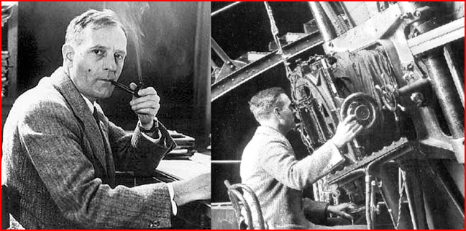
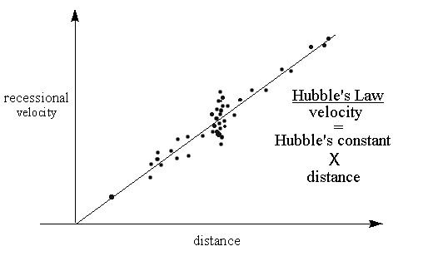
In 1929, Edwin Hubble discovers that the Universe is expanding!
Einstein calls Λ the
“greatest blunder” of his life!

Slide 11
FRW Cosmology basics:
Cosmological Principle
On sufficiently large distance scales, the Universe is
1. Spatially isotropic
2. Spatially homogeneous
⇒ Maximally Symmetric Space

Slide 12
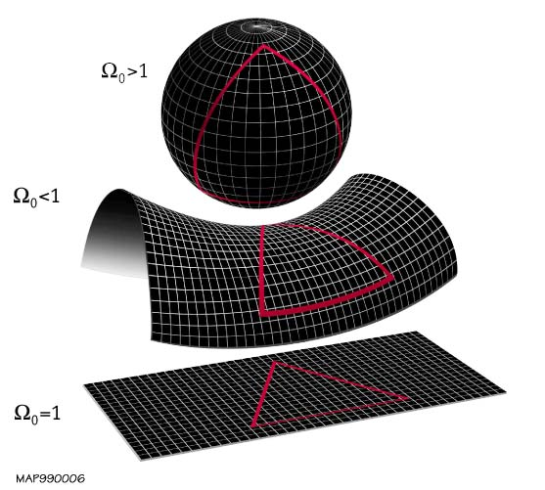
For a Homogeneous & Isotropic Universe… … 3 possible Geometries

Slide 13
The Friedmann equations of FRW Cosmology..
The density (ρ), pressure (p), and curvature (κ ) of the Universe determine the time evolution of the scale factor (a)
The matter & energy content consists of pressureless matter, radiation, and a vacuum energy

Slide 14
Choose an “equation of state”
For radiation:
For pressure-less matter:
For a vacuum energy:

Slide 15
Density as a function of the scale factor
Radiation dominated:
Matter dominated:
Vacuum dominated:
NOTICE:
As t→ 0,
a(t) → 0

Slide 16
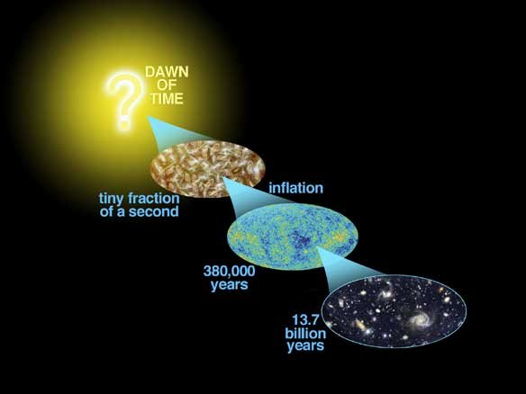
Did the Universe begin with a “Big Bang”??
The “Big Bang” ...
is not an explosion that happened at one point in space
occurred at every place in space @ one moment in time
Big Bang - a time of infinite density, infinite temperature, and infinite spacetime curvature

Slide 17
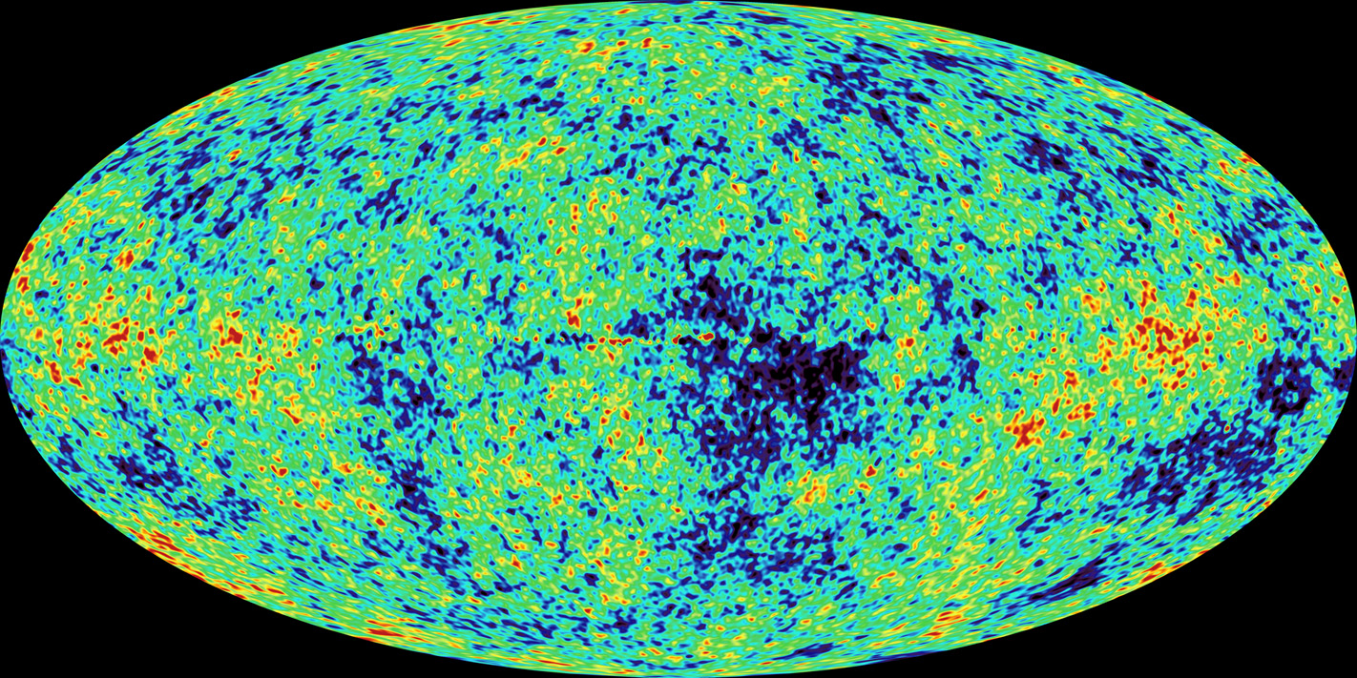
WMAP image of the Cosmic Microwave Background Radiation
Light from when the Universe was 380,000 years old…
Map of μK anisotropies

Slide 18
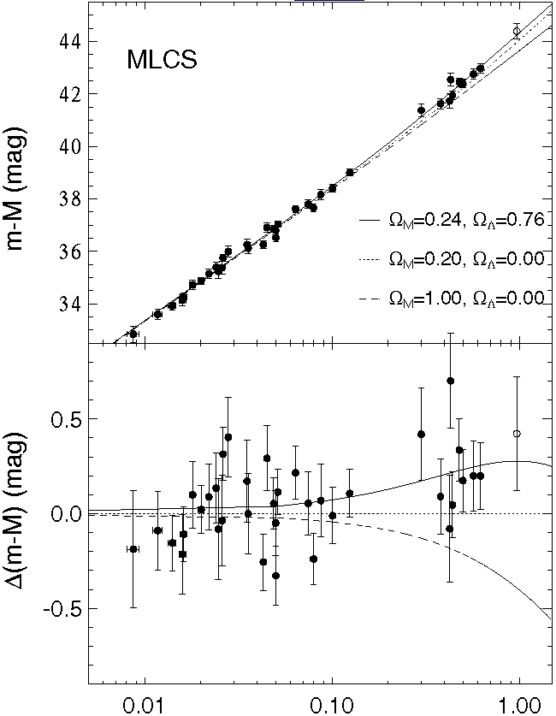
Data from Type Ia Supernovae, WMAP and SDSS implies…
The expansion of the
Universe is ACCELERATING!
The Universe is flat
Seems to indicate a Vacuum Energy
http://nedwww.ipac.caltech.edu/level5/Carroll2/Figures/figure3.jpeg

Slide 19
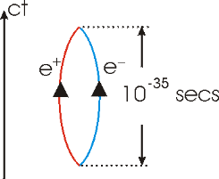
Puzzle 1: The Cosmological Constant Problem?
From the zero-point energies of vacuum fluctuations…
Cosmological observations imply…
Taking the ratio yields..
http://www.upscale.utoronto.ca/GeneralInterest/Harrison/BlackHoleThermo/VirtualPair.gif

Slide 20
The Cosmological Constant Revisited…
Cosmological Constant

Slide 21
Replaced with a vacuum energy..
Vacuum energy
where

Slide 22
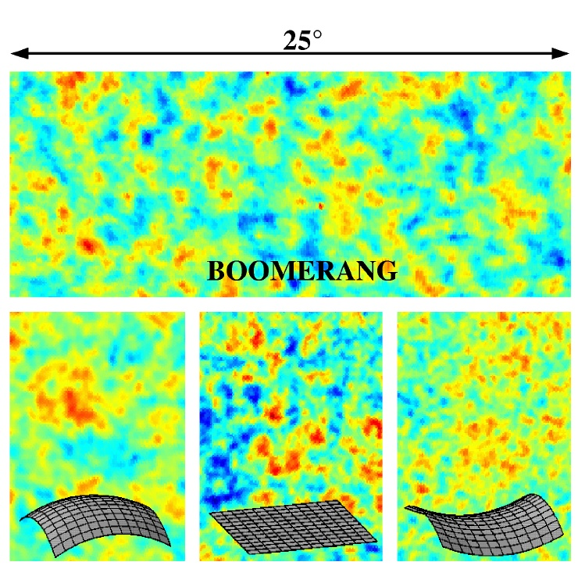
Data from Type Ia Supernovae, WMAP and SDSS implies…
The density parameters:
http://scienceblogs.com-startswithabang-upload-2009-11-dark_energy_beyond_supernovae-model_maps.jpg

Slide 23
The density parameters:
All ordinary matter (stars, galaxies, etc..) comprises only ~4% of the total matter/energy of the Universe!

Slide 24
Puzzle 2: Flatness Puzzle?
Why is the Universe so flat?
The 1st FRW equation can be written as
where the density parameter Ω is

Slide 25
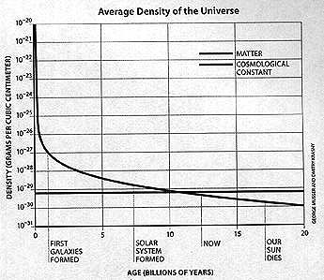
Puzzle 3: Cosmic Coincidence Problem?
Why is the vacuum energy of the same order of magnitude as the matter density?
Mathematically:
Why is ?
In general:

Slide 26
Conclusions
Theory & observational evidence indicate that:
the Universe is flat & infinite in spatial extent
the Universe began w/ a “Big Bang” ~ 13.7 billion years ago
the Universe is undergoing an accelerated expansion
the Universe will continue to expand indefinitely

Slide 27
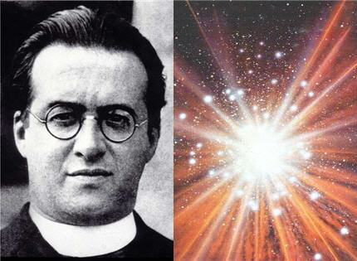
Georges Lemaître suggests the Universe had a temporal beginning..
Belgian Astrophysicist/ Catholic Priest
1927 paper in Annals of the Brussels Scientific Society
Lemaître…
showed that the universe had to be either contracting or expanding.
suggested that the Universe had a definite beginning in which all its matter and energy were concentrated at one point.

Slide 28
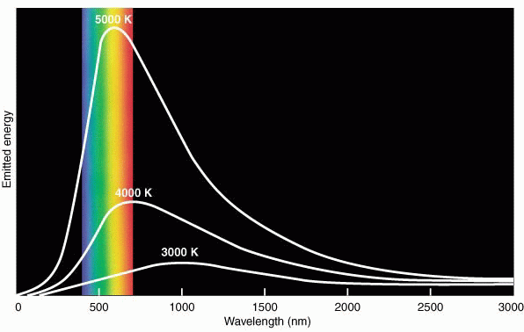
In the early 1960’s, the Princeton group in gravitational physics…
finds that the Universe should be uniformly bathed in a background microwave radiation
predicts a blackbody spectrum of the background radiation w/ T ~ 10K

Slide 29
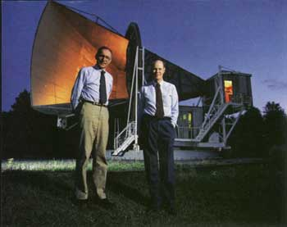
In 1965, observational evidence for the Big Bang!!
Arno Penzias & Robert Wilson
Bell Lab Physicists calibrating the Bell Labs microwave antenna designed for satellite communications
Awarded the 1978 Nobel Prize in physics for discovery of the Cosmic Microwave Background Radiation

Slide 30
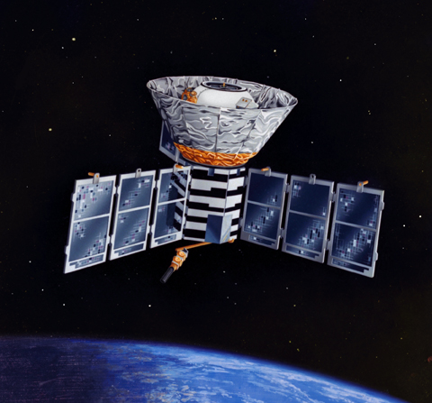
Yeah, but does this microwave background radiation have a Blackbody Spectrum?
In Nov ‘89, NASA launches the Cosmic Background Explorer (COBE) to measure…
the spectrum
the anisotropies
of the cosmic background radiation.

Slide 31
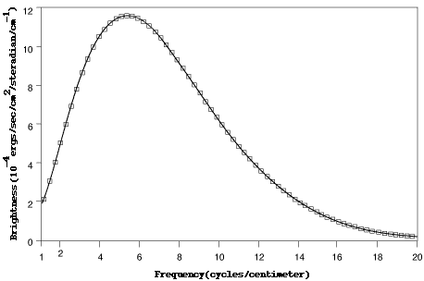
Spectrum of the Cosmic Microwave Background Radiation
John Mather & George Smoot
Awarded the 2006 Nobel Prize in physics “for their discovery of the blackbody form and anisotropy discovery of the CMB”
The excellent agreement with Planck’s law is the best fit ever measured!

Slide 32
For a matter or radiation dominated Universe
LHS must diverge w/ time; Ω = 1 is an unstable fixed point!
From observation:
At BBN, let
Universe would have collapsed in a “Big Crunch” or expanded to a “Big Chill” in a few years!!
1 part in 30 trillion!
Now
Big Bang Nucleosynthesis

Slide 33
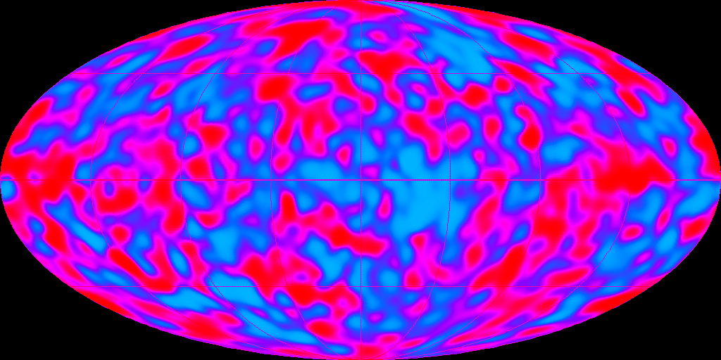
Puzzle 2: Horizon Problem
Why is the CMB uniform on large scales ?
2 antipodal CMB photons are causally disconnected yet have same temperature to 1 part in 10⁵! Why?

Slide 34
Puzzle 3: Initial Jump Start?
The 2nd FRW equation is
for ordinary matter, ∴
So what got the Big Bang going in the 1st place?

Slide 35
Puzzle 4: Structure of the Universe
Where did the regions of slightly enhanced density in the early Universe originate from?

Slide 36
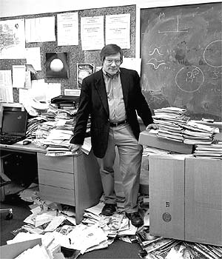
The Inflationary Solution
In 1981, M.I.T. professor Alan Guth realizes that these cosmological puzzles could be solved by considering particle physics.
Grand Unified Theory (GUT) = marriage of 3 of 4 fundamental forces
In early Universe, strong force “freezes” out releasing enormous amounts of energy

Slide 37
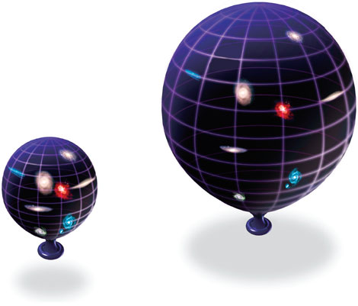
Inflation to the Rescue
Supplement to Big Bang Cosmology
All Big Bang puzzles are solved by this one beautifully simple idea.
Early Universe expands by a factor of 10³⁰ in less than 10⁻³⁶ seconds!

Slide 38
Inflationary Theory
Consider a scalar-field coupled to gravity
where
and where V(φ) describes the self-interaction of the scalar field

Slide 39
Inflationary Theory
For the FRW metric & a homogeneous field φ(t), the dynamics of φ(t) & the geometry are determined by
Notice: mimics Newton’s 2nd Law for a particle being accelerated by a force ~-dV/dφ & impeded by a “Hubble friction” term

Slide 40
Inflationary Theory
The scalar field reaches “terminal velocity” when
For “Slow-Roll” inflation…
are small

Slide 41
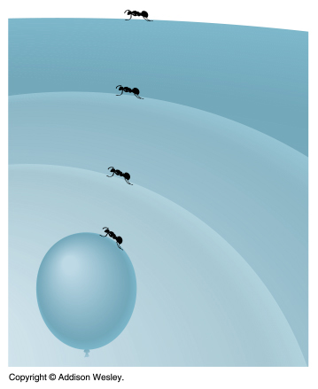
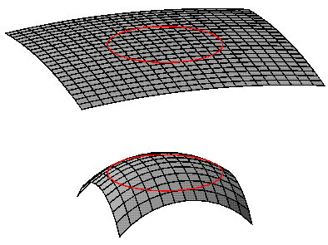
Flatness Puzzle Revisited
Inflation drives the Universe towards flatness
Ω = 1 is an attractor for large t!

Slide 42
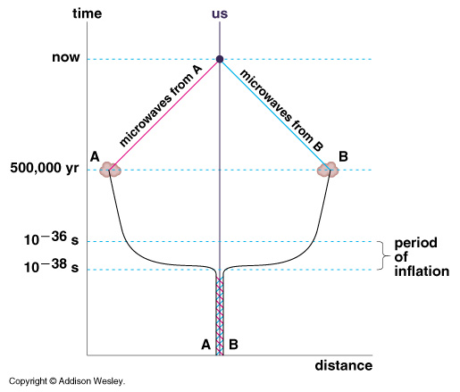
Horizon Puzzle Revisited
During Inflation, the Universe undergoes superluminal expansion to acausal distances
The Universe is smooth on large scales because it was close together & in a state of thermal equilibrium prior to inflation

Slide 43
Initial Jump Start Puzzle Revisited
The scale factor during Inflation
∴
Inflation got the Big Bang going in the 1st place!

Slide 44
Structure of the Universe Revisited
Slightly enhanced density regions?
Quantum perturbations in de Sitter space ⇒ Classical primordial density fluctuations

Slide 45
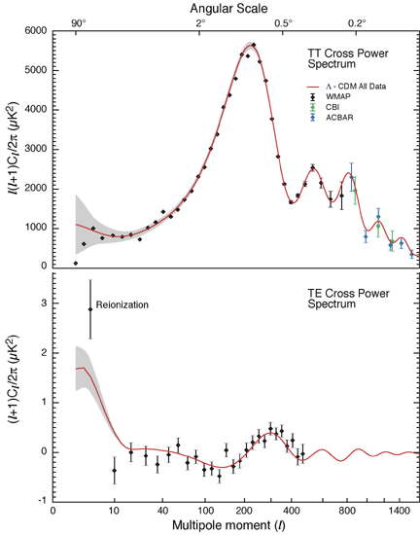
Detailed analysis of temperature variations in CMB
Red curve shows prediction of inflation using matter & energy densities and expansion rates similar to observed values!

