Slide 1
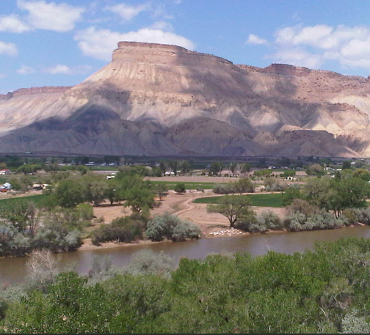
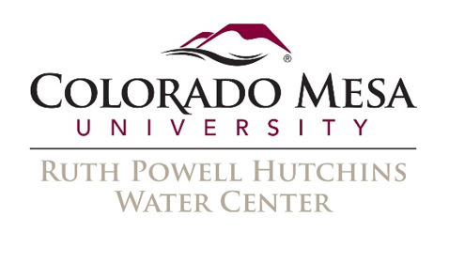
Drought and the Colorado River
How drought is affecting the River, the Grand Valley, and those who rely on it
By: Joel Sholtes and
Holly Stanley

Slide 2
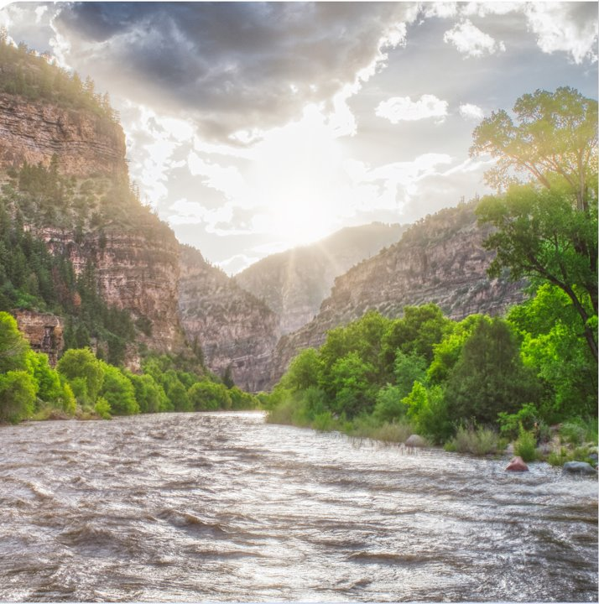
The Colorado River
Forty million people in seven states rely on the Colorado River every day
The temperature outside is increasing because of climate changes. Every time the temperature outside increases by 1 degree, the amount of water in the Colorado River decreases by 5%
For 22 years, drought has been affecting the American West and has caused water levels on the Colorado River to decrease
This means that there is less water available for plants, wildlife, and people
https://cwcb.colorado.gov/colorado-water-plan

Slide 3
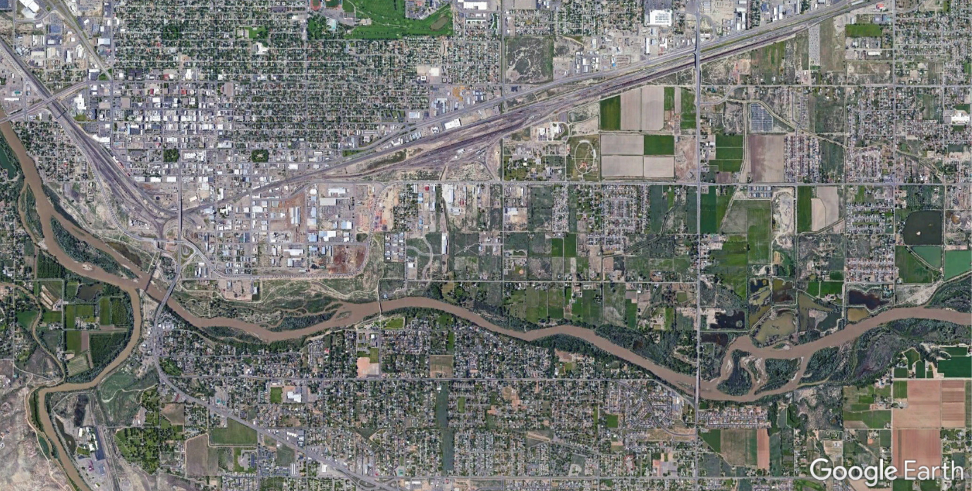
The “Grand” Junction!
Colorado River
Gunnison River

Slide 4
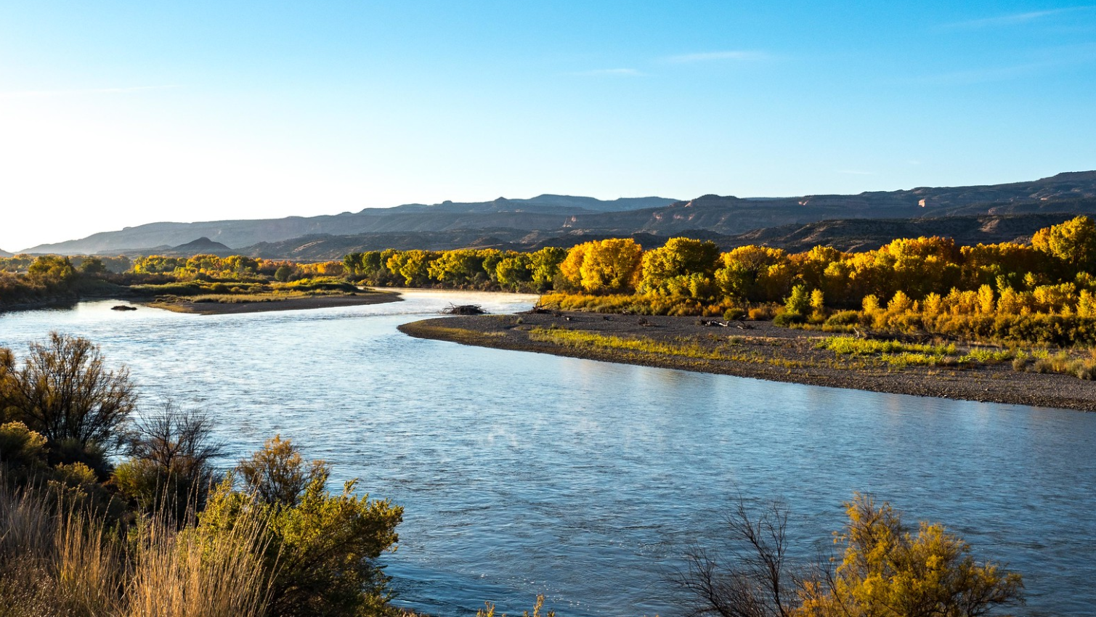
Where does the water in our creeks and rivers come?

Slide 5
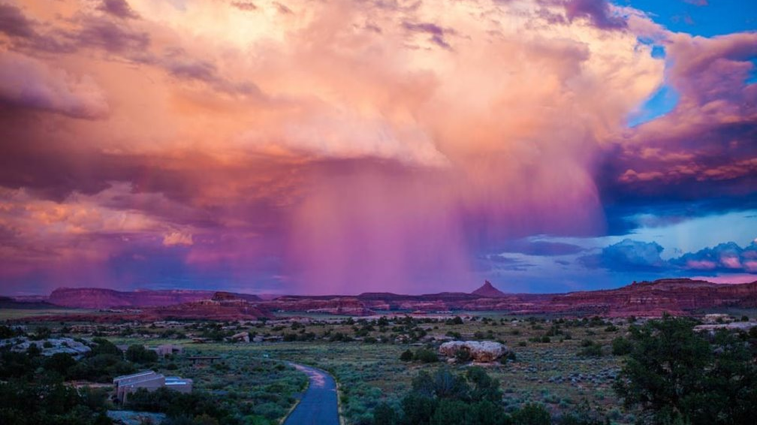
Summer Thunderstorms?

Slide 6
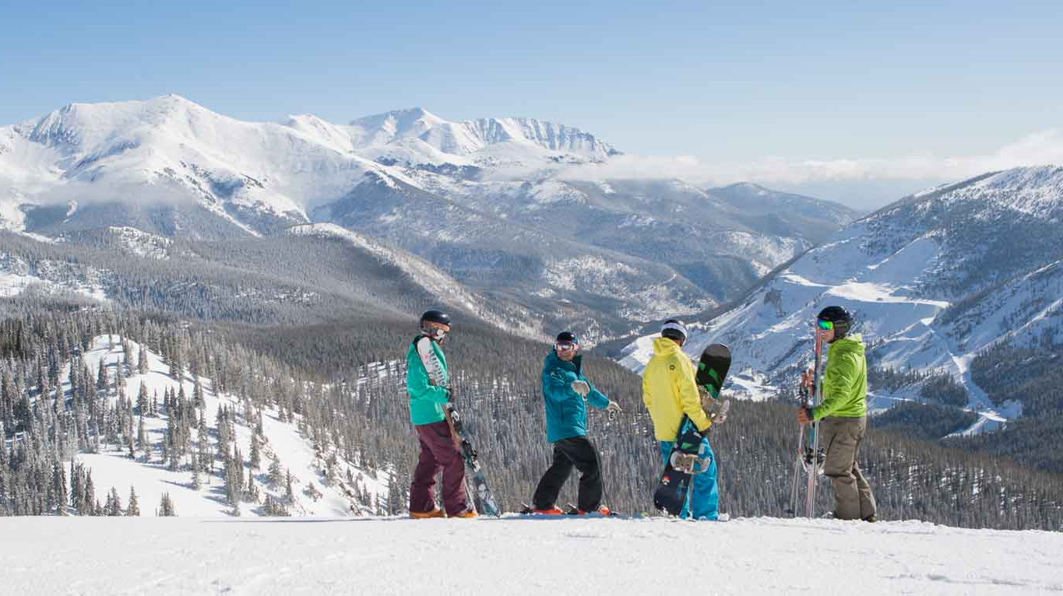
Snow!

Slide 7
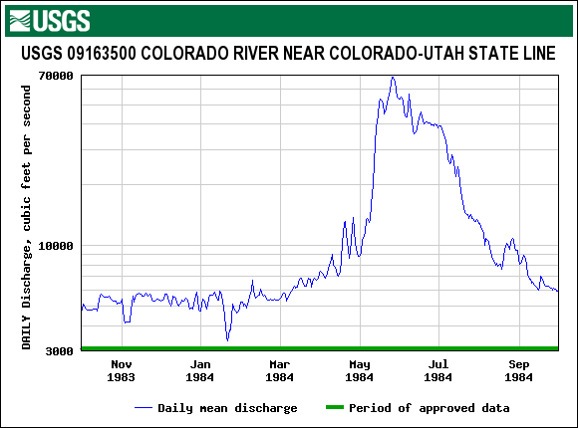
Hydrograph
Snow Melting
Snowmelt Runoff
https://waterdata.usgs.gov/nwis/uv?09163500

Slide 8
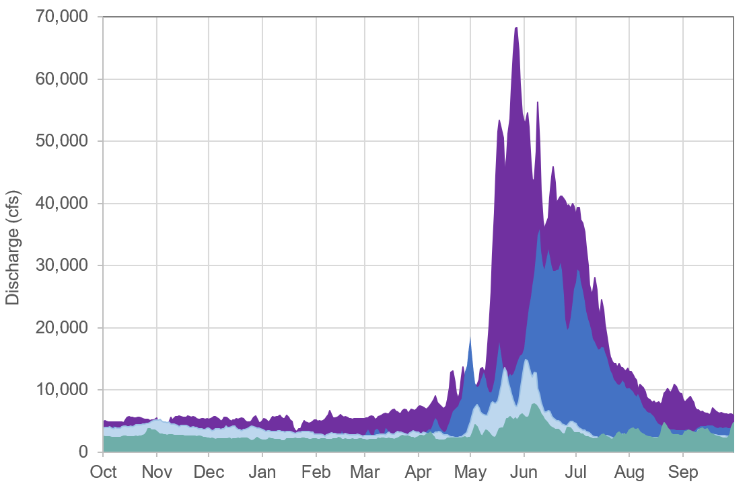
Good Years… and Bad years
USGS Gage at Colorado-Utah State Line
1984
2019
2020
2021
https://waterdata.usgs.gov/nwis/uv?09163500

Slide 9


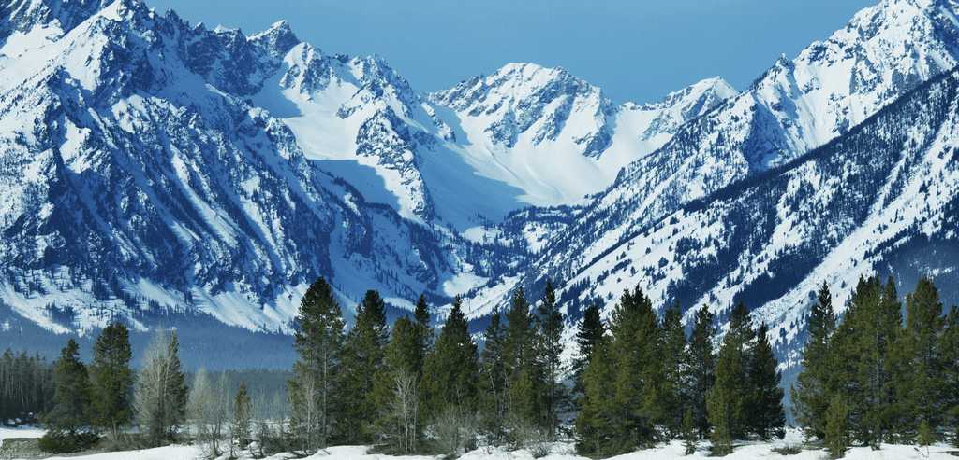


What happens in our rivers when the mountains get a lot of snow?

Slide 10
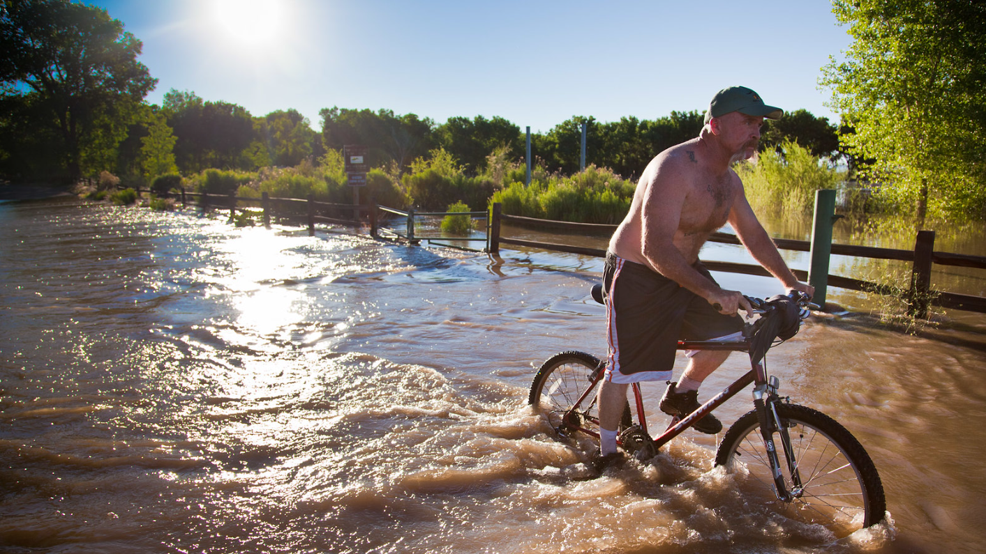

Slide 11
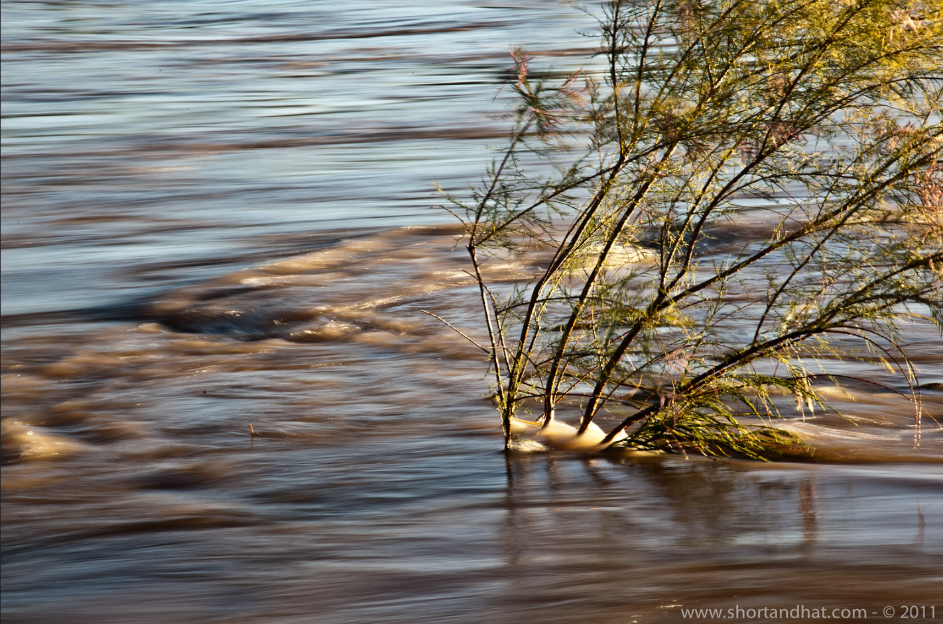
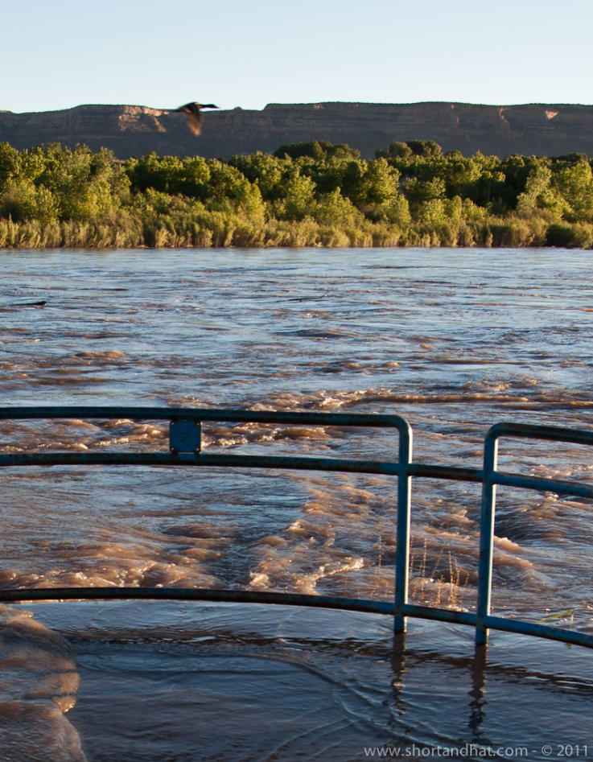
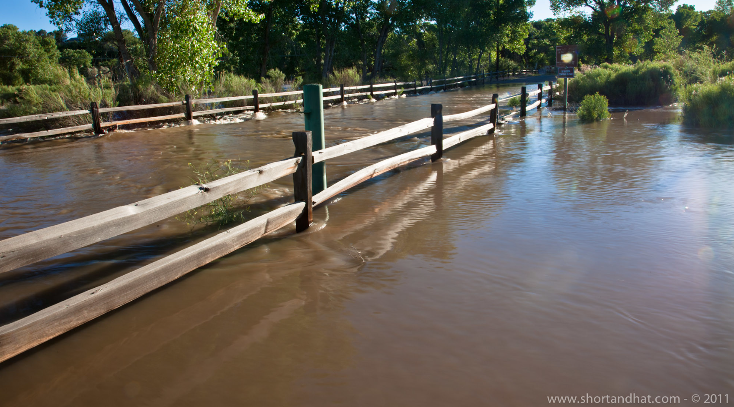
High River Flow Years

Slide 12
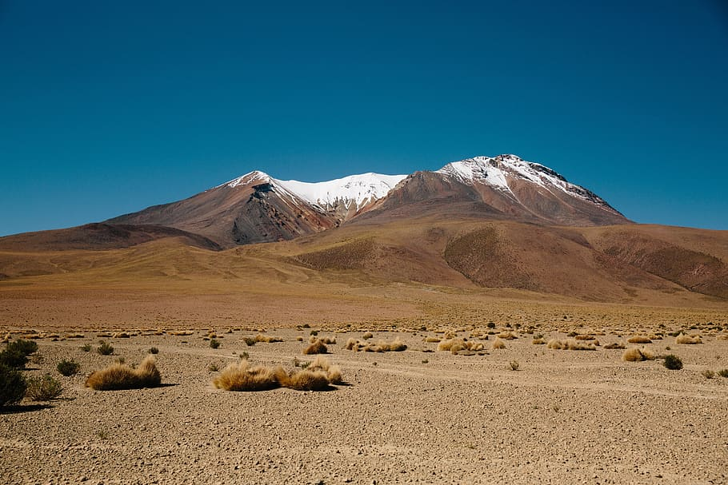



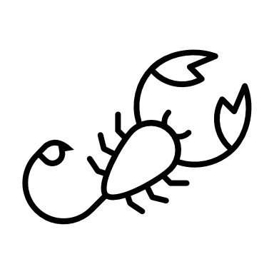
What happens in our rivers when the mountains do not get a lot of snow?

Slide 13
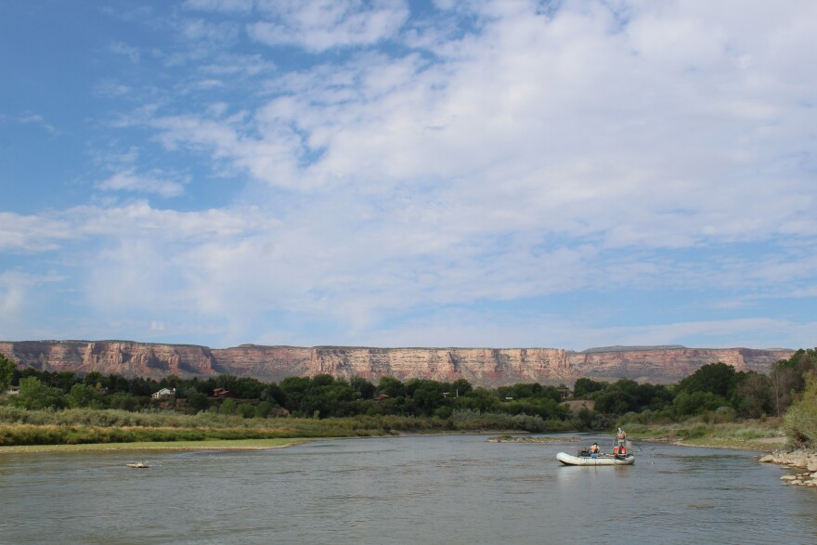
Low River Flows Years

Slide 14
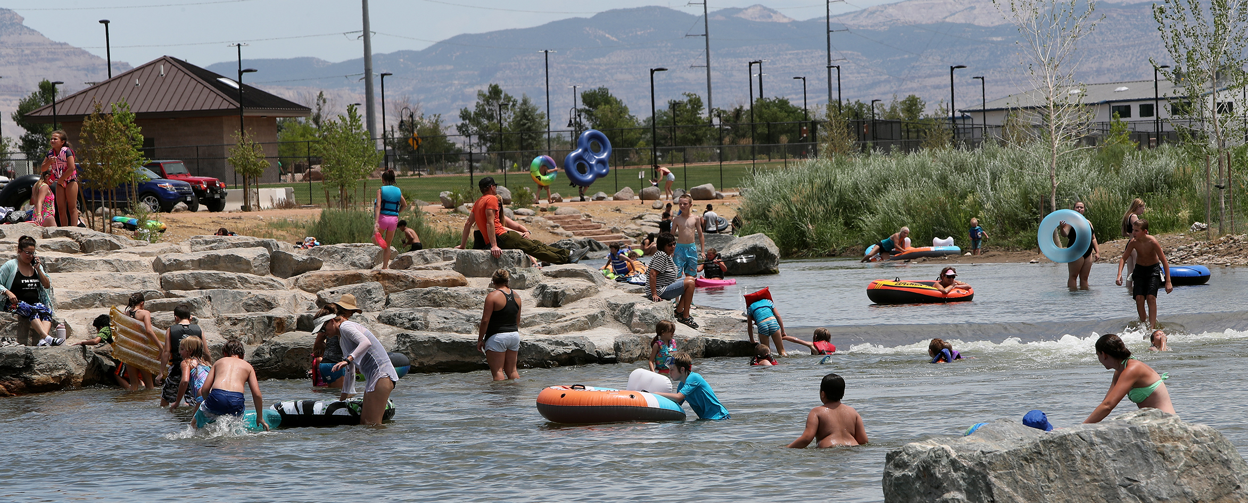
Has anyone been to the River Park at Las Colonias?

Slide 15
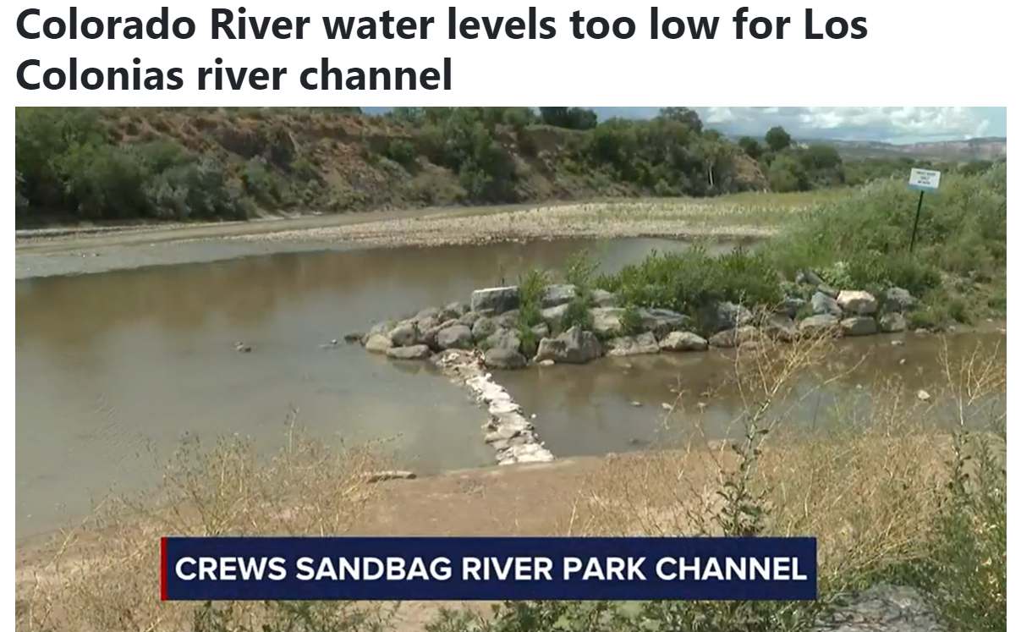
https://www.nbc11news.com/2022/07/27/colorado-river-water-levels-too-low-los-colonias-river-channel/

Slide 16
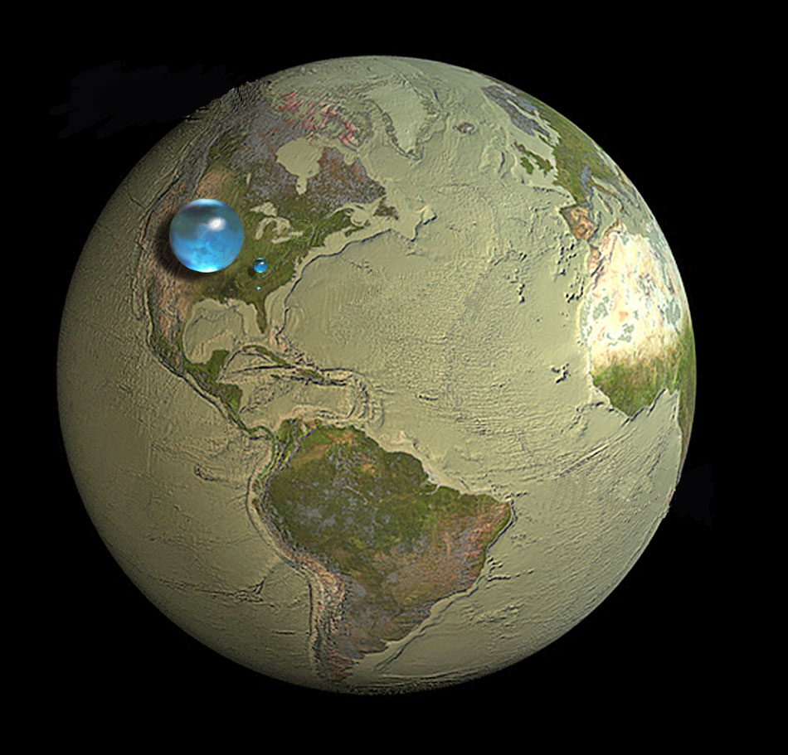
Where in the World is Our Water?
Big blue marble: All the water on our planet (oceans, lakes, rivers, ice)
Small blue marble: All fresh water (lakes, rivers, ice)
Teeny-tiny blue marble: All freshwater that humans can use (lakes, rivers, groundwater)
Credit: Howard Perlman, USGS; globe illustration by Jack Cook, Woods Hole Oceanographic Institution (©); Adam Nieman.
Data source: Igor Shiklomanov's chapter "World freshwater resources" in Peter H. Gleick (editor), 1993,
Water in Crisis: A Guide to the World's Fresh Water Resources (Oxford University Press, New York).

Slide 17
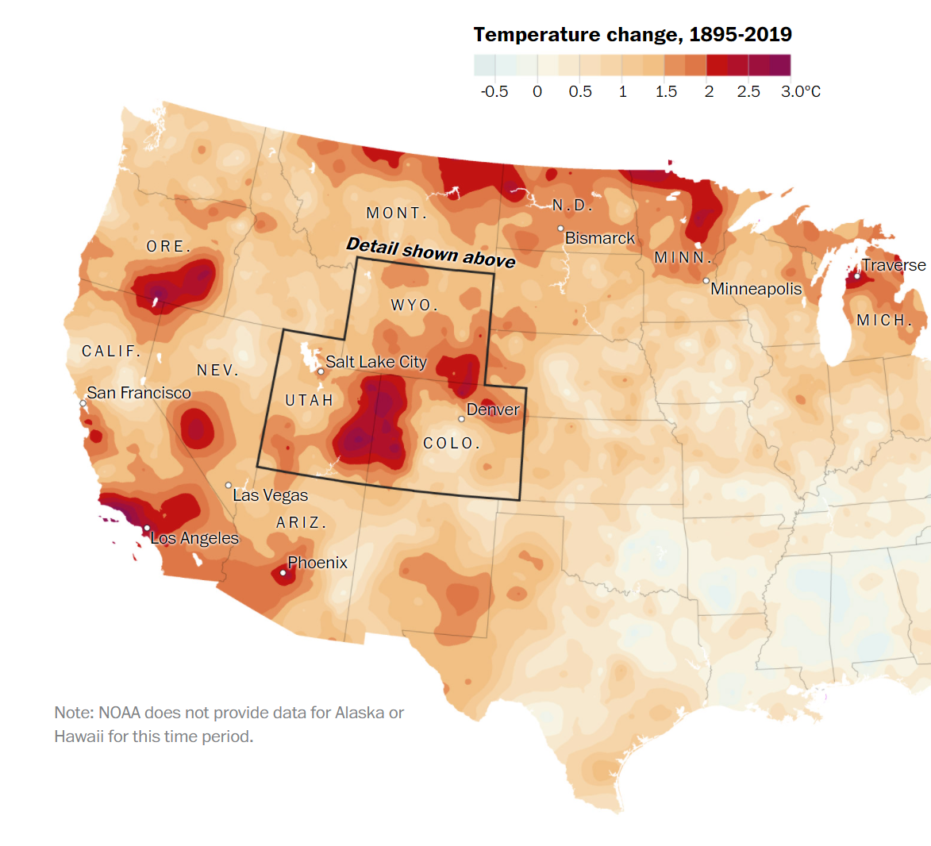
It’s Getting Hot in Here
https://www.washingtonpost.com/graphics/2020/national/climate-environment/climate-change-colorado-utah-hot-spot/

Slide 18
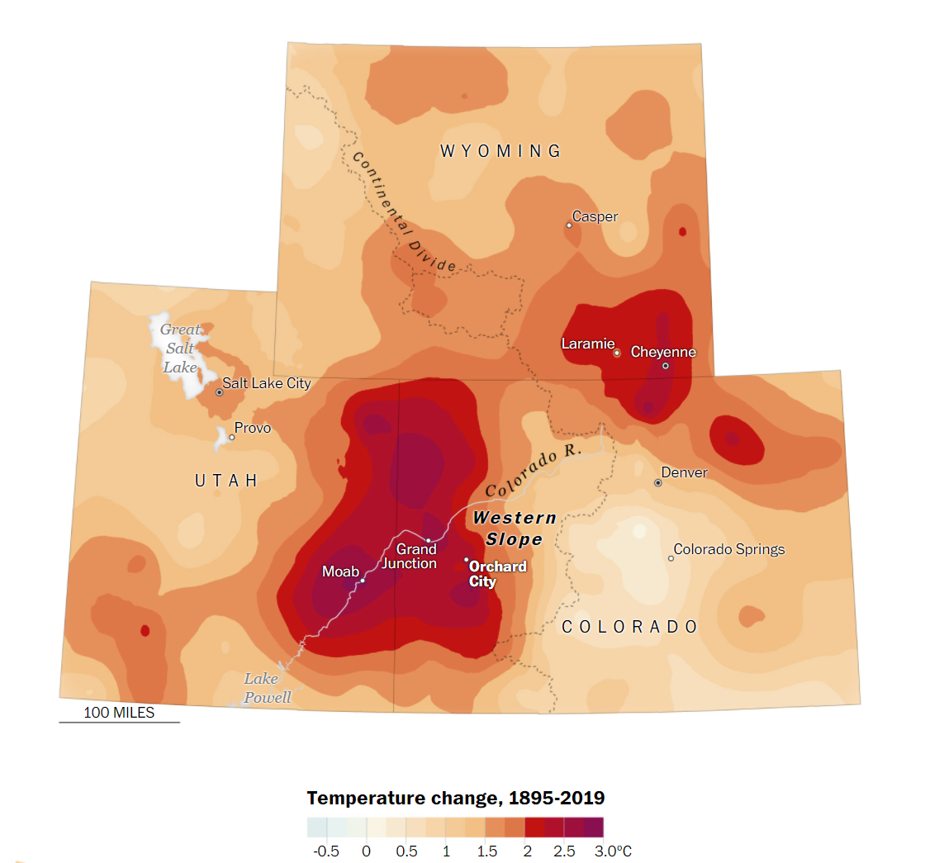
Climate Change
Hot Spot
https://www.washingtonpost.com/graphics/2020/national/climate-environment/climate-change-colorado-utah-hot-spot/

Slide 19
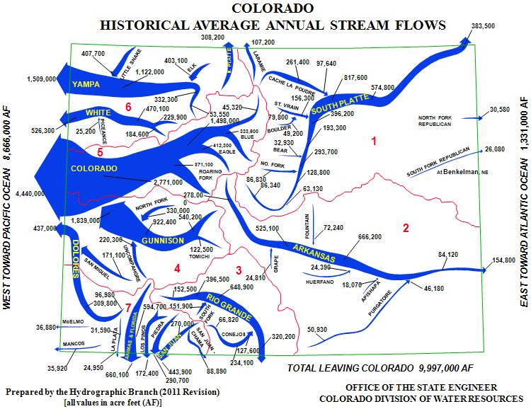
Where Does the Water go in Colorado?

Slide 20
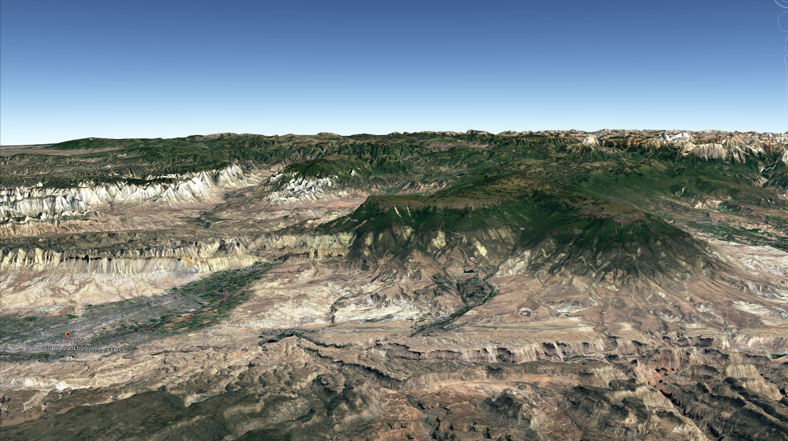
Let’s look at our local mountain: The Grand Mesa

Slide 21
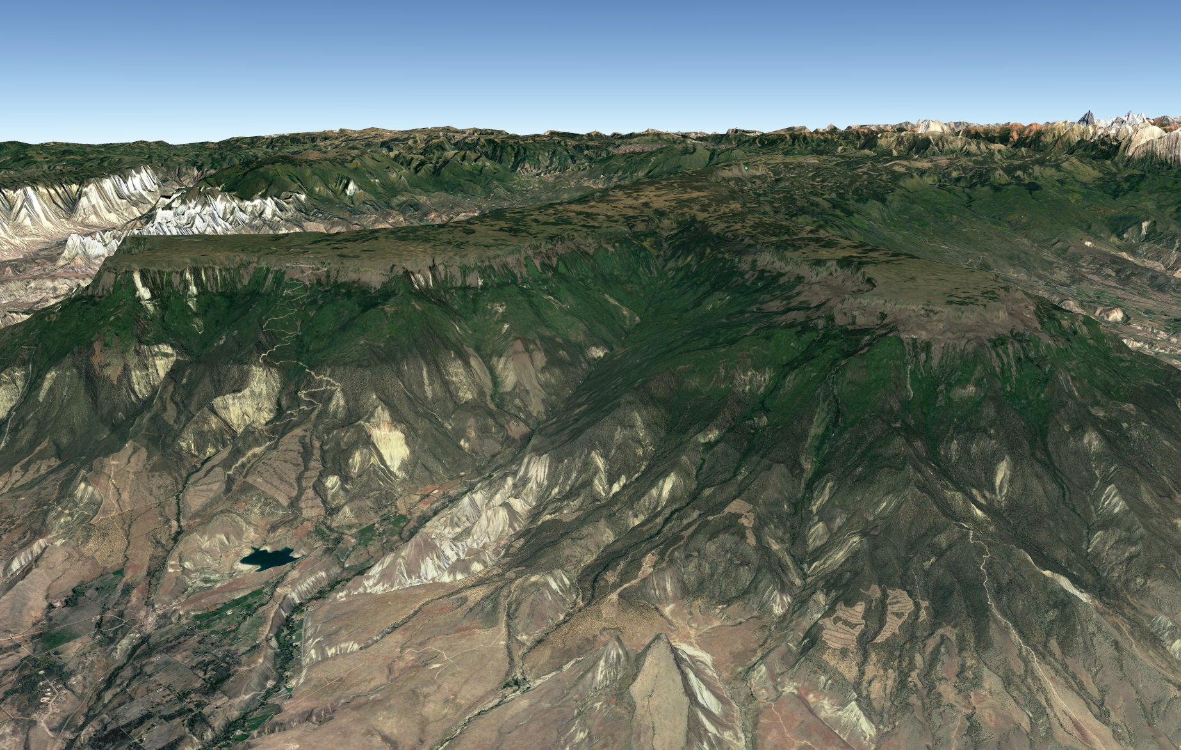

Slide 22
Kannah Creek

Slide 23
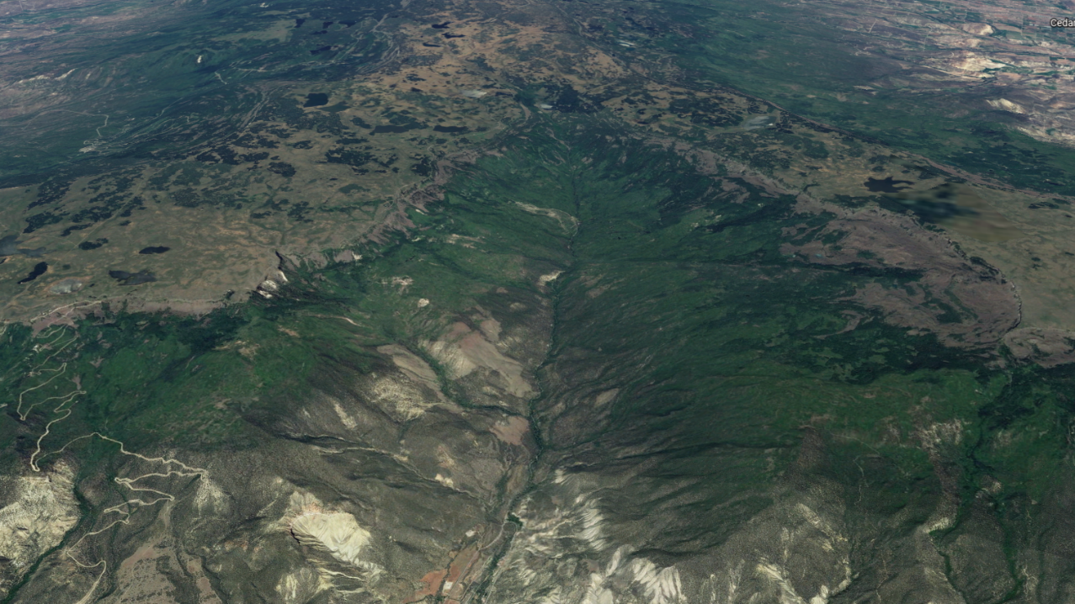
Kannah Creek
Watershed

Slide 24
Kannah Creek
Watershed
Do you know what a watershed is?

Slide 25
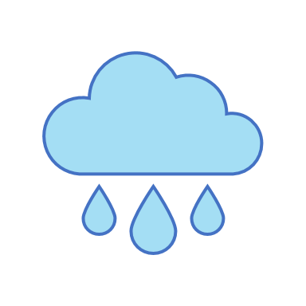

Slide 26

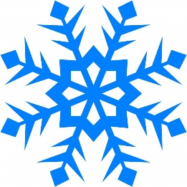
Precipitation
Precipitation

Slide 27
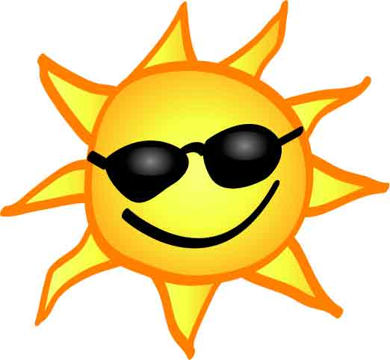
Precipitation
Evapotranspiration
Sublimation
Precipitation – Evapotranspiration – Sublimation

Slide 28
Precipitation
Evapotranspiration
Sublimation
Surface and Subsurface Runoff
Precipitation – Evapotranspiration – Sublimation = Runoff

Slide 29
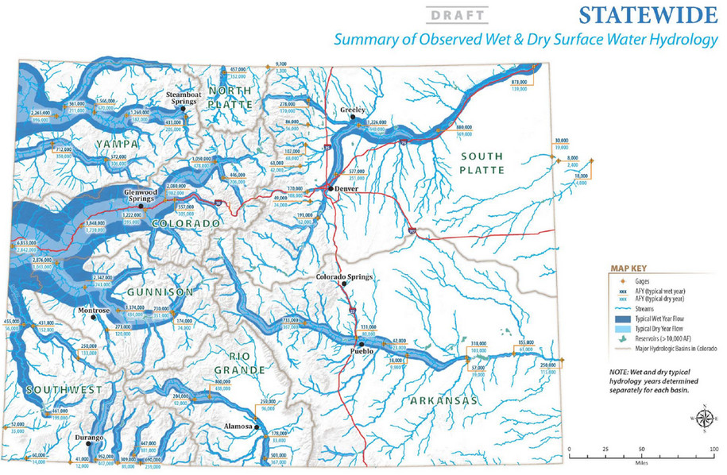
Runoff Distribution in Colorado

Slide 30
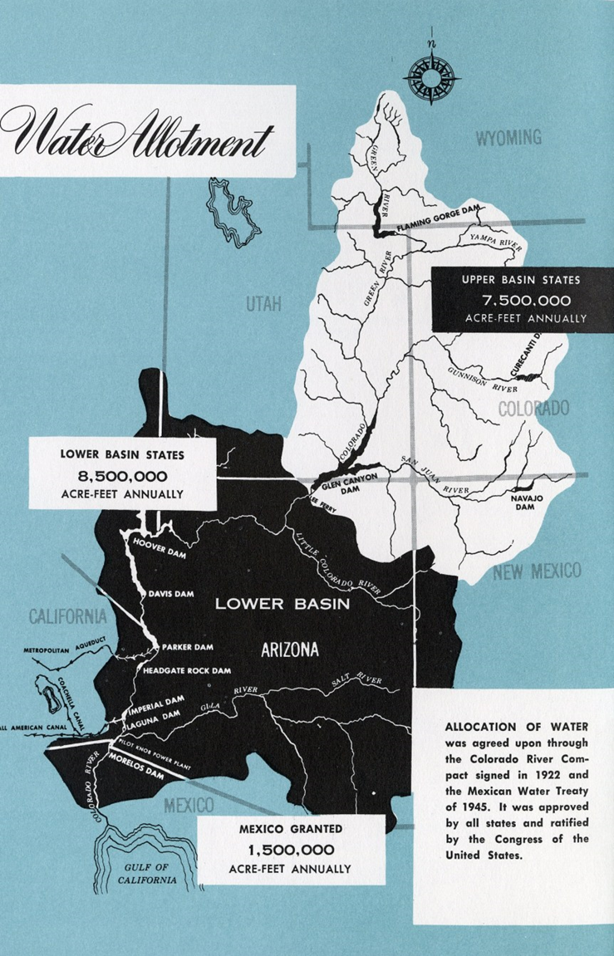
The Colorado River Watershed
Most of the snow and rain falls in Colorado and Wyoming
We must share all that water with Arizona, California, and Mexico
Recently, there has not been enough water for everyone to the same amount they are used to using.
We must find a way to share less water fairly.

Slide 31
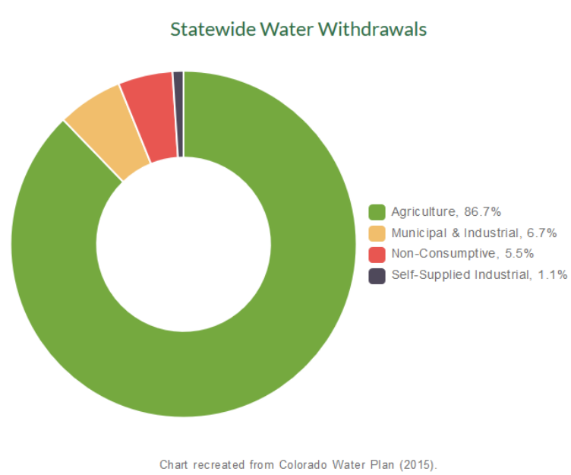
How do we use water in Colorado?

Slide 32
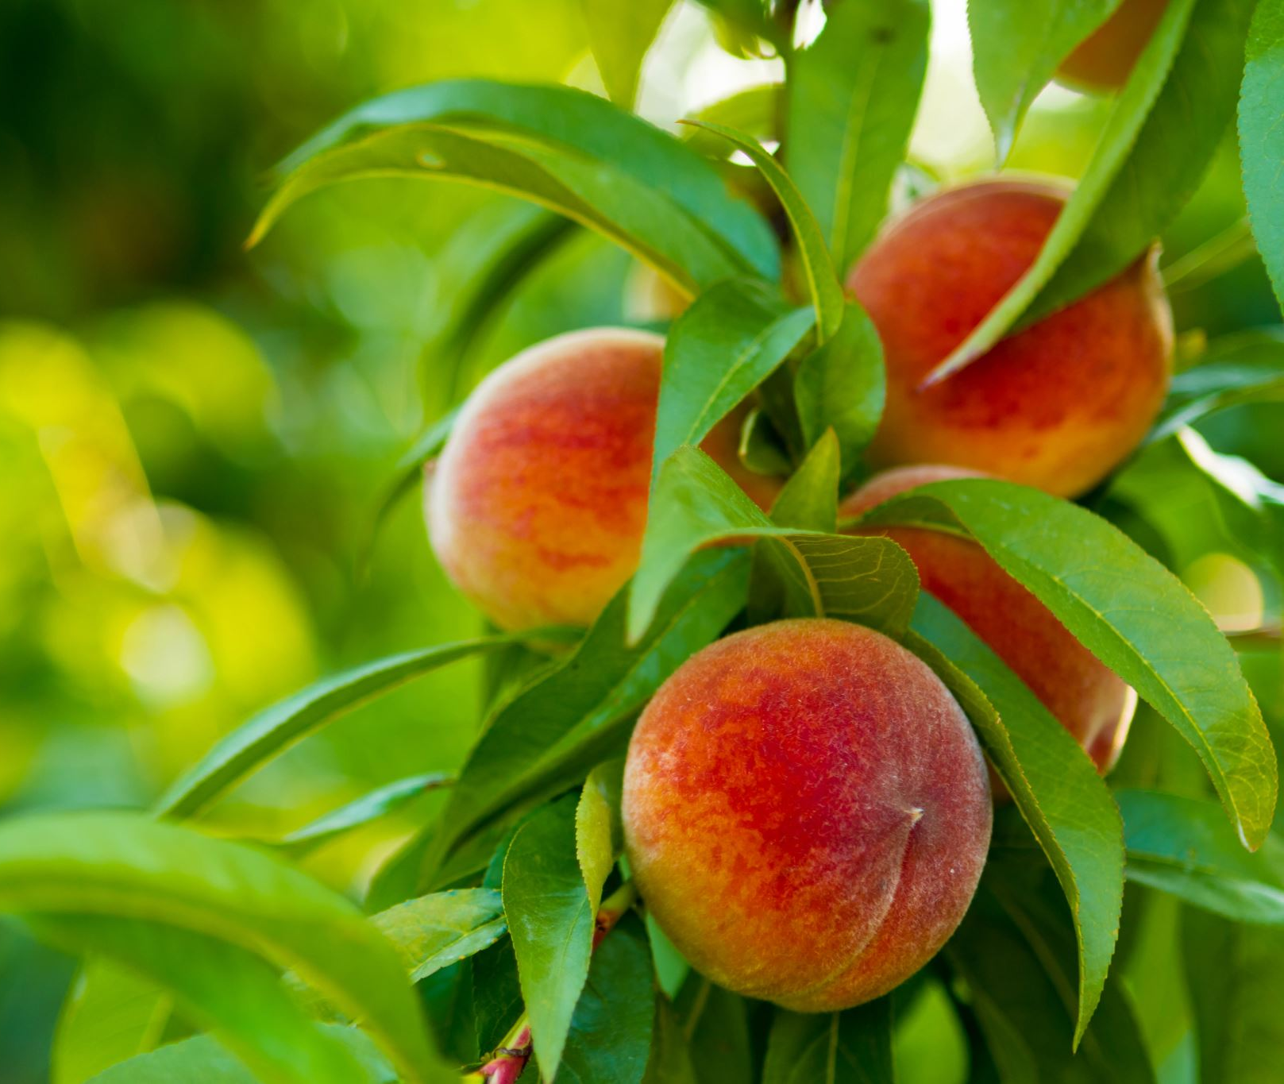
Plants
The Colorado River waters nearly 6 million acres of farmland which creates $5 billion a year.
On the Western Slope of Colorado, we grow plants that provide food for our state, our country, and the world. Farming is an important part of our identity and our heritage.
https://www.waltonfamilyfoundation.org/stories/environment/
farmers-and-ranchers-lead-the-way-on-conserving-the-colorado-river

Slide 33
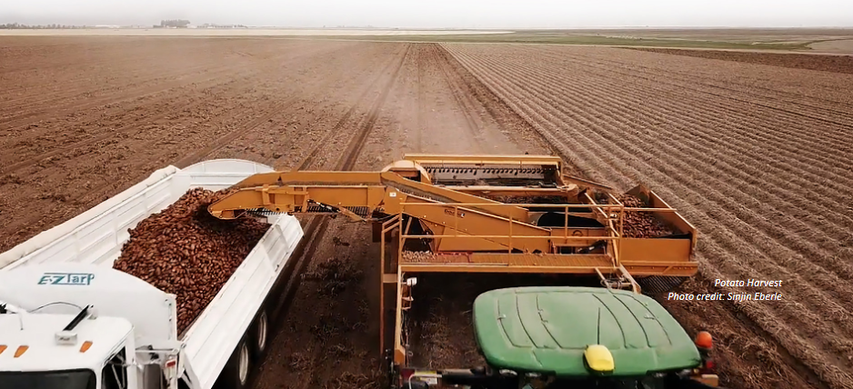
Impacts of Drought on Agriculture
Farming Water Gaps
Not enough water for everyone in the Western United States
This may change how well crops can grow, the amount and types of crops grown, as well as how many fields a farmer is able to water (less crop fields)
https://dnrweblink.state.co.us/CWCB/0/edoc/219188/Colorado_WaterPlan_2023_Digital.pdf

Slide 34
Can you name some food we grow in the Grand Valley?
How could farmers be affected by climate change/drought?

Slide 35
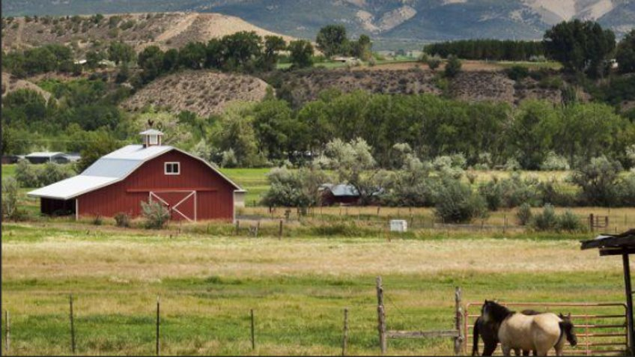
Wildlife
The Colorado River is an environmental wonder and home to countless animal species. All these animals could be affected by drought.
https://www.waltonfamilyfoundation.org/stories/environment/
farmers-and-ranchers-lead-the-way-on-conserving-the-colorado-river

Slide 36
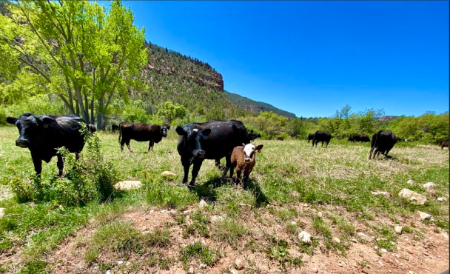
The Colorado River and its tributaries help support many ranches

Slide 37
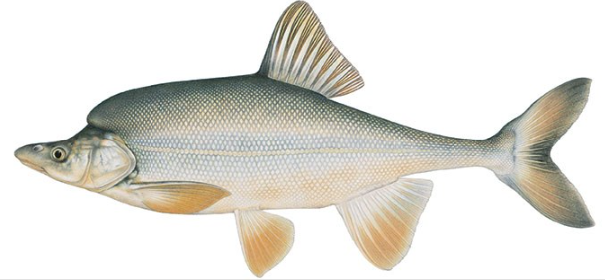
Colorado Native Threatened Species
The Colorado River is also home to the humpback chub, a threatened species of fish that looks like what you would get if you crossed a carp and a bison.
https://www.nationalgeographic.com/animals/article/this-odd-colorado-river-fish-faces-an-uncertain-future

Slide 38
Impacts of Drought on Wildlife
Drought can affect the amount of water wildlife have available and this can lead to a loss of places where animals can live and where they eat
Warming climate can create a mismatch between when more water is available and when fish need extra water
Drier conditions can cause higher water temperatures which is bad for animals that live in and around the Colorado River
Drought lowers the amount of water in streams, rivers, and in the ground

Slide 39
What are some animals that you can think of that need the Colorado River to survive?
How could they be
affected by drought?

Slide 40
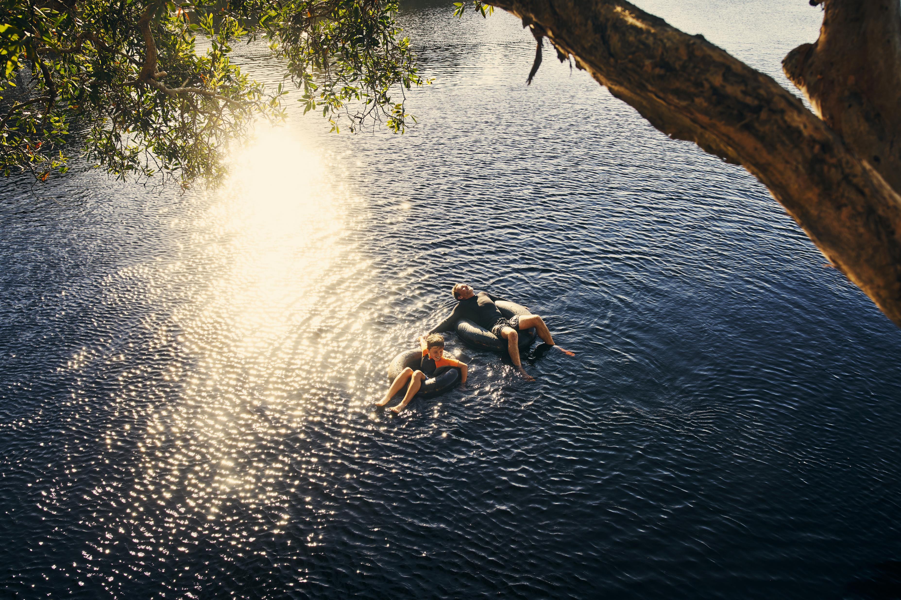
HUMANS

Slide 41
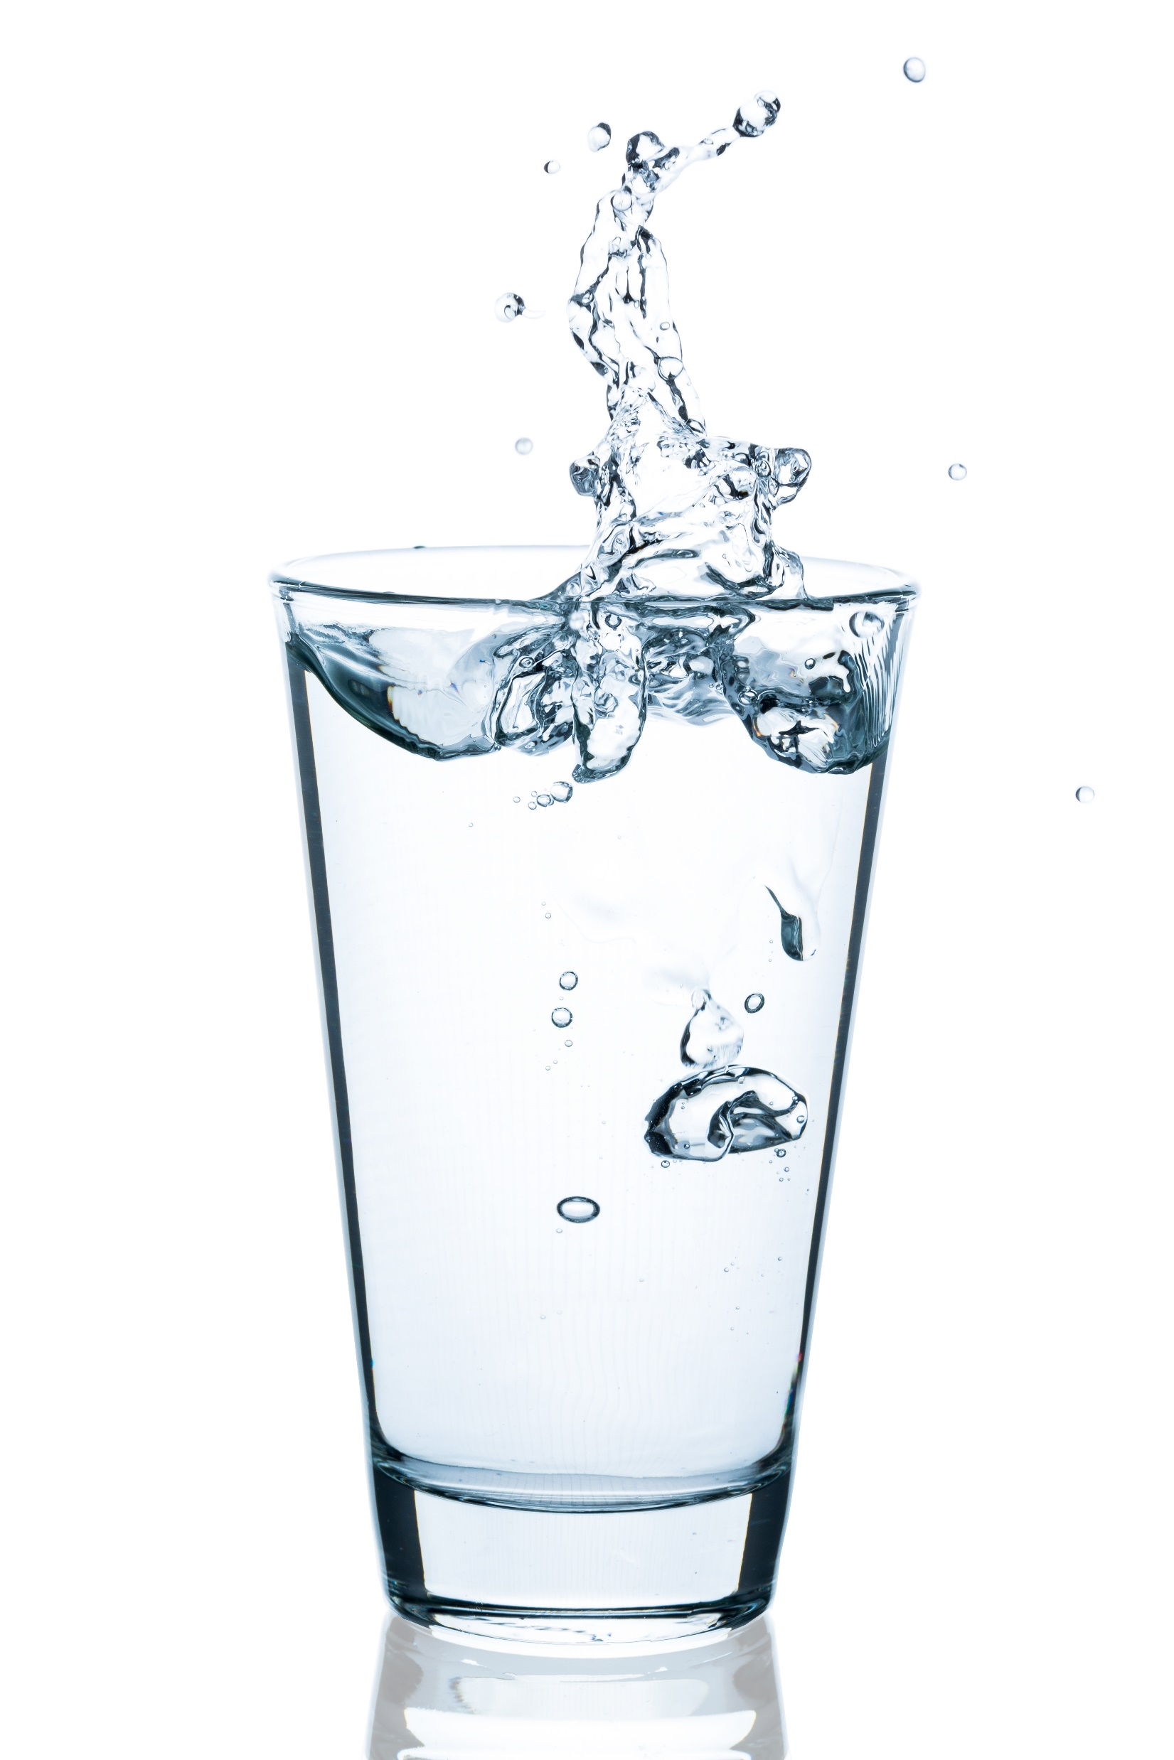
Drinking Water
The Colorado River provides drinking water for major cities like Denver, Phoenix, and Los Angeles.
Grand Junction has always gotten its drinking water from pristine runoff up 11,000 feet on the Grand Mesa.
Last year because of extreme drought and increased temperature, Grand Junction had to use the Colorado River for its drinking water for the first time in 65 years.
Ute Water draws water from Colorado River for the first time in 65 years (coloradosun.com)

Slide 42
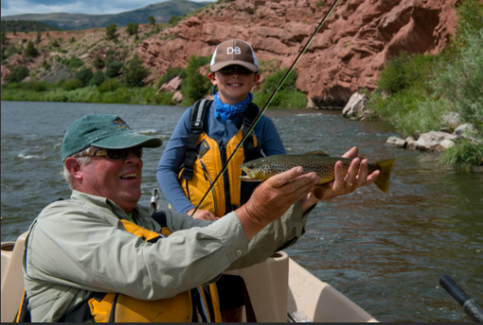
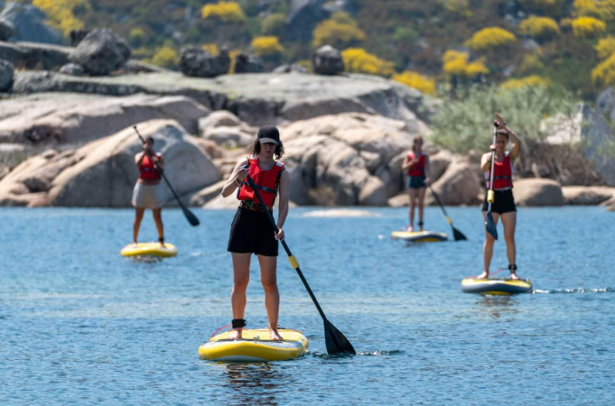
Recreation
Outdoor recreation provides jobs and fun
for many people
Some of these water related activities include, fishing, rafting, paddleboarding, skiing, plus many more
With drought these activities and jobs could become harder to do
Fishing Report | Colorado River | Fly Fishing Outfitters
Stand Up Paddleboarding | SUP Rentals, Lessons, & Guided Trips (coloradoraftingcompany.com)

Slide 43
What are some other ways that we use the Colorado River?
How do you think drought will affect humans who live near the Colorado River?

Slide 44
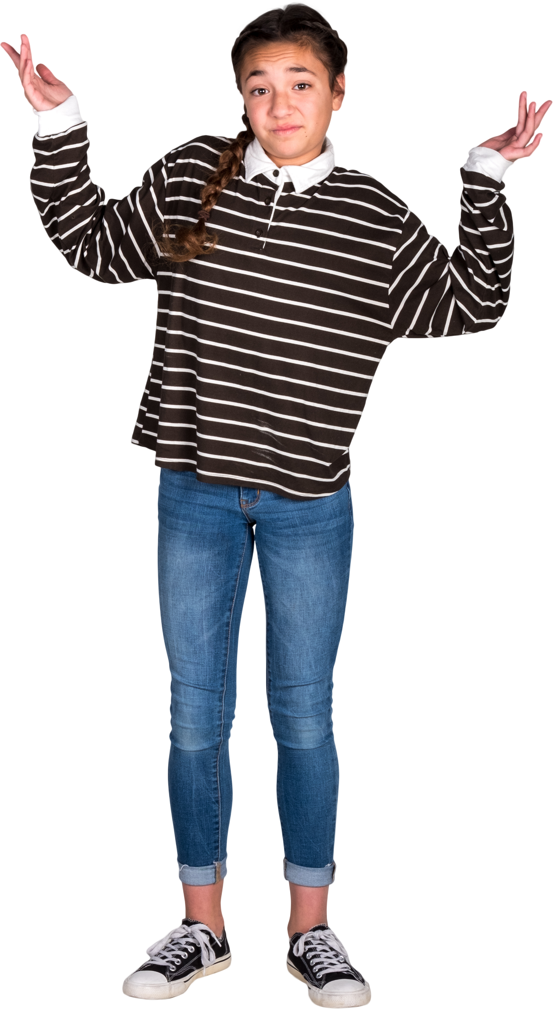
What can we do to help?
We should think of ways to save water when we can and where we can.
This is called Water Conservation.
Using less water will help the plants, animals, and humans who use the Colorado River, so that they are not hurt as badly by drought and global warming.

Slide 45
Water Conservation
If you see a water leak, tell your parents so they can fix it. If your toilet or faucet has a leak, it could waste 200 gallons of water.
Take a shower instead of a bath. A shower uses 10-25 gallons, while taking a bath uses 70 gallons.
Turn off the tap when you brush your teeth in the morning and before bedtime. This could save 4 to 8 gallons of water a day.
WaterSense for Kids | US EPA

Slide 46

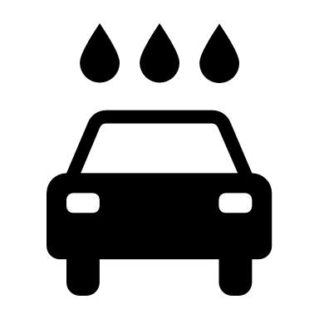
Water Conservation
Instead of using the hose, try using a bucket and sponge to clean your bike or when you are helping wash your parents car. A hose can waste 6 gallons of water in a minute if you accidently leave it running.
When you are helping your parent with yard work, remember to not water the lawn during the middle of the day when it is hot and sunny. This is wasteful because the water will evaporate before the plants have time to drink it.
WaterSense for Kids | US EPA

Slide 47
What ways can you think of to save water?

Slide 48
Thank you!!!

