Slide 1
Colorado’s Water Plan
Presentation for
Kiwanis Club of Grand Junction
January 7, 2016
Hannah Holm, Coordinator
Ruth Powell Hutchins Water Center at Colorado Mesa University
Notes:
The Colorado Basin Roundtable is one of 9 basin roundtables of stakeholders in the state formed in 2005 by the state legislature to do “bottom-up” water planning.
SGM is the company leading the planning effort for the Colorado Basin Roundtable that we are discussing today.
The Water Center at CMU is helping lead the public outreach and participation process.

Slide 2

Mission: to perform and facilitate interdisciplinary and collaborative research, education, outreach and dialogue to address the water issues facing the Upper Colorado River Basin.

Slide 3
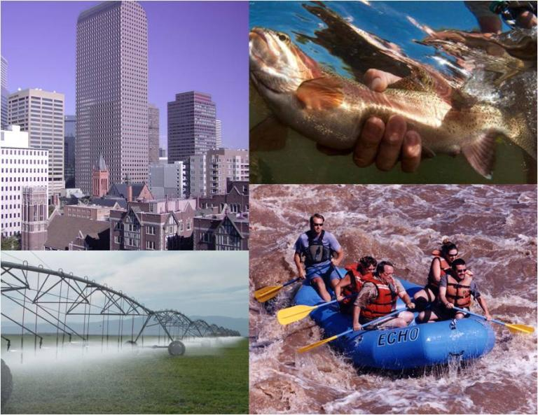
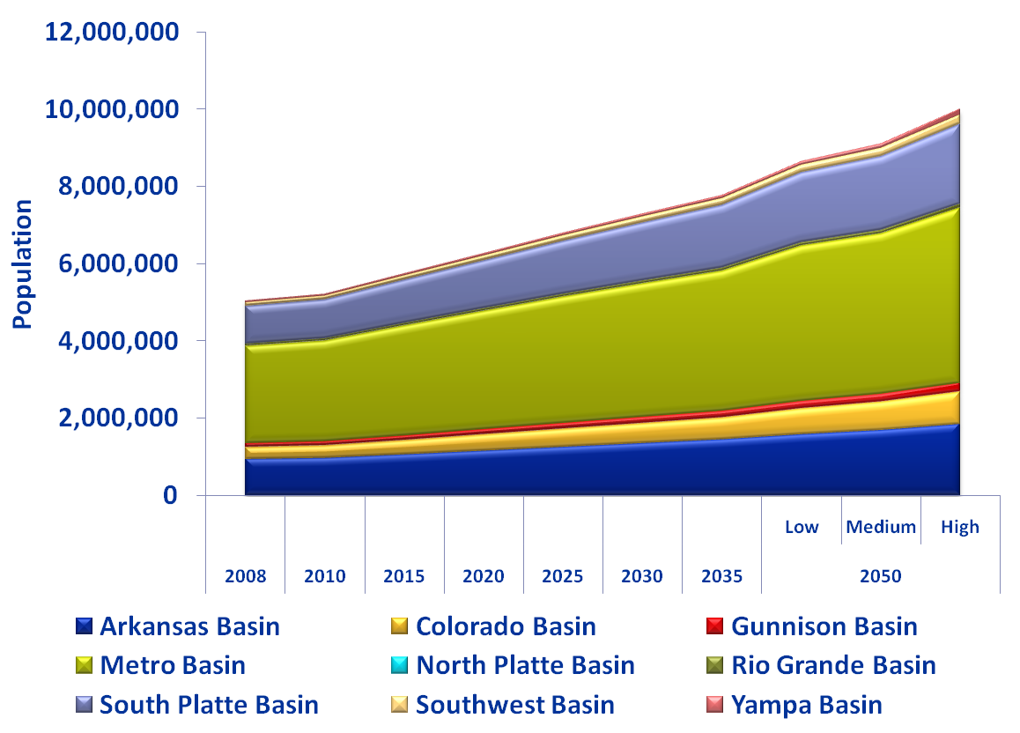
Why write a Colorado Water Plan?
Our population is increasing but there’s no new water.
Environment
Municipal 7%
Industrial 4%
Many uses compete for a limited water supply.
Agriculture 89%
Recreation
Graphics provided by the Colorado Foundation for Water Education; percentages are for the amount of water consumed (not just diverted) in Colorado, according to the Colorado Water Plan.
Notes:
As you are probably aware, we are entering an era of increasing competition for water.
Agriculture is currently by far the largest user of water in the state.
Municipal use is where the largest growth is expected.
Water to sustain the environment and provide recreation don’t deplete streams, but water rights to ensure those functions can limit other uses.

Slide 4
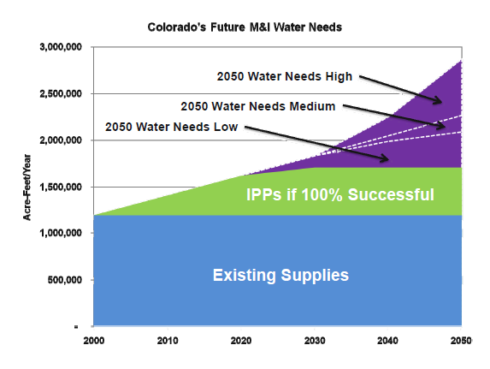
Colorado is facing a future“Gap”
Notes:
All areas of the state have projected gaps, but the size of the gap is the largest on the Front Range.
Current (Colorado Basin) demand 62,000 acre-feet which can increase to ~120,000 acre-feet in the future
This graph just shows the urban water gap – many argue that we also already have substantial gaps in meeting agricultural and environmental needs.
In the Colorado Basin:
Shortage of 100,000 acre-feet of water to support irrigated agriculture
There is also a non-consumptive gap in the Colorado River Basin, although it hasn’t been quantified.

Slide 5
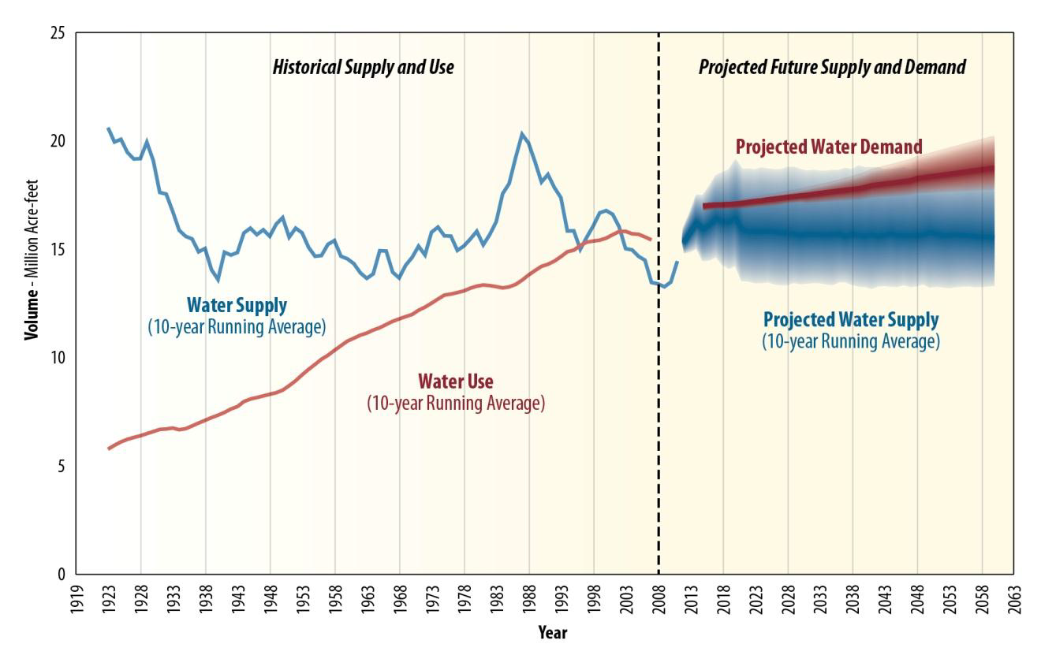
Colorado Basin-wide Gap: Now and Bigger
Source: US Bureau of Reclamation Colorado River Basin Supply and Demand Study, 2012
Notes:
Basinwide, annual water use has already begun to exceed annual inflows of water into the system – a situation permitted by the extensive reservoir storage in the basin.
The lower basin is using more than its allocation; the upper basin hasn’t yet reached full use of its allocation.

Slide 6
Colorado Water Plan Goals:
A productive economy that supports:
    vibrant and sustainable cities.
    viable and productive agriculture.
    a robust skiing, recreation and tourism industry.
Efficient and effective water infrastructure promoting smart land use.
A strong environment that includes healthy watersheds, rivers and streams, and wildlife.
Source: Governor Hickenlooper’s Executive Order for Colorado’s Water Plan.

Slide 7
How, for an uncertain future?
No & Low Regret Actions in the CO Water Plan:
  Minimize permanent “buy & dry” of ag lands by supporting lower-impact alternatives.
  Plan and preserve options for developing unallocated water on the Western Slope.
  Establish low to medium conservation strategies.
  Implement projects to support environmental and recreational uses.
  Support projects that are already planned.
  Implement storage and other infrastructure projects.
  Implement water re-use strategies.
Source: Colorado’s Water Plan (Summarized)

Slide 8
Source: Chapter 10 of Colorado’s Water Plan

Slide 9
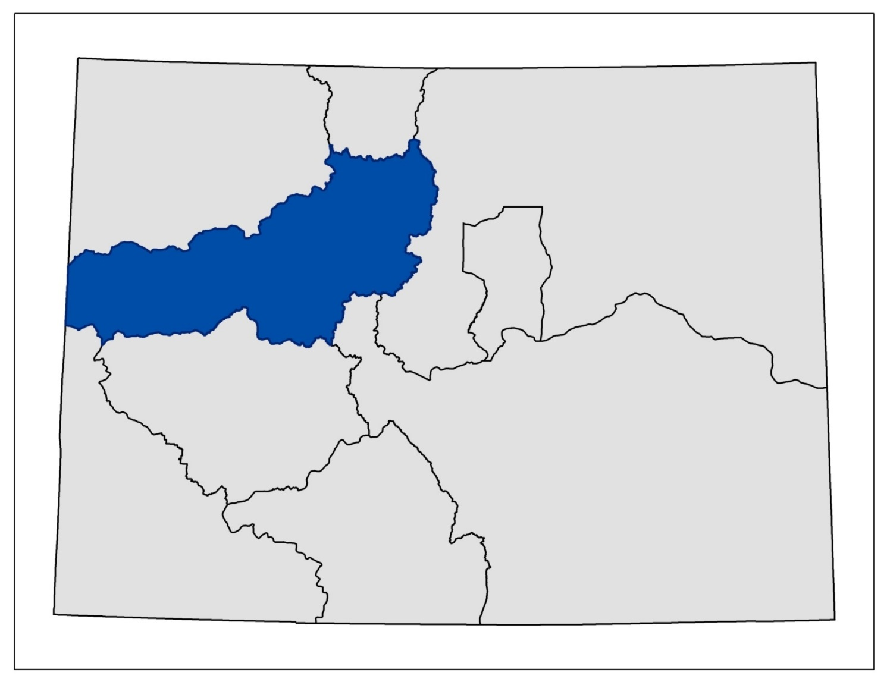
Details left to Basin Roundtables
North
Platte
Yampa/White
South Platte
Colorado
Metro
Gunnison
Arkansas
Rio Grande
Southwest

Slide 10
Colorado Basin Plan Themes
Protect & Restore Healthy Streams, Rivers, Lakes and Riparian Areas
Sustain Agriculture
Secure Safe Drinking water
Develop Local Water Conscious Land Use Strategies
Assure Dependable Basin Administration
Encourage High Level of Basinwide Conservation
Source: Final Colorado Basin Implementation Plan, 4/17/15

Slide 11
Gunnison Basin Goals
Primary Goal: Protect Existing Uses
Complementary Goals:
Discourage conversion of productive agricultural land.
Reduce agricultural water shortages.
Identify and address municipal and industrial shortages.
Quantify and protect environmental and recreational uses.
Maintain & Improve water quality.
Maintain & modernize critical infrastructure.
Create & maintain public education, outreach & stewardship processes.
  Source: Final Gunnison Basin Implementation Plan, 4/17/15 (summarized)

Slide 12
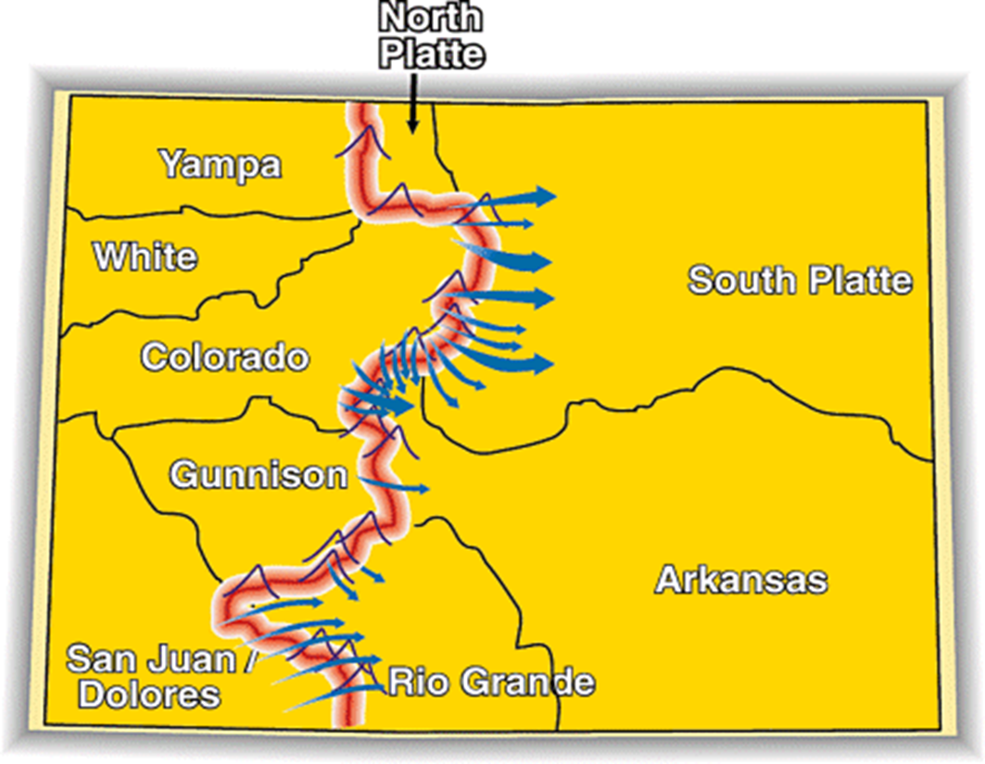
Conceptual Framework for negotiations on a future TMD:
Existing Transmountain Diversions
East Slope not looking for a firm yield & would accept hydrologic risk.
A new TMD would be used conjunctively with non-West Slope water (interruptible supply agreements, aquifers, etc).
To manage when a new TMD could divert, triggers are needed.
An collaborative program that protects against involuntary curtailment is needed for existing uses and some future development, but will not cover a new TMD.
Future West Slope needs should be accommodated as part of a new TMD project.
Colorado will continue its commitment to improve conservation and reuse.
Environmental resiliency and recreational needs must be addressed both before and with a new TMD.
Summarized from the draft Colorado Water Plan

Slide 13
For more information:
On Colorado’s Water Plan
www.coloradowaterplan.com
On the Hutchins Water Center at CMU
www.coloradomesa.edu/Water-Center
Thank you!

